Slide 1
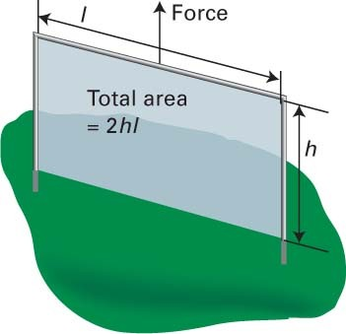
Thermodynamics of surfaces and interfaces
Atkins (ed. 12, 11): §14C.2 - 14C.4
Atkins (ed. 10): §16C.2 - 16C.4
Atkins (ed. 9): §17.8 - 17.10
Study Guide: P.19

Slide 2
Na₂ClO₃ crystals in a saturated solution
Optically left
rotating crystal
saturated
solution
Optically right
rotating crystal
Optical active crystals under polarizing microscope
Notes:
2

Slide 3
Large crystals grow; small crystals dissolve
Na₂ClO₃ crystals in a saturated solution
T = 0
T = 1 day
Notes:
3

Slide 4
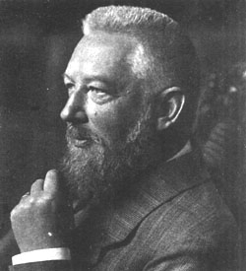
Na₂ClO₃ crystals in a saturated solution
Wilhelm Ostwald
(1853-1932)
Ostwald ripening
(1896)
T = 0
T = 1 day
Large crystals grow; small crystals dissolve
Notes:
4

Slide 5
Na₂ClO₃ crystals in a saturated solution
T = 0
T = 1 day
10 days
30 days
Equilibrium: one single crystal of single handedness!
Notes:
5

Slide 6
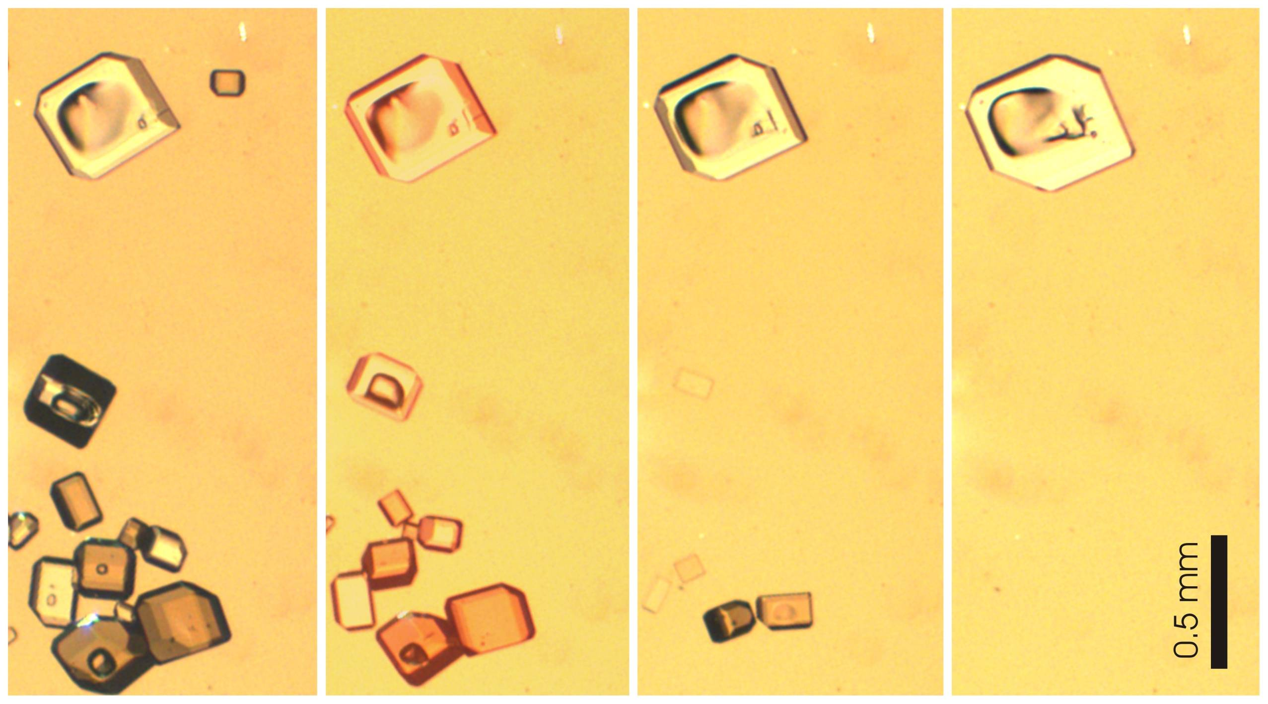
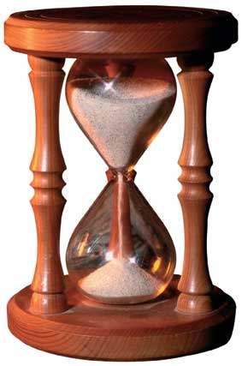
Na₂ClO₃ crystals in a saturated solution
T = 0
T = 1 day
10 days
30 days
Equilibrium: one single crystal of single handedness!
Notes:
6

Slide 7
Gibbs-Thomson effect
Interfacial (free) energy between two phases
σ : Interfacial surface
A : Helmholtz free energy
crystal
solution

Slide 8
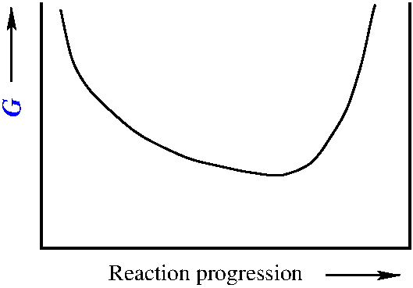
Gibbs-Thomson effect
Interfacial (free) energy between two phases
σ : Interfacial surface
A : Helmholtz free energy
Gibbsfree energy
Helmholtz free energy
Equilibrium state
Equilibrium state
A
Energy minimum
Energy minimum
T,P
T,V
0
Reaction progression ξ
1
0
Reaction progression ξ
1
ξ_{eq}
ξ_{eq}

Slide 9
Gibbs-Thomson effect
Interfacial (free) energy between two phases
σ : Interfacial surface
$d$A_{T,V} = dW_{σ} ≡ γdσ
γ : Interfacial or surface tension
Interfacial tension γ tends to reduce σ
σ (m²): surface
γ (Jm⁻²): surface free energy
relevant for P >1

Slide 10
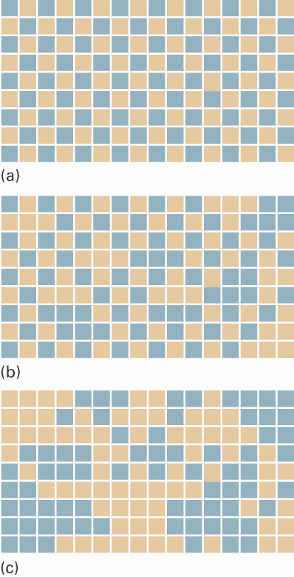
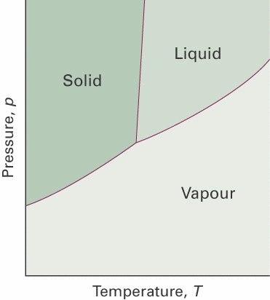
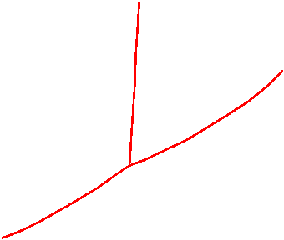
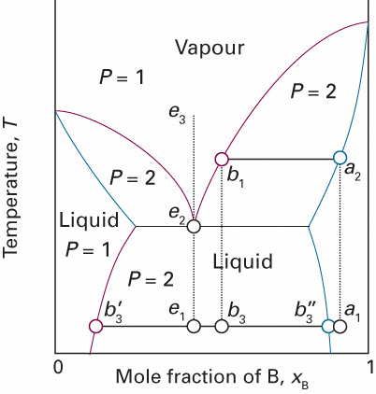
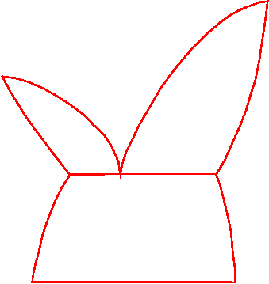
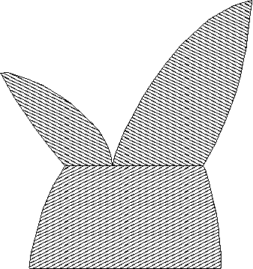
Gibbs-Thomson effect
Interfacial (free) energy between two phases
σ : Interfacial surface
$d$A_{T,V} = dW_{σ} ≡ γdσ
γ : Interfacial or surface tension
relevant for P >1
P =2,3
P =2,3
P =1

Slide 11
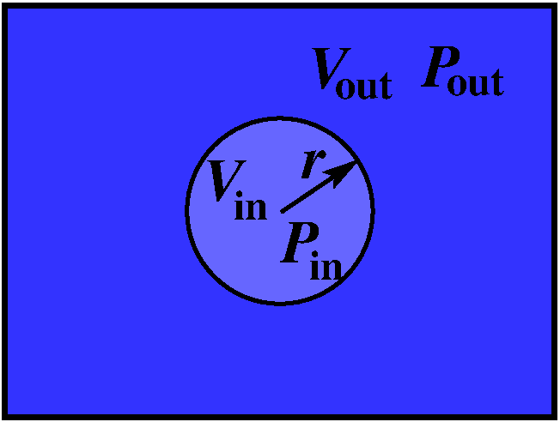
Gibbs-Thomson effect: Laplace equation
Equilibrium:
Interfacial or surface tension γ>0 tends to reduce σ
Smallest surface σ is a sphere
Equilibrium:
Relation between P_{in}, P_{out} and γ ?

Slide 12
Gibbs-Thomson effect: Laplace equation
Equilibrium:
Interfacial or surface tension γ>0 tends to reduce σ
Smallest surface σ is a sphere
Let’s work this out in detail
Equilibrium:
Relation between P_{in}, P_{out} and γ ?

Slide 13
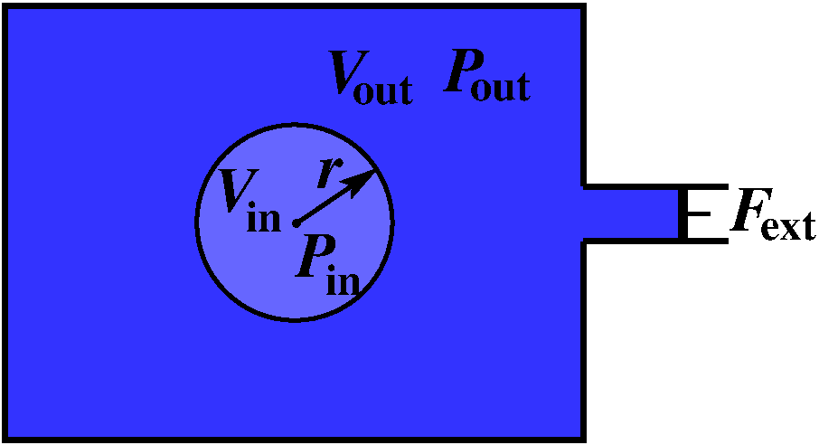
Gibbs-Thomson effect: Laplace equation

Slide 14
Gibbs-Thomson effect: Laplace equation
Equilibrium and isotropic γ:
Laplace equation

Slide 15
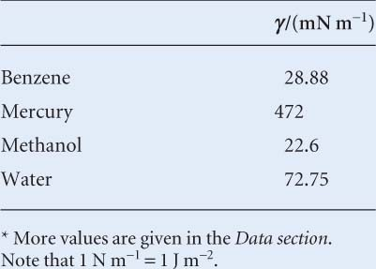
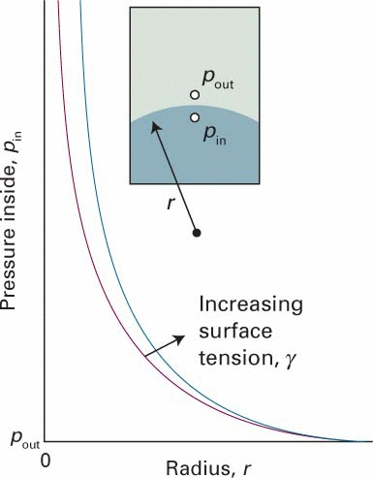
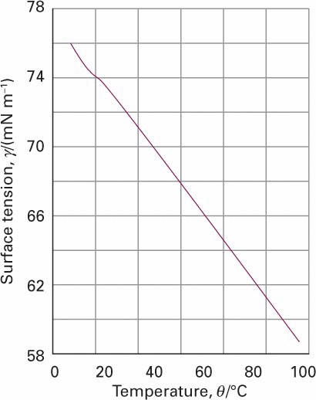
Gibbs-Thomson effect: Laplace equation
Surface tension γ (Jm⁻² = Nm⁻¹)
(293 K, in air)
Laplace equation
water

Slide 16
Surface tension and capillary action

Slide 17
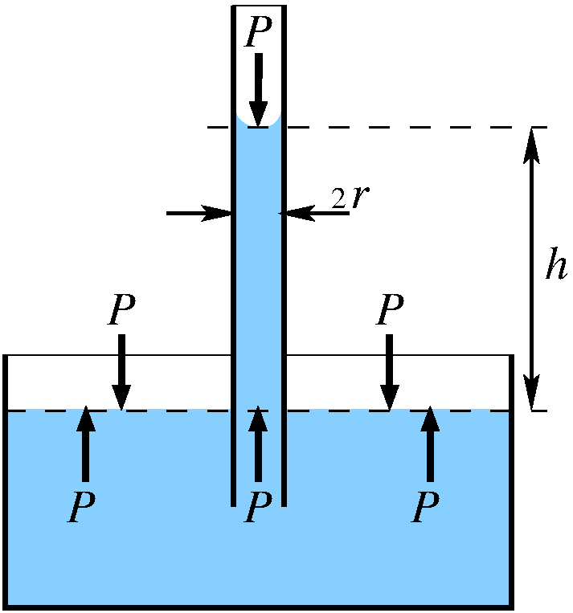
Surface tension and capillary action
Adhesive force between liquid and capillary, e.g. H₂O/glass

Slide 18
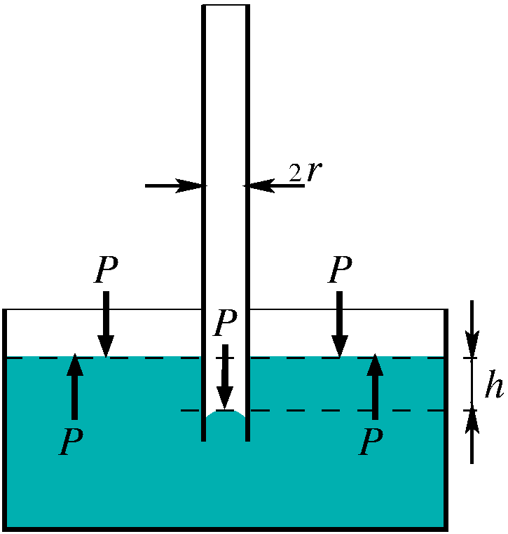
Surface tension and capillary action
Adhesive force between liquid and capillary, e.g. H₂O/glass
Stronger cohesive force within the liquid, e.g. Hg/glass

Slide 19
Surface tension and capillary action
Adhesive force between liquid and capillary
Pressure of a liquid column
of height h and mass density ρ

Slide 20
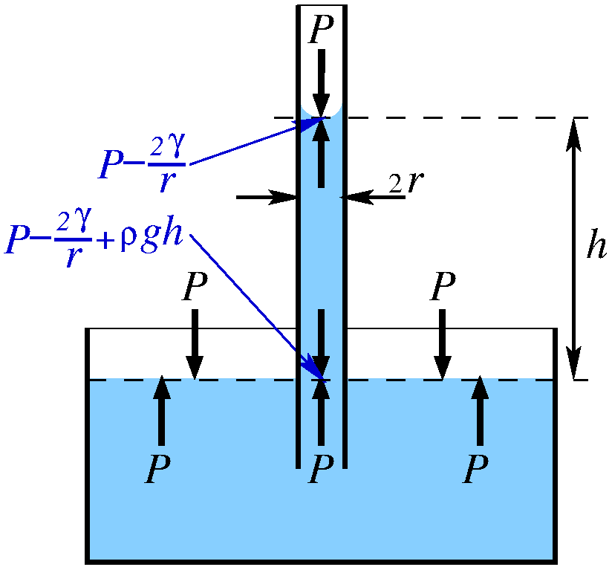
Surface tension and capillary action
Adhesive force between liquid and capillary
Laplace equation
equilibrium

Slide 21
Surface tension and capillary action
Adhesive force between liquid and capillary
Laplace equation
equilibrium
capillary rise
Exercise 22

Slide 22
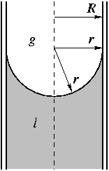
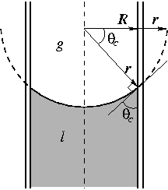
Surface tension and capillary action

Slide 23
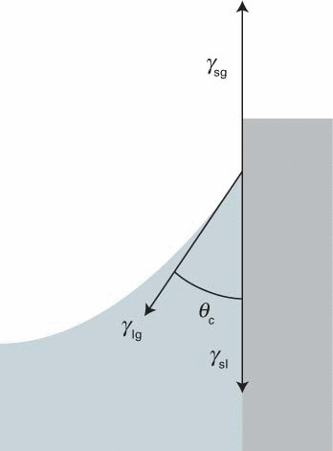
Surface tension and capillary action
equilibrium situations
Each interfacial tension
tries to reduce its
corresponding surface

Slide 24
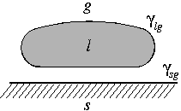
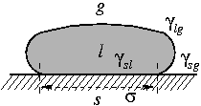
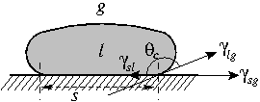
Surface tension and wetting
specific
work (J/m²)
of adhesion
(γ is always trying to reduce the corresponding surface)
horizontal
Force (N/m)
balance
(equilibrium)

Slide 25
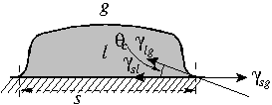
Surface tension and wetting
}
Work (J/m²)
Force (N/m)
partial dewetting
partial wetting

Slide 26
Kelvin equation

Slide 27
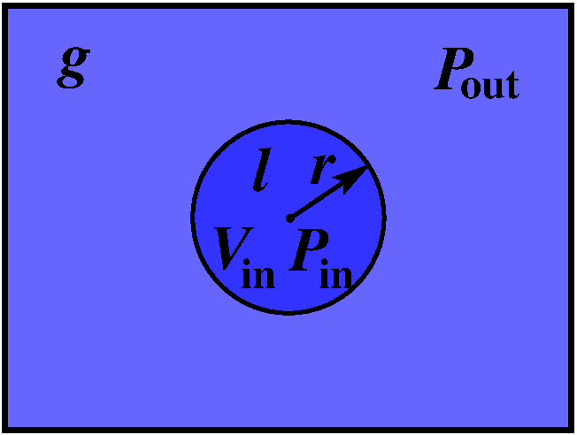
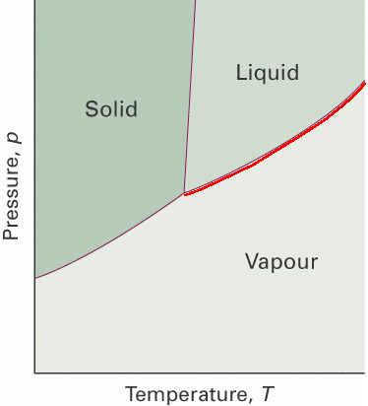
Kelvin equation
nucleation barrier for condensation (g → l)
Laplace equation
equilibrium
(pure compound)
Surface tension will change P_{g}
@ constant T

Slide 28
Kelvin equation
nucleation barrier for condensation (g → l)
Laplace equation
Let’s work this out in detail
equilibrium
(pure compound)
Surface tension will change P_{g}
@ constant T

Slide 29
Kelvin equation
nucleation barrier for condensation (g → l)

Slide 30
Kelvin equation
nucleation barrier for condensation (g → l)
Kelvin equation
Consider an undercooled gas:
→ P_{g} > P*
→small droplets evaporate
→condensation nucleation barrier

Slide 31
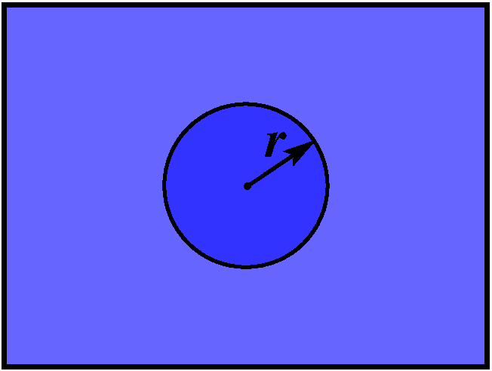
nucleation of phase β(s) from phase α(l)
revert to Gibbs free energy
classical nucleation theory
spherical nucleus, radius r
driving force:
surface free energy: γ
molar volume of phase β: V_{m}
β
γ
β
α

Slide 32
nucleation of phase β(s) from phase α(l)
revert to Gibbs free energy
classical nucleation theory
spherical nucleus, radius r
driving force:
surface free energy: γ
molar volume of phase β: V_{m}
β
γ
α
gain
cost
(if )

Slide 33
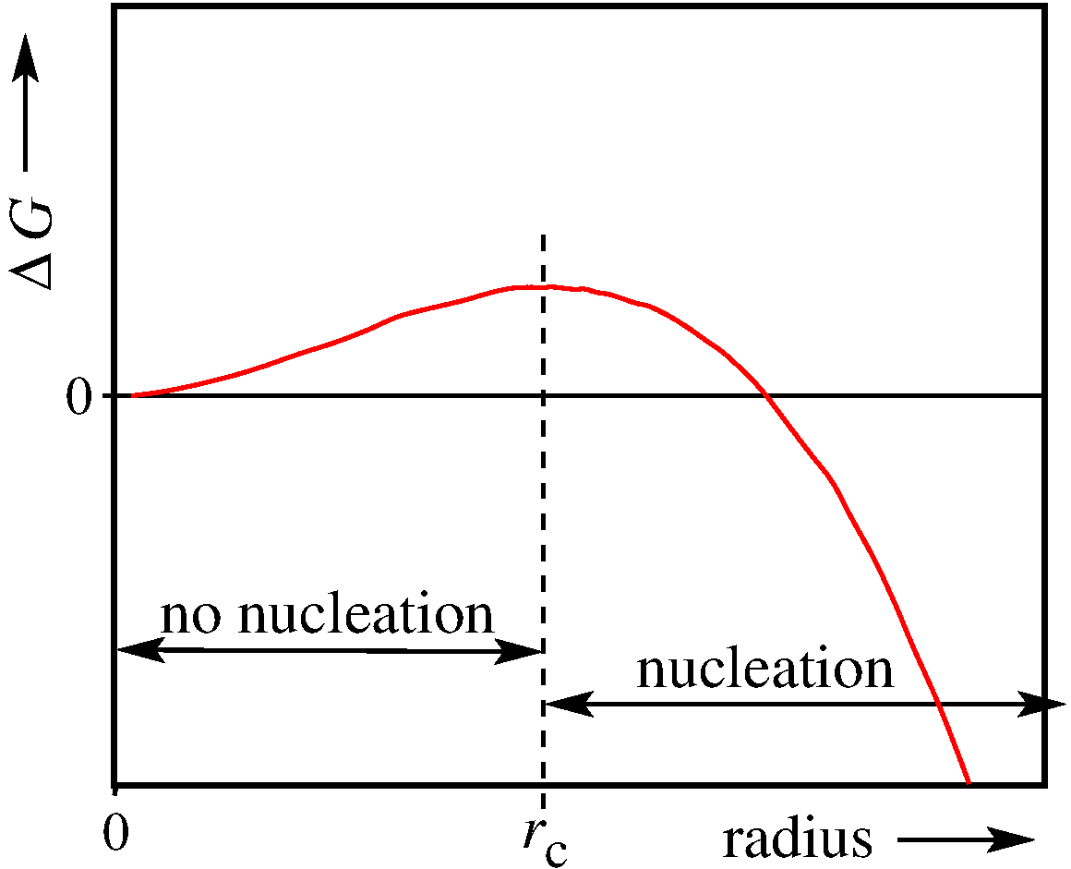
nucleation of phase β(s) from phase α(l)

Slide 34
nucleation of phase β(s) from phase α(l)
critical radius r_{c}:
nucleation barrier depends on supersaturation (Δμ = Δμ(T ))
-low Δμ : no nucleation
-high Δμ : easy nucleation
Exercise 23

Slide 35
Electrochemistry and electrolytic solutions

Slide 36
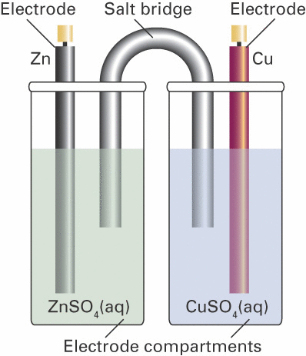
Electrochemistry and electrolytic solutions
-
E
+
Pt
Pt
This is a partly recap from Thermodynamics (Lecture 4)
( https://www.vsc.science.ru.nl/hugom/Thermo/Thermo.html )

Slide 37
Chemical reaction equilibria: electrochemistry
Equilibrium state
Energy minimum
Equilibrium:
T,P
0
ξ_{eq}
1
Reaction progression ξ

Slide 38
Chemical reaction equilibria: electrochemistry
perfect gas mixtures
pure liquids
pure solids
Neutral solutions (Lecture 3)
solutions
Electrolytes (ions): Electrochemistry

Slide 39
Chemical reaction equilibria: electrochemistry
Electrochemistry: a few concepts
1) Aqueous dissolution of a sparingly soluble salts
(Note: the equation is overall charge neutral)
Solubility s of the salt:

Slide 40
Chemical reaction equilibria: electrochemistry
Aqueous dissolution of a sparingly soluble salts
(Note: both sides of the equation are charge neutral)
(*)
Exercise 24
(*) https://www.chm.uri.edu/weuler/chm112/refmater/thermtable.html

Slide 41
Chemical reaction equilibria: electrochemistry
Electrochemistry: a few concepts
2) Electrochemical cells: basic example
-
E
+
(Reduction halfreaction)
Pt
(Reduction halfreaction)
(Total cell reaction)
(Note: the equation is overall charge neutral)
In which direction will the reaction run spontaneously?
→ Where is the equilibrium?

Slide 42
Chemical reaction equilibria: electrochemistry
Voltage E represents a
‘driving force’ like Δ_{r}G
-
E
+
Pt
Equilibrium state
Energy minimum
T,P
0
Reaction progression ξ
1
ξ_{eq}
Ideal volt meter has an infinitely large internal resistance
➔measures E with zero current

Slide 43
Chemical reaction equilibria: electrochemistry
Voltage E represents a
‘driving force’ like Δ_{r}G
-
E
+
Pt
Equilibrium:
Relation between E and Δ_{r}G

Slide 44
Chemical reaction equilibria: electrochemistry
Voltage E represents a
‘driving force’ like Δ_{r}G
-
E
+
Pt
Equilibrium:
Relation between E and Δ_{r}G

Slide 45
Chemical reaction equilibria: electrochemistry
Equilibrium:
Equilibrium:
Number of electrons transferred
in chemical equation
Faraday constant
(charge of 1 mole of electrons)

Slide 46
Chemical reaction equilibria: electrochemistry
Nernst equation
reaction
-
E
+
Equilibrium state
Pt
Energy minimum
T,P
0
Reaction progression ξ
1
ξ_{eq}

Slide 47
Chemical reaction equilibria: electrochemistry
Nernst equation
with
Nernst also holds for half reactions:
Note: reduction half reaction

Slide 48
Chemical reaction equilibria: electrochemistry
Nernst also holds for half reactions
-

Slide 49
Chemical reaction equilibria: electrochemistry
Nernst also holds for half reactions
-

Slide 50
Chemical reaction equilibria: electrochemistry
Nernst also holds for half reactions
Exercise 25

Slide 51
Chemical reaction equilibria: electrochemistry
2) Electrochemical cells: another example
Standard electrochemical potentials of
redox couples are in tables as
reduction half reactions
- sign as we need a reduction and an oxidation half reaction

Slide 52
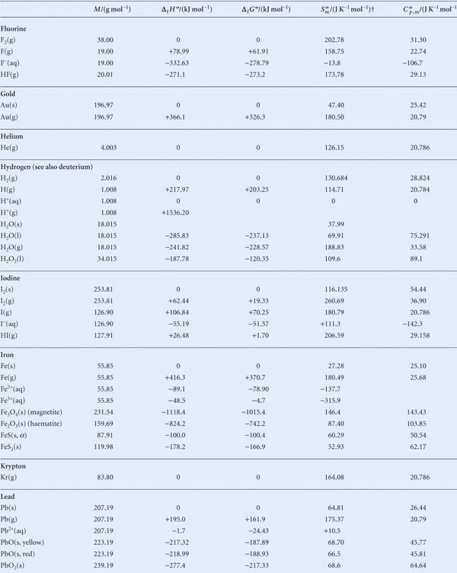
Chemical reaction equilibria: ions in solution
Standard
thermodynamic
data
(@ 298K)
(Ed.11: Table 2C.7)

Slide 53
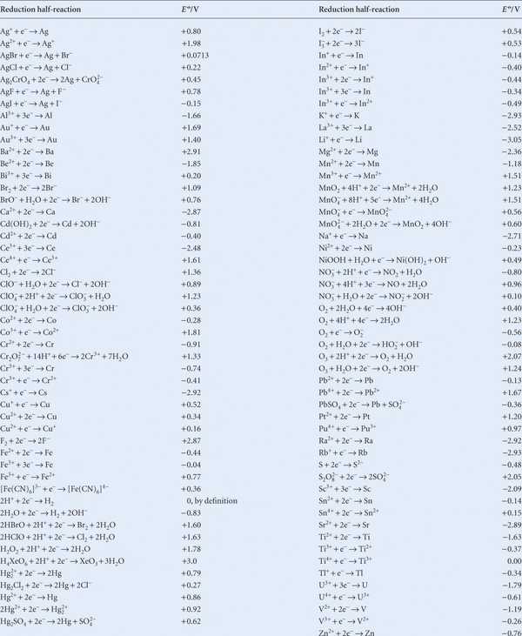
Standard
electrochemical
potentials E^{Θ}
of redox
couples
(@ 298K)
alphabetical order
(Ed.11:
Table 6D.1b)
for all T(aq)

Slide 54
Chemical reaction equilibria: electrochemistry
3) Standard hydrogen electrode

Slide 55
Chemical reaction equilibria: electrochemistry
3) Standard hydrogen electrode

Slide 57
Chemical reaction equilibria: electrochemistry
Very dilute solutions → a_{H2O} ≈ 1
Very very dilute solutions→a_{i}≈[i ]
Exercise 24-25

Slide 58
Chemical reaction equilibria: electrochemistry
Activity as an effective concentration
ideal or dilute
behaviour
deviation
from ideal
activity coefficient on the concentration scale
Molarity (mol/L):

Slide 59
Chemical reaction equilibria: electrochemistry
Activity as an effective concentration
Molarity (mol/L)
Molality (mol/kg)
Mole fraction ( )
example

