Slide 1
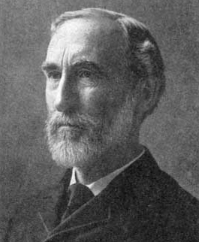
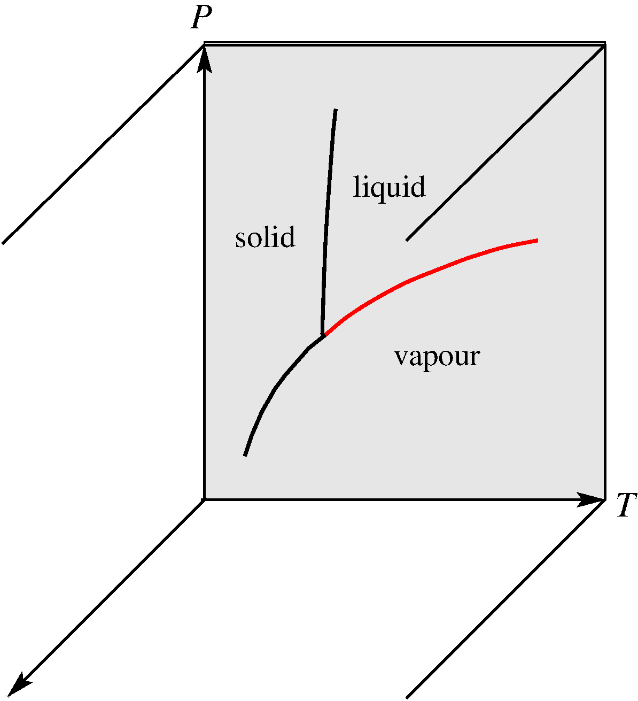
Phase diagrams of multicomponent systems
P,T, x diagram of a binary sytem
C = 2
F = 3
F = 3
F’ = 2
F’ = 2
F = 2
Gibbs phase rule
F’ = 1
F = 1
F = 3
F’ = 0
F’ = 2
(if x is considered fixed)
Comp. x_{B}

Slide 2
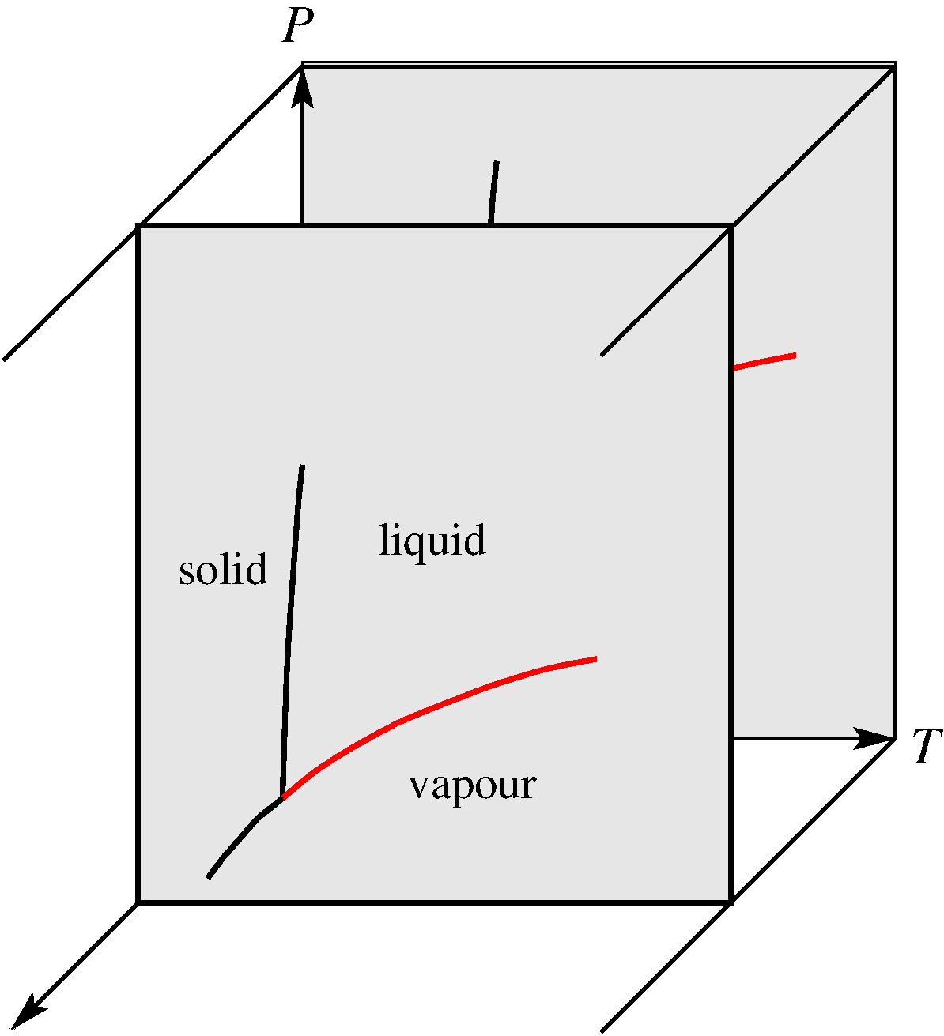
Vapour-liquid-composition diagram
P,T, x diagram of a binary sytem
C = 2
Gibbs phase rule
F’ = 2
F’ = 2
F’ = 1
(x is fixed)
F’ = 2
F’ = 0
Comp. x_{B}

Slide 3
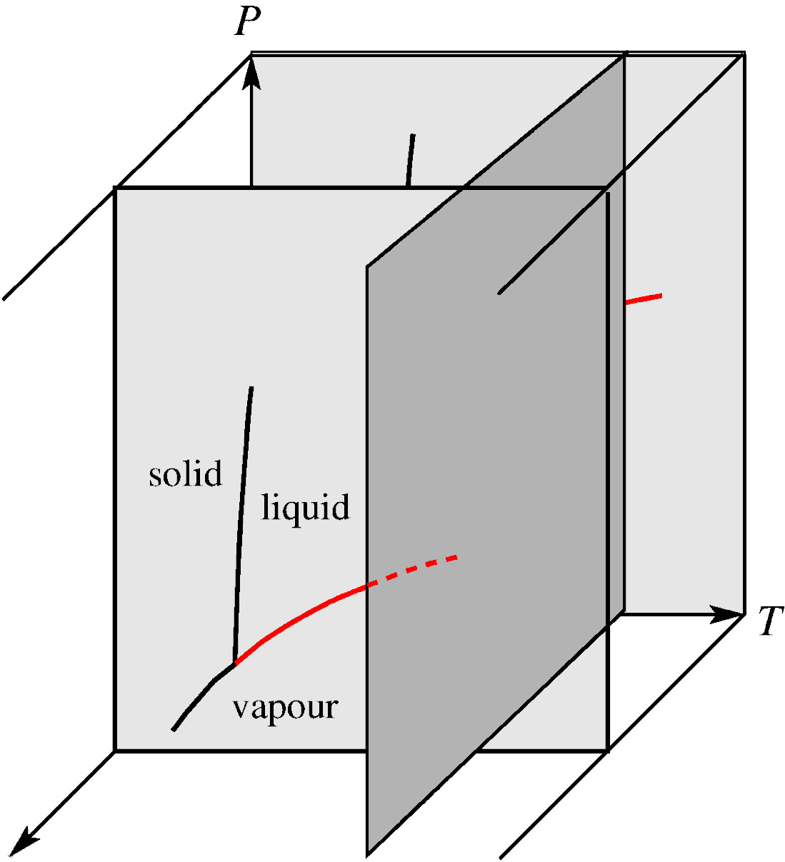
Vapour-liquid-composition (P,x) diagram
C = 2
Fixed T
Gibbs phase rule
Comp. x_{B}
Comp. x_{B}

Slide 4
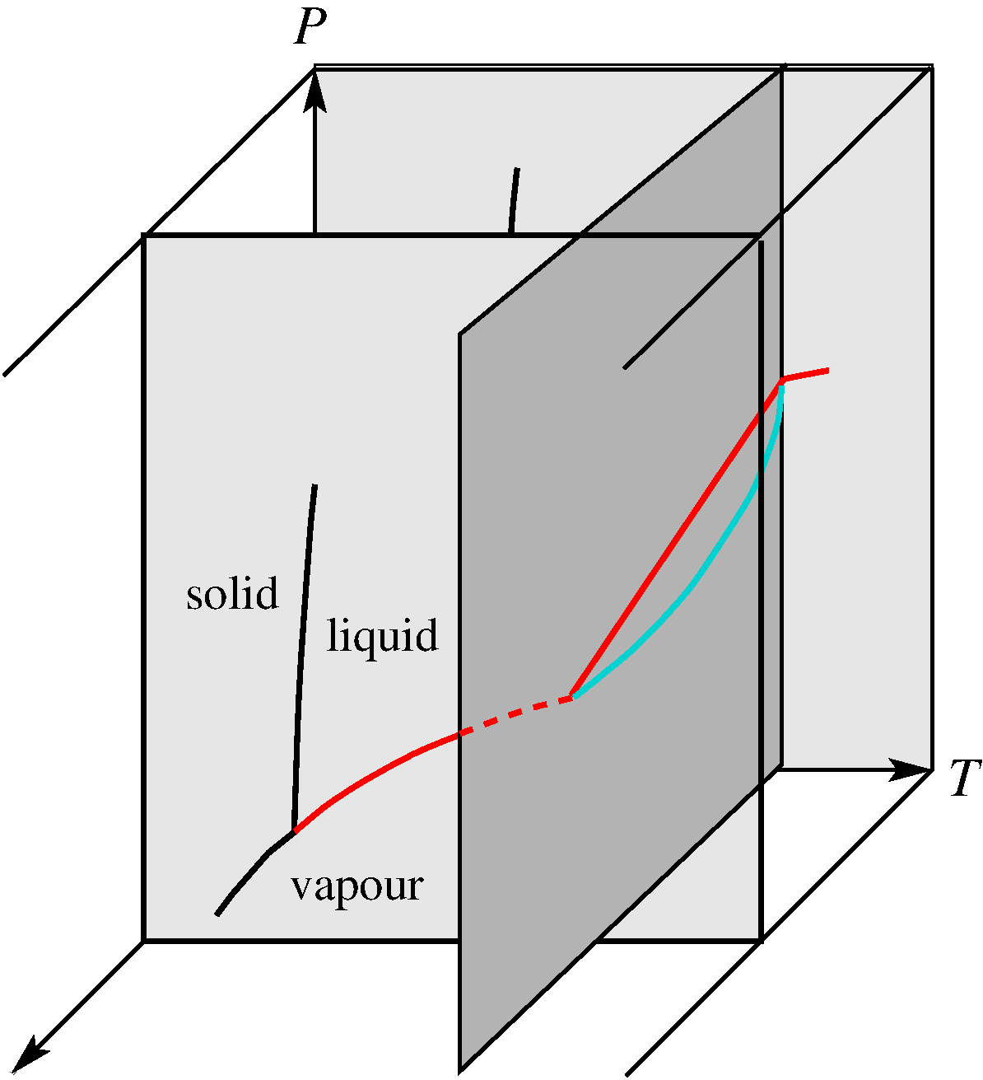
Vapour-liquid-composition (P,x) diagram
C = 2
Fixed T
Gibbs phase rule
Comp. x_{B}
Comp. x_{B}

Slide 5
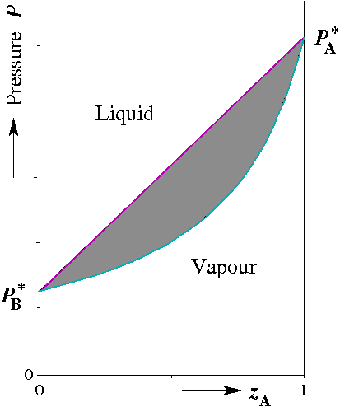
Vapour-liquid-composition (P,x) diagram
C = 2
Fixed T
Ideal solution
Comp. x_{B}
Comp. z_{B}
z_{B}: either x_{B} or y_{B}

Slide 6
Vapour-liquid-composition (P,x) diagram
C = 2
Fixed T
Ideal solution
Comp. x_{B}
Comp. x_{B}

Slide 7
Vapour-liquid-composition (P,x) diagram
C = 2
Fixed T
Ideal solution
Comp. y_{B}
Comp. y_{B}

Slide 8
Vapour-liquid-composition (P,x) diagram
C = 2
Fixed T
Ideal solution
Comp. z_{B}
Comp. z_{B}
z_{B}: either x_{B} or y_{B}

Slide 9
Vapour-liquid-composition (P,x) diagram
C = 2
Fixed T
Ideal solution
Comp. z_{B}
Comp. z_{B}
z_{B}: either x_{B} or y_{B}

Slide 10
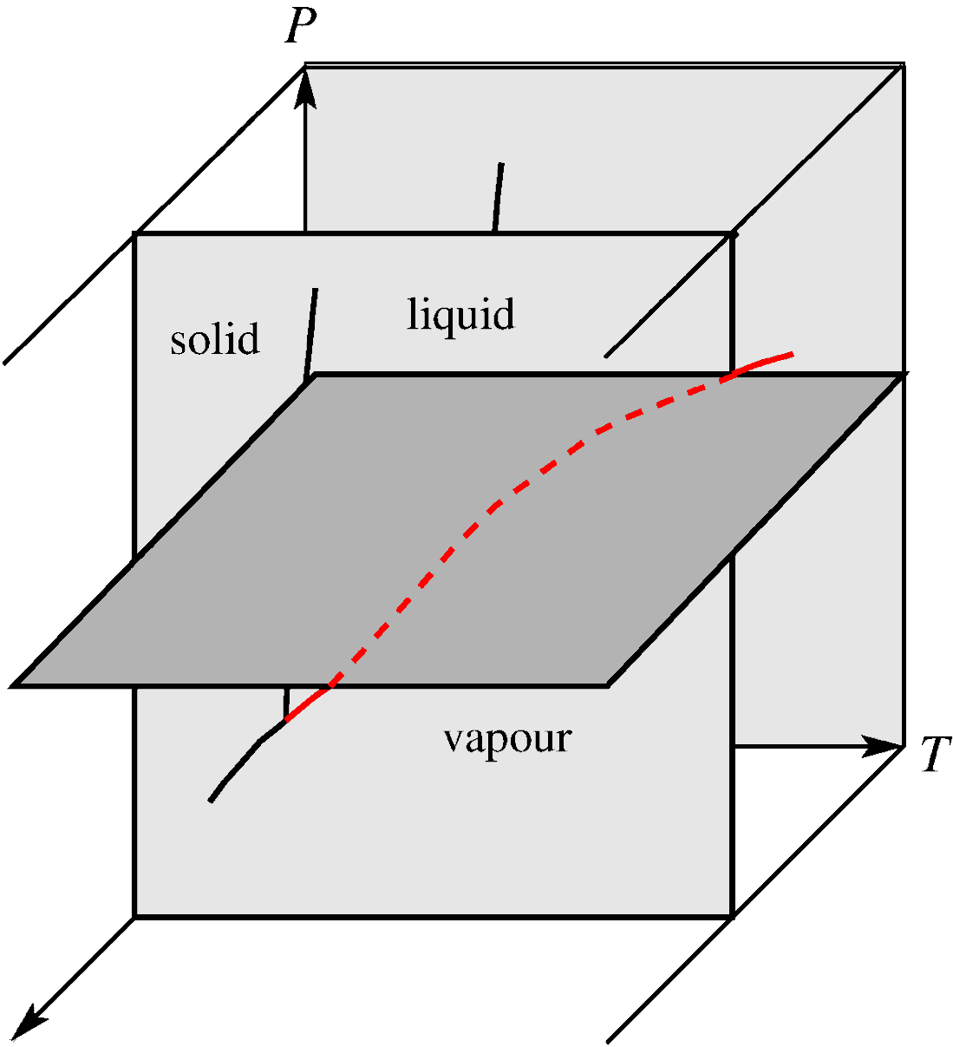
Vapour-liquid-composition (T,x) diagram
C = 2
Comp. x_{B}
Fixed P
Comp. x_{B}

Slide 11
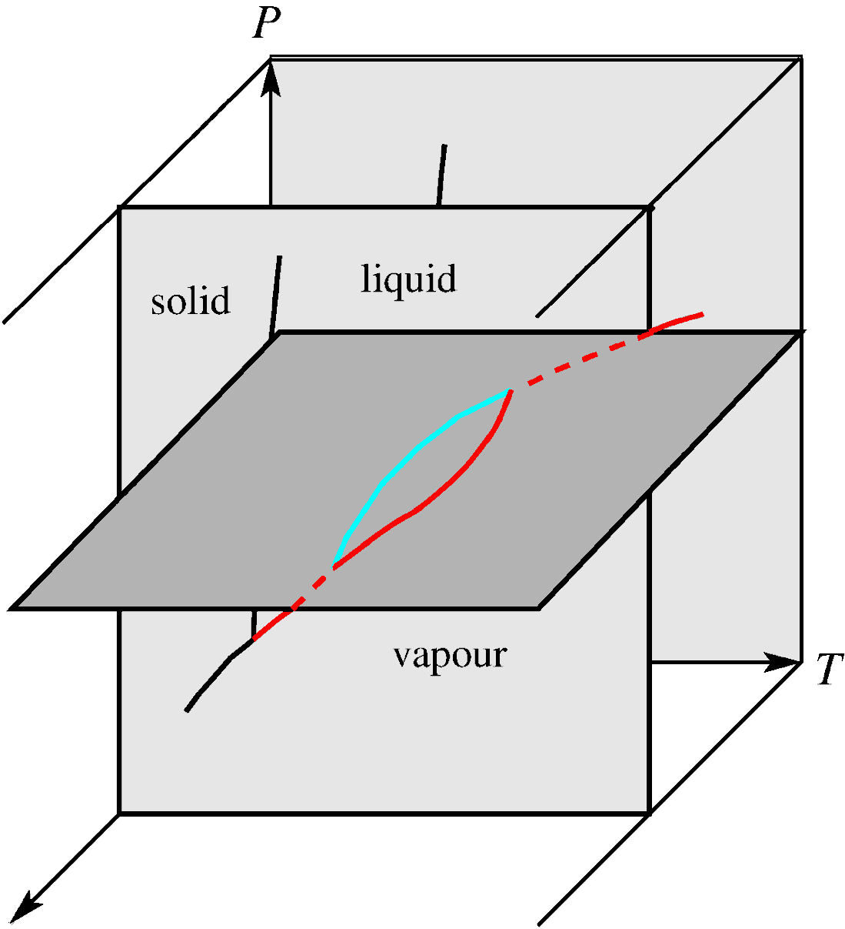
Vapour-liquid-composition (T,x) diagram
C = 2
Comp. z_{B}
Fixed P
Comp. z_{B}
z_{B}: either x_{B} or y_{B}

Slide 12
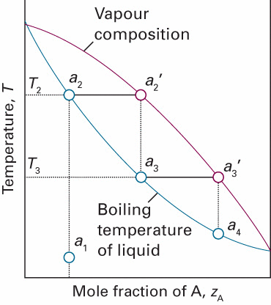
Vapour-liquid-composition (T,x) diagram
C = 2
Ideal solution
Comp. z_{B}
Fixed P
Comp. z_{B}
z_{B}: either x_{B} or y_{B}

Slide 13
Vapour-liquid-composition (T,x) diagram
C = 2
Ideal solution
Comp. z_{B}
Fixed P
Comp. z_{B}
z_{B}: either x_{B} or y_{B}

Slide 14
C = 2
Temperature-composition diagrams
Ideal solution
Fixed P

Slide 15
C = 2
Temperature-composition diagrams
Ideal solution
Fixed P

Slide 16
C = 2
Temperature-composition diagrams
Ideal solution
Fixed P

Slide 17
C = 2
Temperature-composition diagrams
Ideal solution
B: non volatile
Fixed P

Slide 18
C = 2
Temperature-composition diagrams
Ideal solution
B: non volatile
This was a condition for
a simple expression for
boiling point elevation
Fixed P
(together with )
(Ideal solution)

Slide 19
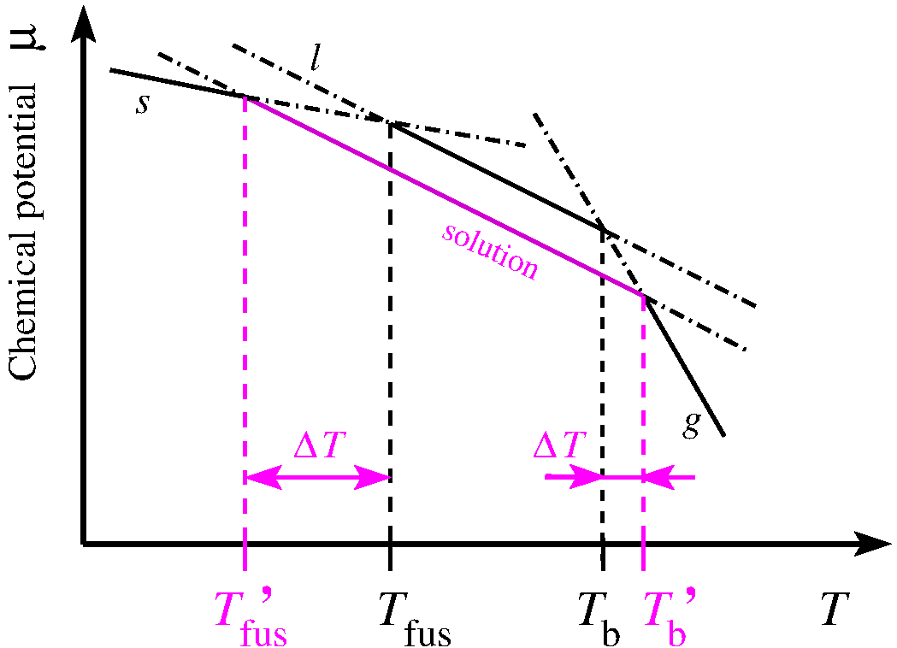
Solutions: Colligative properties
Lecture 5: Thermodynamics
(http://www.vsc.science.ru.nl/hugom/Thermo/Thermo.html)
pure solvent A
Freezing point depression
Fixed P
Boiling point elevation

Slide 20
C = 2
T-x diagrams: Boiling point elevation
Ideal solution
B: non volatile
Fixed P

Slide 21
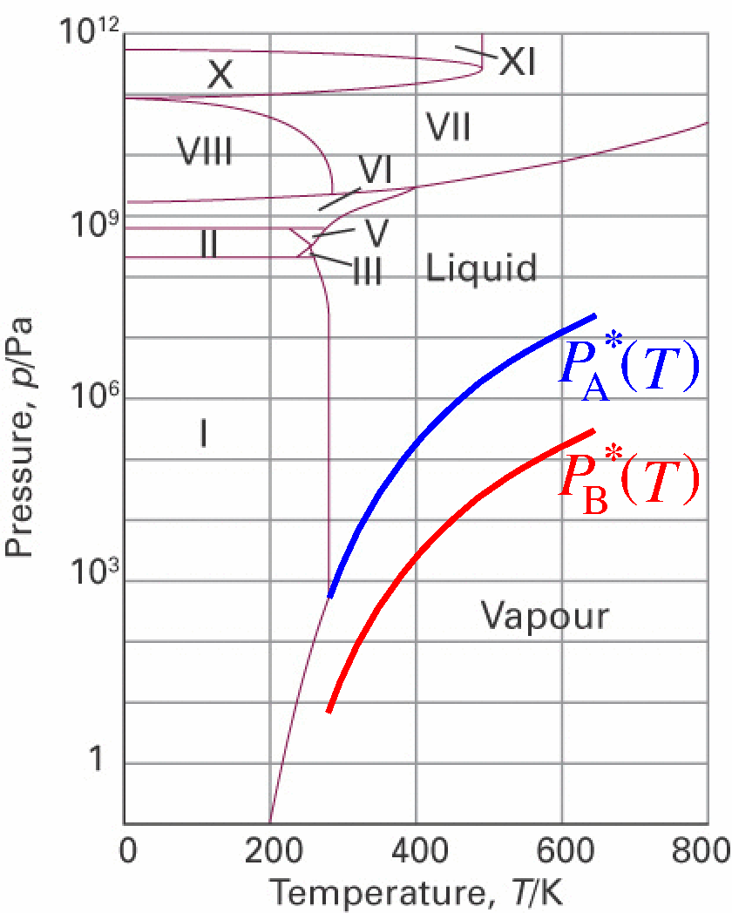
C = 2
T-x diagrams: Boiling point elevation
Ideal solution
B: non volatile
Fixed P

Slide 22
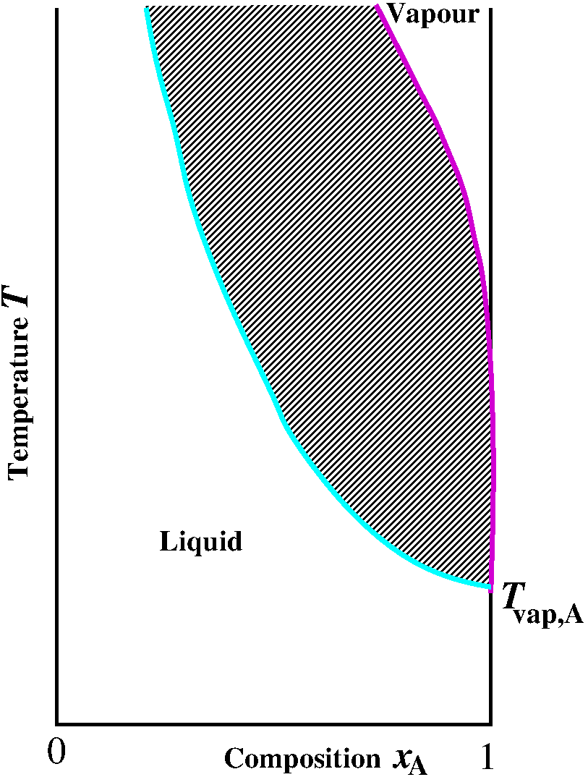
C = 2
T-x diagrams: Boiling point elevation
B: non volatile
Fixed P

Slide 23
C = 2
T-x diagrams: Boiling point elevation
B: non volatile
Fixed P

Slide 24
C = 2
T-x diagrams: Boiling point elevation
B: non volatile
(A+B)_{l} + A_{g}
Fixed P

Slide 25
C = 2
T-x diagrams: Boiling point elevation
B: non volatile
(A+B)_{l} + A_{g}
Fixed P
Boiling point elevation

Slide 26
C = 2
T-x diagrams: Colligative properties
Similar colligative properties (ideal solutions and x_{B}<<1):
Boiling point elevation
Freezing point depression
Exercise 18
Osmosis
Solubility
Exercise 19
A is the solvent and B is the solute

Slide 27
C = 2
Liquid-liquid separation (oiling out)
Extreme case of non-ideality

Slide 28
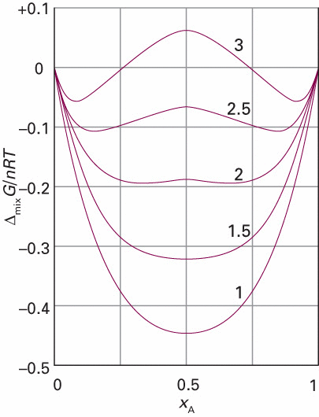
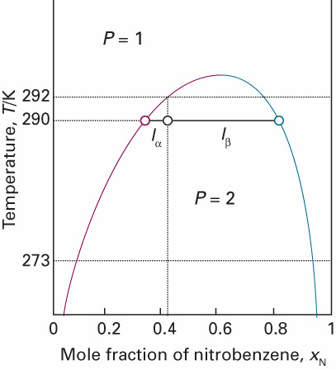
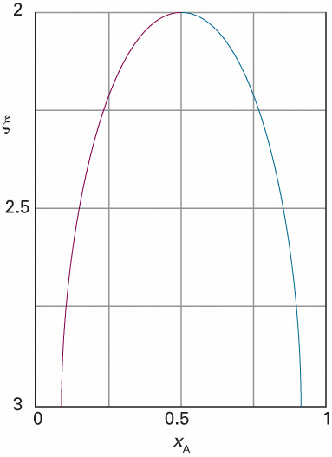
C = 2
Liquid-liquid separation (oiling out)
(Exercise 17)
Partial miscibility
of liquids
Nitrobenzene/hexane
Lever rule

Slide 29
C = 2
Liquid-liquid separation (oiling out)
Upper Critical (Solution) Temperature
Nitrobenzene/hexane
Lever rule

Slide 30
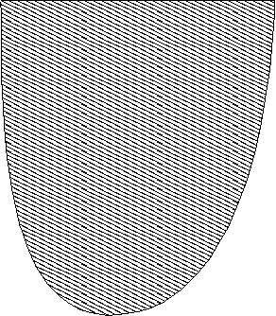
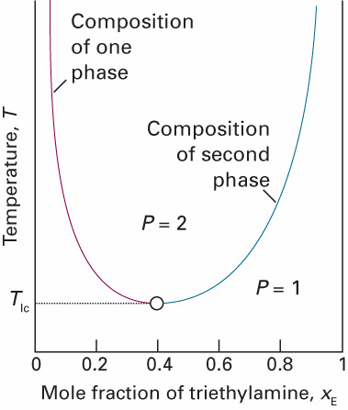
C = 2
Liquid-liquid separation (oiling out)
Upper Critical (Solution) Temperature
Nitrobenzene/hexane
H₂O / triethylamine
Lower Critical (Solution) Temperature
Lever rule

Slide 31
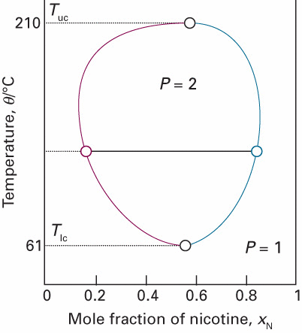
C = 2
Liquid-liquid separation (oiling out)
Upper Critical (Solution) Temperature
H₂O / nicotine
Lower Critical (Solution) Temperature
Lever rule

Slide 32
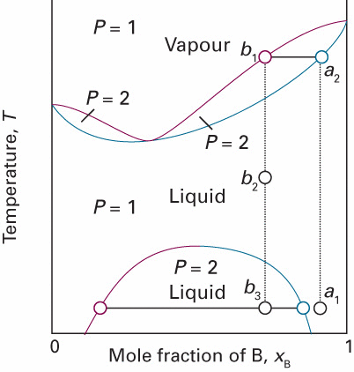
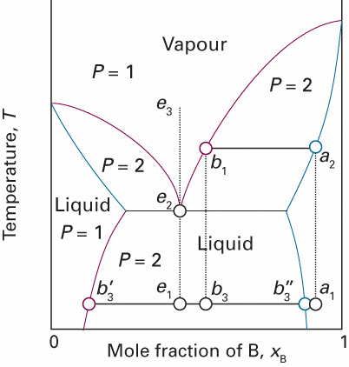
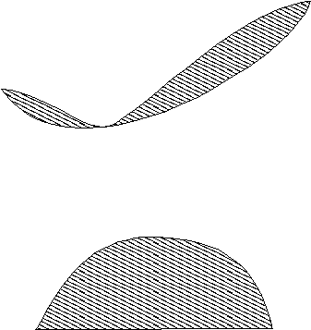
C = 2
L-L separation in liquid-gas phase diagram
Lever rule

Slide 33
C = 2
L-L separation in liquid-gas phase diagram
P = 3
F’ = C – P + 1
Lever rule

Slide 34
C = 2
Solid-liquid phase diagram

Slide 35
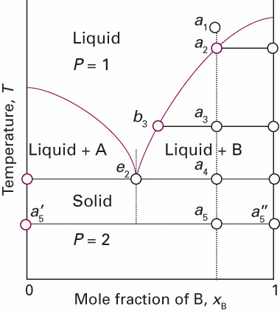
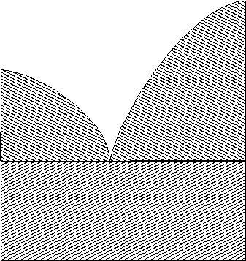
C = 2
Solid-liquid phase diagram
Eutectic: A(s) and B(s) not miscible
T_{e(utectic)}
Completely immiscible solids
Lever rule

Slide 36
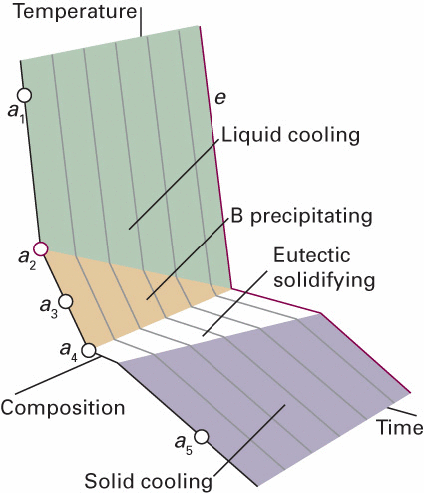
C = 2
Solid-liquid phase diagram
Eutectic: A(s) and B(s) not miscible
T_{e(utectic)}
P = 3
Exercise 18
Lever rule

Slide 37
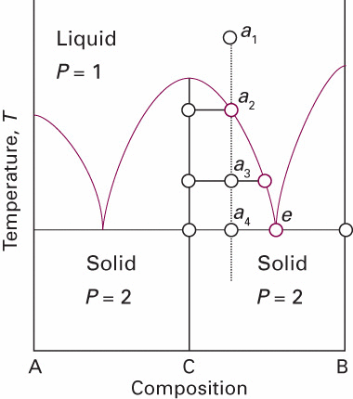
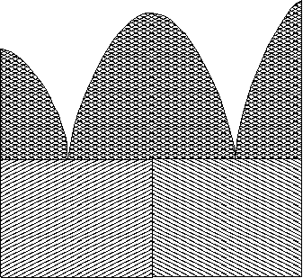
C = 2
Solid-liquid phase diagram
Compound
C = AB
Lever rule
Three solid compounds: A, B and C = AB

Slide 38
C = 2
Solid-liquid phase diagram
Compound
C = AB
T_{e(utectic)}
P = 5
F = -2
Lever rule
Three solid compounds: A, B and C = AB

Slide 39
C = 2
Solid-liquid phase diagram
Compound
C = AB
T_{e(utectic)}
P = 5
F = -2
Lever rule
Three solid compounds: A, B and C = AB

Slide 40
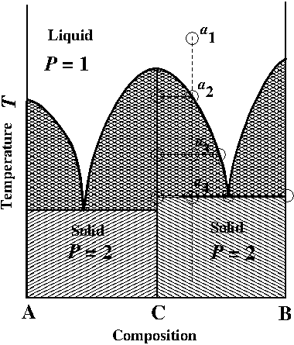
C = 2
Solid-liquid phase diagram
Compound
C = AB
Lever rule
Three solid compounds: A, B and C = AB

Slide 41
C = 2
Solid-liquid phase diagram
Exercise 20
Compound
C = AB
T_{e}(CB)
T_{e}(AC)
P = 3
P = 3
Lever rule
Three solid compounds: A, B and C = AB

Slide 42
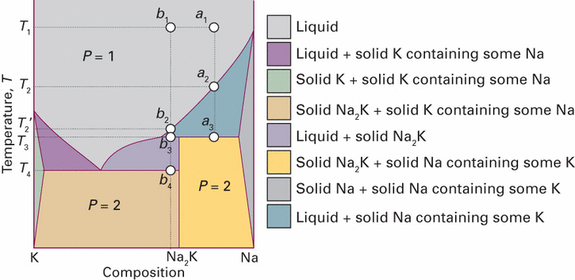
C = 2
Solid-liquid phase diagram
Lever rule

Slide 43
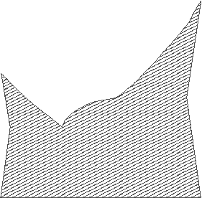
C = 2
Solid-liquid phase diagram
peritectic
Incongruent melting
Solid solutions
Lever rule

Slide 44
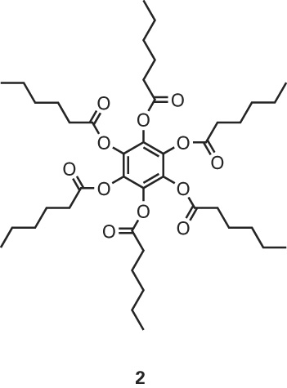
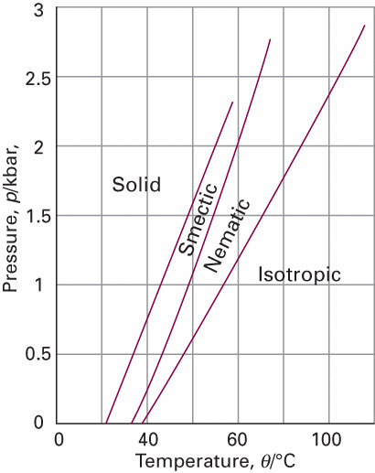
C = 1
Condensed matter phase diagrams
Liquid crystals
(mesophase)
nematic
smectic
cholesteric

Slide 45
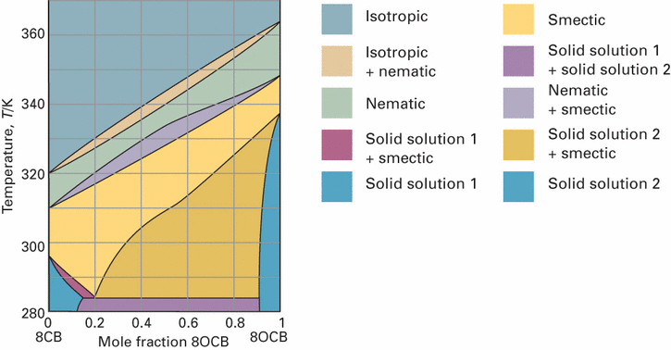
C = 2
Condensed matter phase diagrams
Liquid crystals

Slide 46
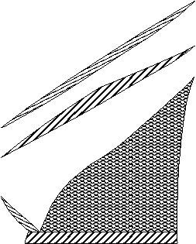
C = 2
Condensed matter phase diagrams
Liquid crystals

Slide 47
Ternary phase diagrams

Slide 48
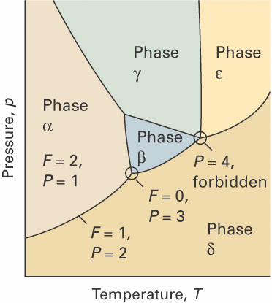
C = 2
Binary phase diagrams
Pressure
Gibbs phase rule
F = 3
F = 1
F = 0
Temp.
F = 2
Comp. x_{A}

Slide 49
C = 3
Ternary phase diagrams
Pressure
Gibbs phase rule
F = 3
F = 1
F = 0
Temp.
F = 2
Comp. x_{A}

Slide 50
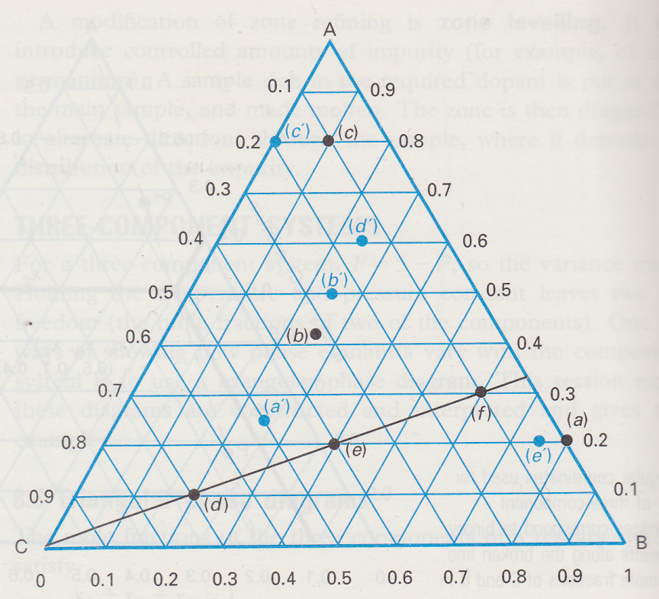
C = 3
Ternary phase diagrams
F = 3 – P + 2
F” = 3 – P
F” = 2 – P
P,T
F” = 1 – P
C = 2
C = 1

Slide 51
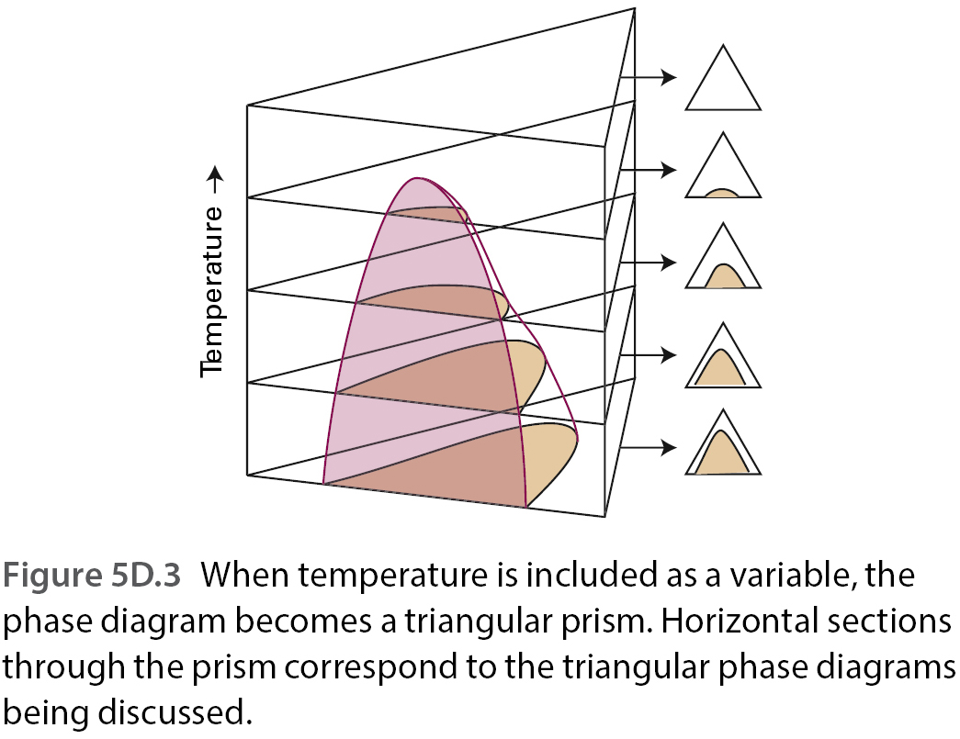
C = 3
Ternary phase diagrams
F = 3 – P + 2
F” = 3 – P
P,T’
P,T
P,T

Slide 52
C = 3
Ternary phase diagrams
F = 3 – P + 2
F” = 3 – P
P,T’
P,T
P,T
Exercise 21

Slide 53
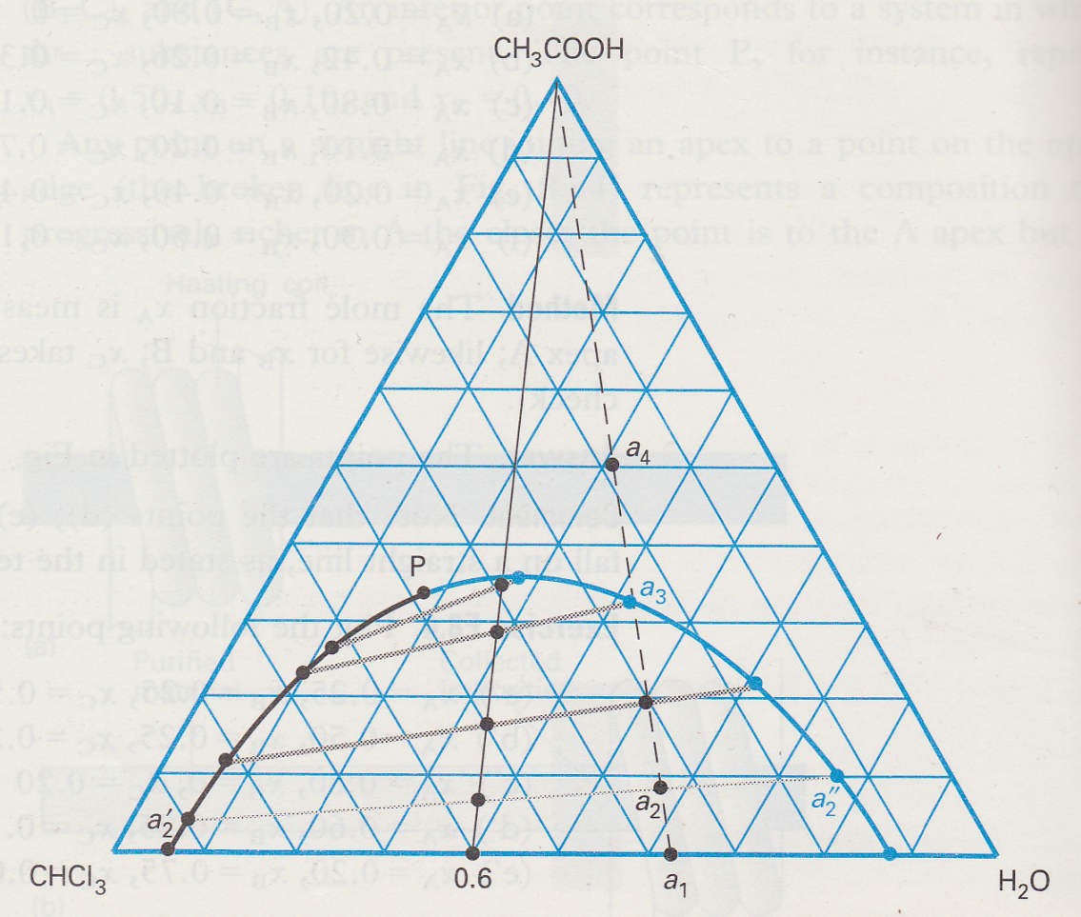
C = 3
Ternary phase diagrams
F” = 3 – P
P,T
l-l separation
Plait point
P = 1
Tie line
P = 2
(CHCl₃, CH₃COOH, H₂O)

Slide 54
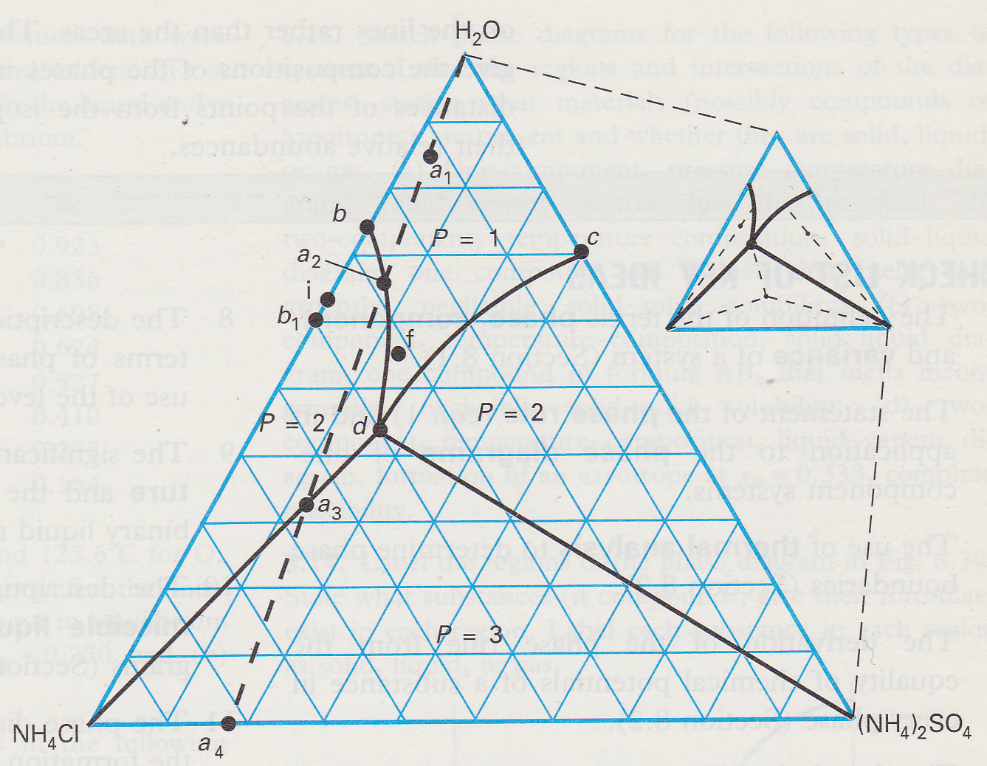
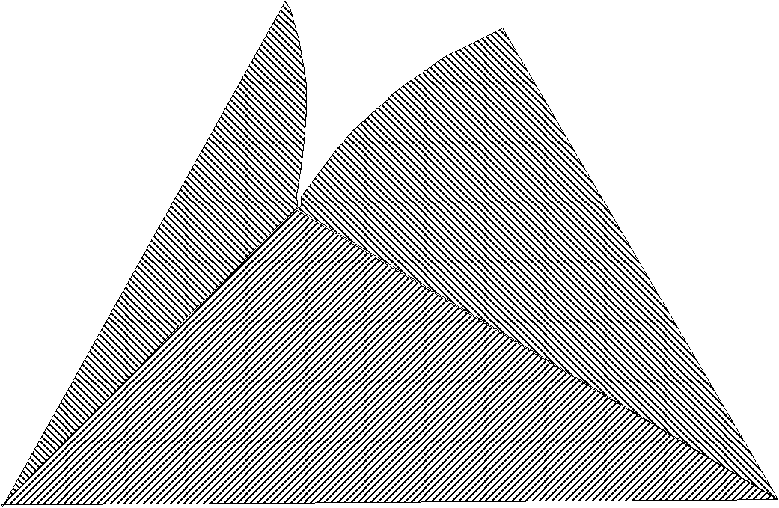
C = 3
Ternary phase diagrams
P,T
Tie line
((NH₄)₂SO₄, NH₄Cl, H₂O)

