Slide 1
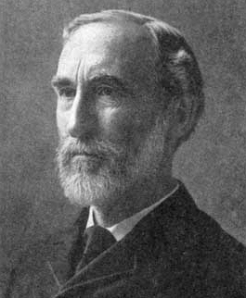
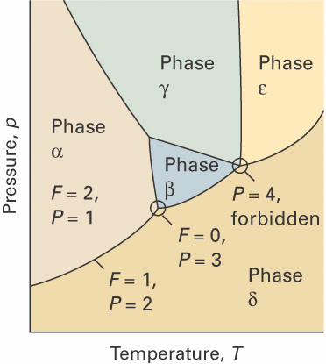
Phase diagrams of binary systems
C = 2
Pressure
Gibbs phase rule
F = 3
F = 1
F = 0
Temp.
F = 2
Comp. x_{A}

Slide 2
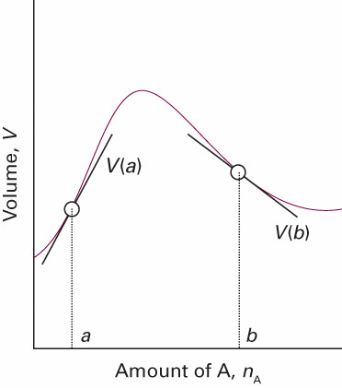
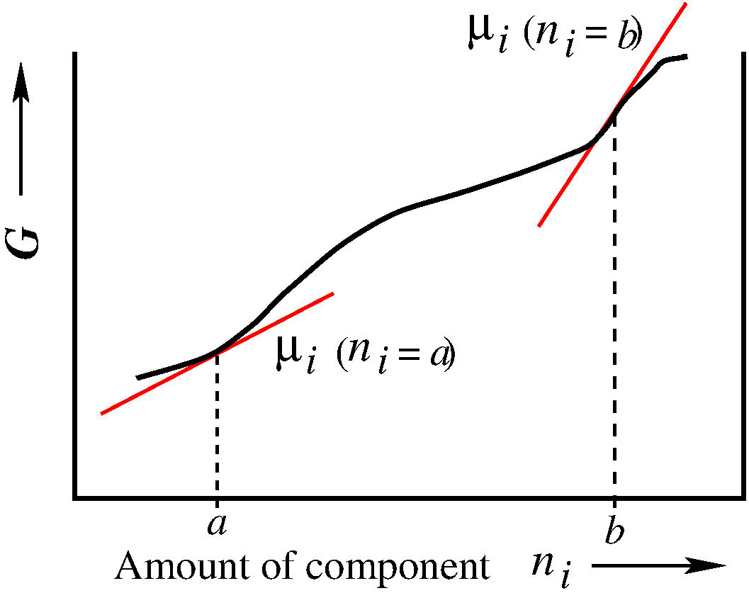
Partial molar quantities
A
A

Slide 3
Mixing processes of perfect gases:binary mixture
Perfect gas mixing @ P,T
+
Mole fraction

Slide 4
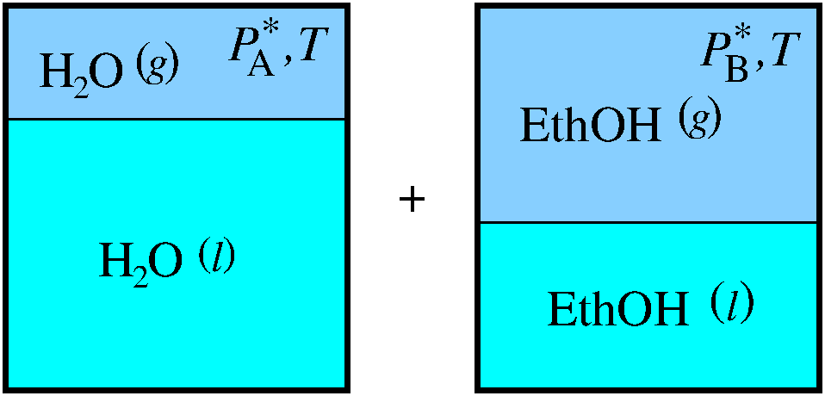
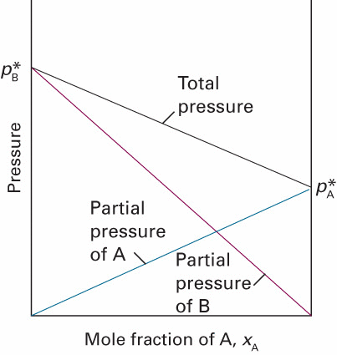
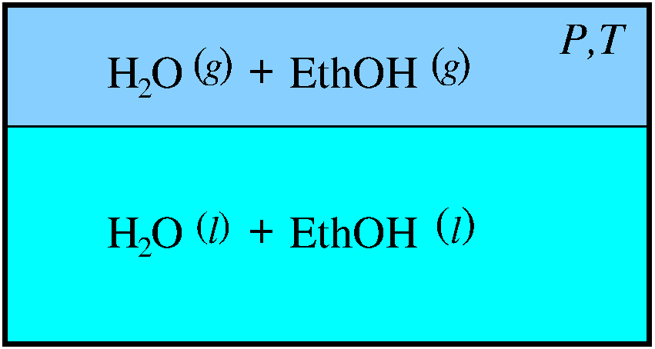
Mixing processes of l,g equilibrium:binary mixture
Ideal solution @ T
+
Liquid mole fraction x_{A}
Ideal solution (Raoult)

Slide 5
Mixing processes of l,g equilibrium:binary mixture
Ideal solution @ T
+
NOT AN IDEAL SOLUTION
Liquid mole fraction x_{A}
Ideal solution (Raoult)

Slide 6
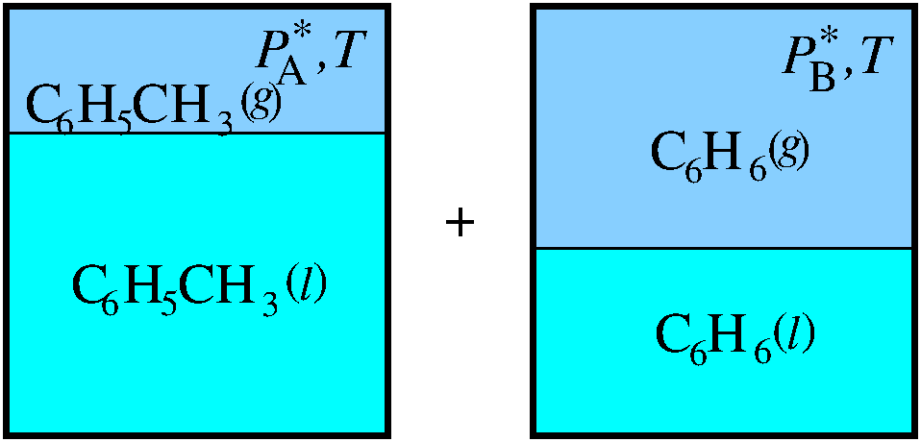
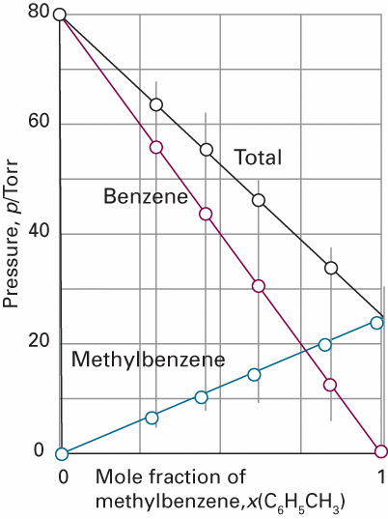
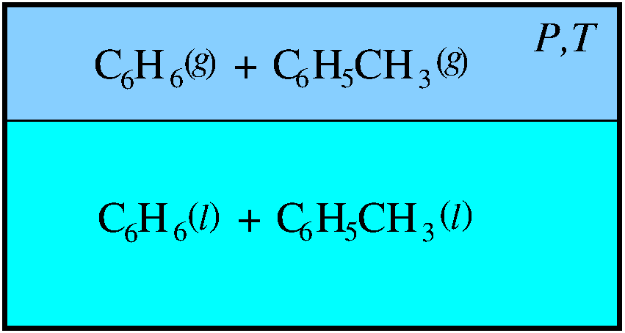
Mixing processes of l,g equilibrium:binary mixture
Ideal solution @ T
Ideal solution (Raoult)

Slide 7
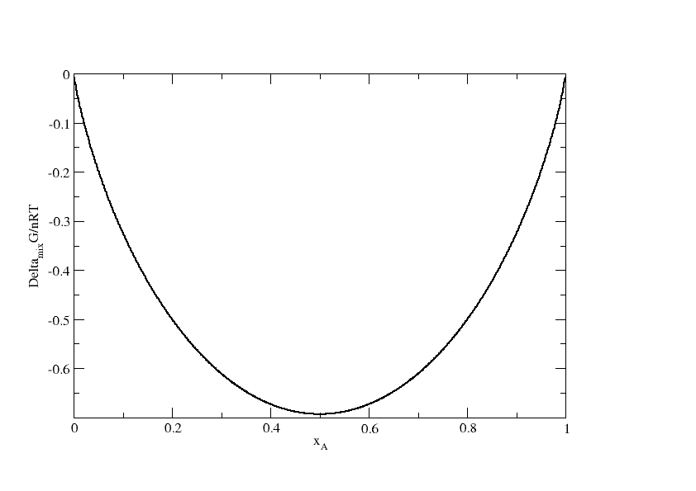
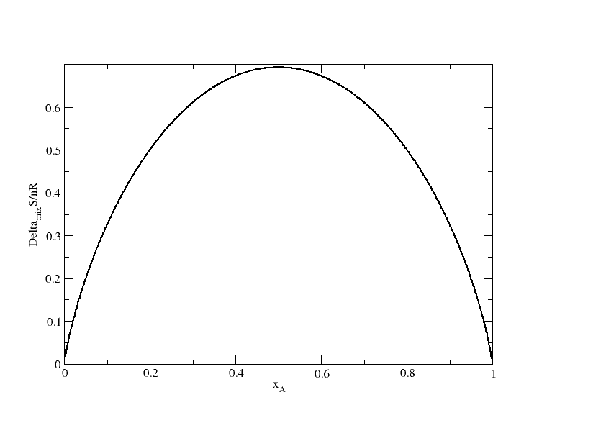
Thermodynamics of ideal mixing
(perfect gas mixtures and ideal solutions)
Δ_{mix}G/nRT
Δ_{mix}S/nR
x_{A}
x_{A}

Slide 8
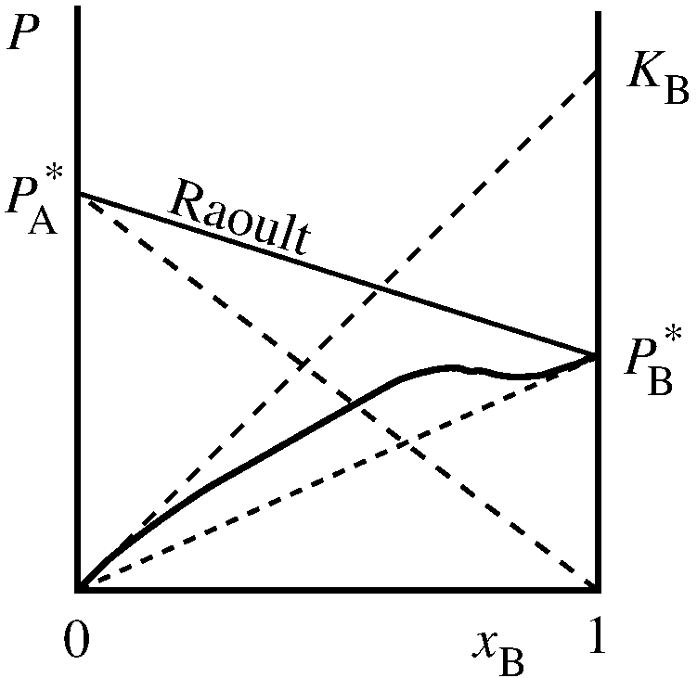
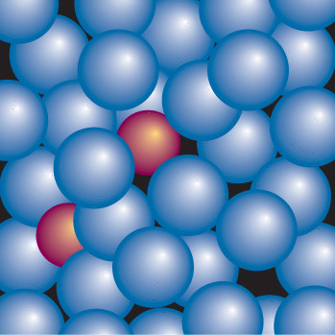
Thermodynamics of non-ideal mixing liquids
almost pure solvent A
Ideal-dilute solution
B
A
very low concentration of solute B
solute B expelled from solution
Ideal-dilute solutions: Henry constant K_{B}

Slide 9
Vapour-liquid diagrams of binary systems

Slide 10
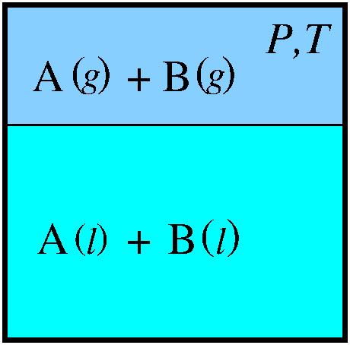
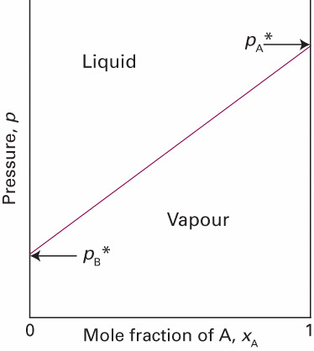
Vapour-liquid diagrams of binary systems
P = P_{A} + P_{B}
Ideal solution
(Raoult)

Slide 11
Vapour-liquid diagrams of binary systems
Liquid
P = P_{A} + P_{B}
vapour
Ideal solution
(Raoult)

Slide 12
Vapour-liquid diagrams of binary systems
C = 2
Ideal solution

Slide 13
Vapour-liquid diagrams of binary systems
C = 2
Ideal solution
we use y for the mole fractions in the gas phase

Slide 14
Vapour-liquid diagrams of binary systems
C = 2
Ideal solution

Slide 15
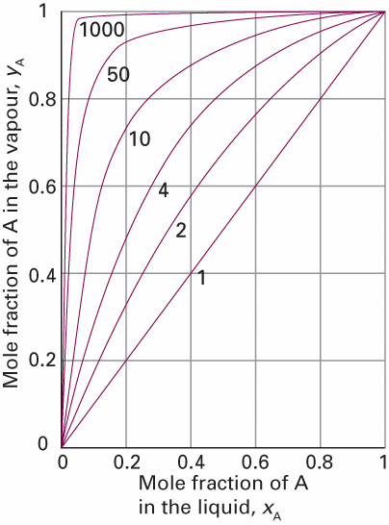
Vapour-liquid diagrams of binary systems
C = 2
Ideal solution

Slide 16
Vapour-liquid diagrams of binary systems
C = 2
Ideal solution

Slide 17
Vapour-liquid diagrams of binary systems
C = 2
Ideal solution
Let’s work this out in detail

Slide 18
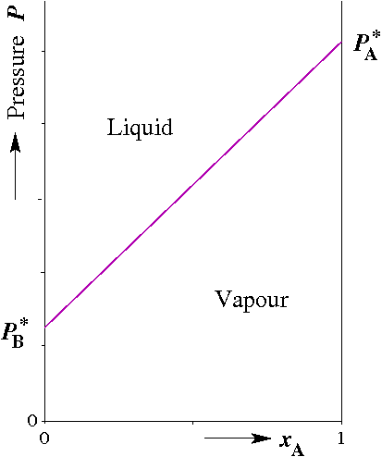
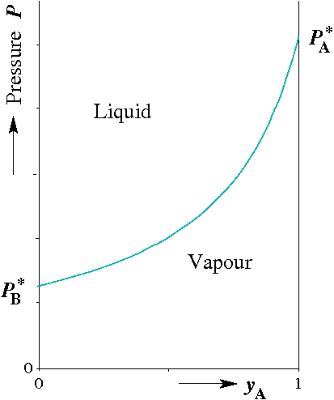
Vapour-liquid diagrams of binary systems
Ideal solution

Slide 19
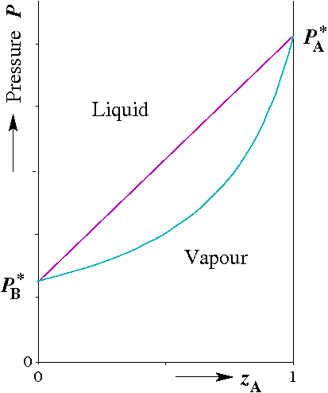
Vapour-liquid diagrams of binary systems
Ideal solution

Slide 20
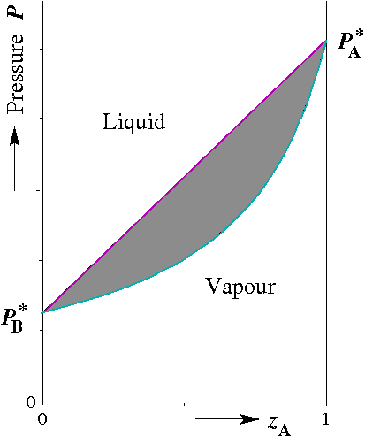
Vapour-liquid diagrams of binary systems
Ideal solution

Slide 21
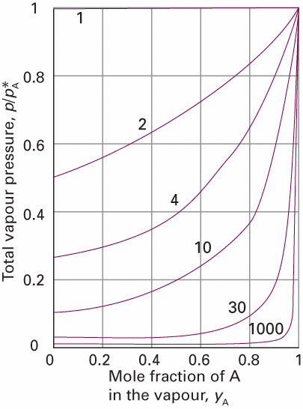
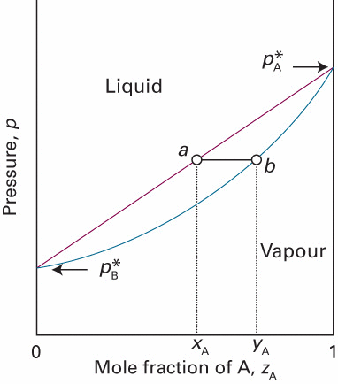
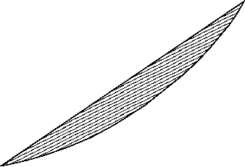
Vapour-liquid diagrams of binary systems
Fixed T
P = 1
P = 2
P = 1
Ideal solution

Slide 22
Vapour-liquid diagrams of binary systems
Fixed T
P = 1
P = 2
F = C – P + 2
F’ = C – P + 1
P = 1
Ideal solution
Exercise 14-15

Slide 23
Lever rule
C = 2
Isopleth
Tie line
Phase α
Liquidus
P = 1
Gas line
P = 2
z_{A} is the overall composition
of the mixture
Phase β
P = 1

Slide 24
Lever rule
C = 2
Isopleth
Tie line
{
Phase α
Liquidus
P = 1
Gas line
P = 2
Phase β
P = 1

Slide 25
Lever rule
C = 2
Isopleth
Tie line
{
Phase α
P = 1
P = 2
$$l_{β}$$
$$l_{α}$$
Phase β
Lever rule
P = 1

Slide 26
Pressure-composition diagrams
Pressure
F = 3
F = 1
F = 0
Temp.
F = 2
Comp. x_{A}

Slide 27
Pressure-composition diagrams
Pressure
F = 3
F = 1
F = 0
Temp.
F = 2
Comp. x_{A}
Temperature-composition diagrams

Slide 28
Pressure-composition diagrams
Fixed T
Pressure
F = 3
F = 1
F = 0
Temp.
F = 2
Comp. x_{A}

Slide 29
Temperature-composition diagrams
Pressure
F = 3
F = 1
F = 0
Temp.
Fixed P
F = 2
Comp. x_{A}
Temperature-composition diagrams

Slide 30
Pressure-composition diagrams
Ideal solution
Fixed T

Slide 31
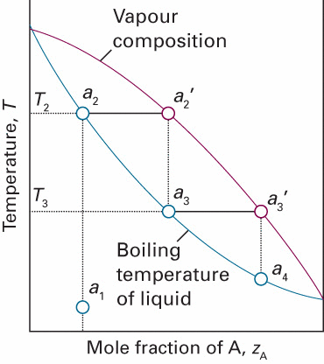
Temperature-composition diagrams
Ideal solution
vapour
liquid
Fixed P

Slide 32
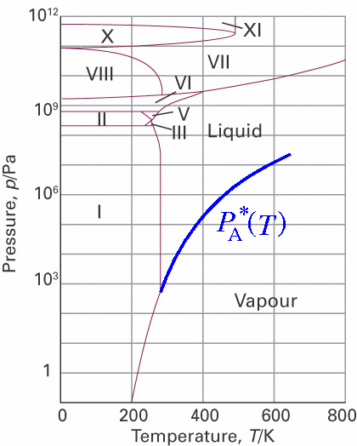
Temperature-composition diagrams
Ideal solution
vapour
(Clapeyron)
liquid
(P,T )-diagram
Component A
Fixed P

Slide 33
Temperature-composition diagrams
Ideal solution
P = 1
P = 2
(Clapeyron)
(P,T )-diagram
Component A
P = 1
F = C – P + 2
Fixed P
F’ = C – P + 1

Slide 34
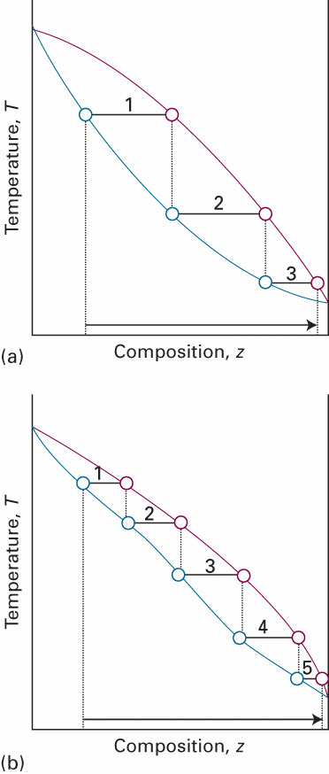
C = 2
Temperature-composition diagrams
vapour
ideal solution
liquid
Composition z_{A}
Excess Gibbs free energy
G^{E} < 0
G^{E} is the excess Gibbs free energy of the liquid mixture

Slide 35
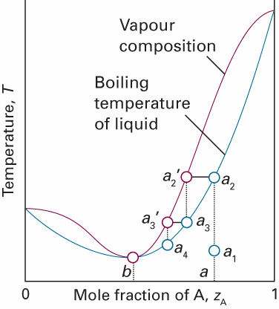
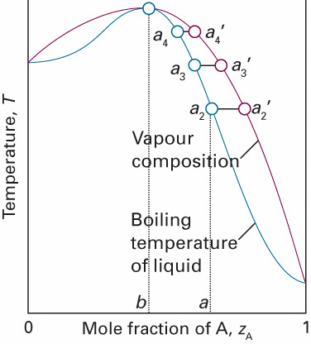
C = 2
Temperature-composition diagrams
vapour
ideal solution
liquid
Composition z_{A}
non-ideal solutions
Composition z_{A}

Slide 36
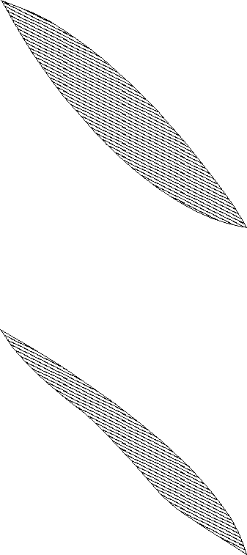
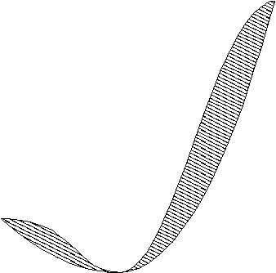
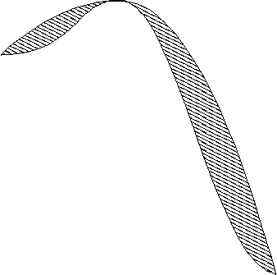
C = 2
Temperature-composition diagrams
vapour
ideal solution
liquid
Composition z_{A}
non-ideal solutions
Composition z_{A}

Slide 37
C = 2
Temperature-composition diagrams
P = 1
P = 1
P = 2
vapour
P = 2
P = 1
vapour
liquid
P = 2
liquid
P = 2
P = 1
Low boiling azeotrope
High boiling azeotrope
H₂O/Eth: 4 wgt%H₂O @ 78°C
H₂O/HCl: 80 wgt%H₂O @ 108.6°C
Exercise 16

Slide 38
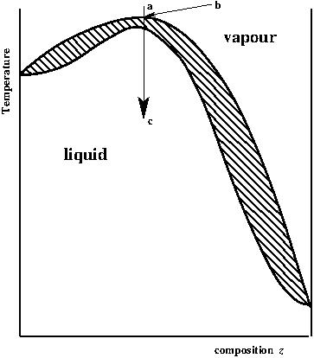
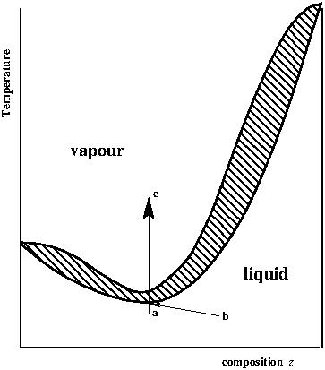
C = 2
Impossible azeotropes
Composition z_{A}
Composition z_{A}
would lead to g-g separation

Slide 39
C = 2
Impossible azeotropes
NOT POSSIBLE
NOT POSSIBLE
Composition z_{A}
Composition z_{A}
would lead to g-g separation

Slide 40
Exess functions

Slide 41
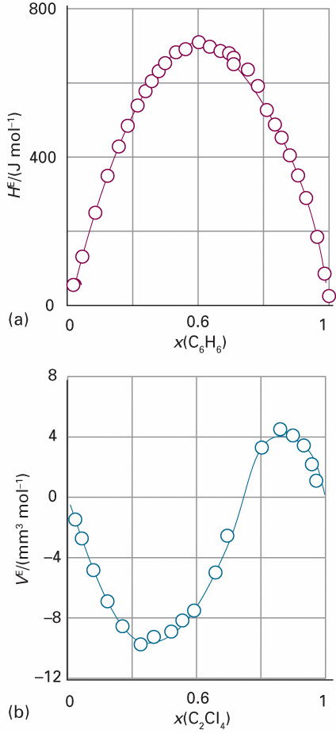
Exess functions
{
Non-ideal mixing
(Excess functions)
H ^{E} (J/mol)
Benzene/cyclohexane
 |  | Ideal | Regular | Quasi regular
S^{E} |  | =0 | =0 | ≠0
H^{E} |  | =0 | ≠0 | ≠0
x (C₆H₆)
V ^{E} (mm³/mol)
Cl₄ethene/cyclopentene
x (C₂Cl₄)

Slide 42
Exess functions
Regular solution
-T
=
(Regular solution: H^{E} ≠ 0)
(Regular solution: S^{E} = 0)

Slide 43
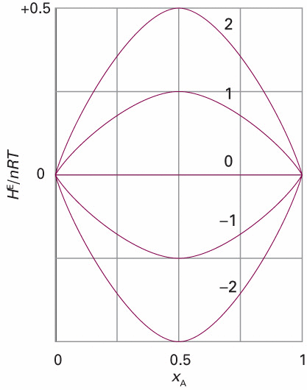
Exess functions
Regular solution
-T
=
β =
(Regular solution: H ^{E} ≠ 0)

Slide 44
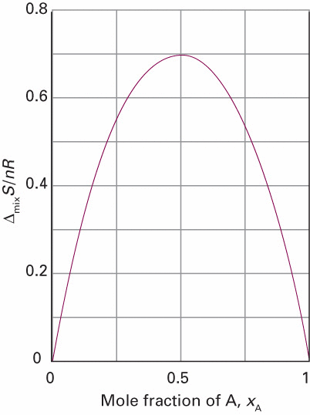
Exess functions
Regular solution
-T
=
β =
(Regular solution: H ^{E} ≠ 0)
(Regular solution: S ^{E} = 0)

Slide 45
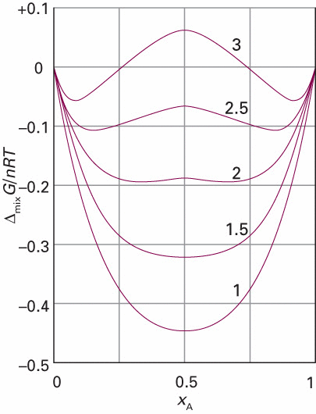
Exess functions
Regular solution
-T
=
β =
β =
(Regular solution: H ^{E} ≠ 0)
(Regular solution: S ^{E} = 0)

Slide 46
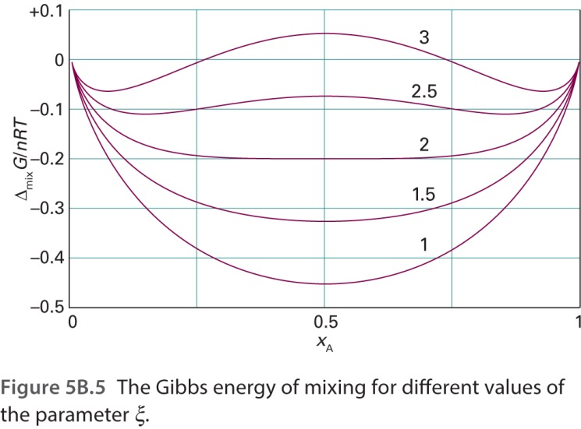
Liquid-liquid separation for Regular solution
β =
Model regular solution

Slide 47
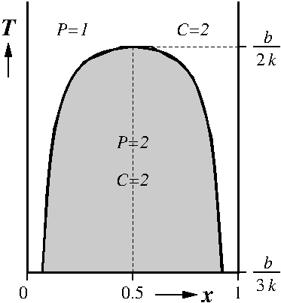
Liquid-liquid separation for Regular solution
β =
Model regular solution

Slide 48
Liquid-liquid separation for Regular solution
β =
Model regular solution

Slide 49
Liquid-liquid separation for Regular solution
β =
Model regular solution

Slide 50
Liquid-liquid separation for Regular solution
β =
Liquid-liquid separation
Exercise 17
Model regular solution

Slide 51
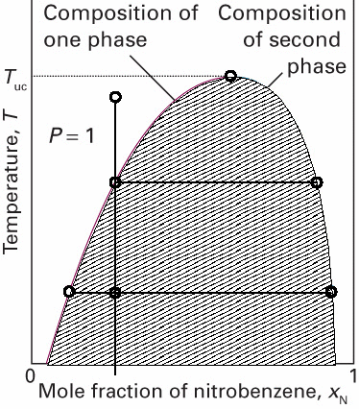
Liquid-liquid separation for quasi regular solution
P = 2
l₁
l₂
z_{N}
Nitrobenzene in hexane

Slide 52
Liquid-liquid separation for quasi regular solution
P = 2
$$n_{1}l_{1}=n_{2}l_{2}$$
l₁
l₂
Lever rule
z_{N}
Nitrobenzene in hexane

Slide 53
Liquid-liquid separation for quasi regular solution
Upper Critical temperature
P = 2
$$n_{1}l_{1}=n_{2}l_{2}$$
l₁
l₂
Lever rule
z_{N}
Nitrobenzene in hexane

