Slide 1
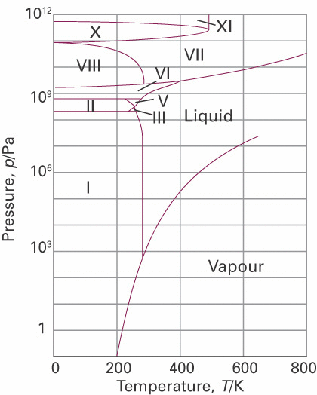
Phase diagrams and phase transitions
of unary systems
Phase transitions
Phase boundaries
Phase transition temperature
Melting point
Boiling point
Triple point
Critical point
Polymorphic forms
Thermodynamics vs kinetics
Metastable phases
Solids
Solid
(Equilibrium) Phase Diagram of a pure compound

Slide 2
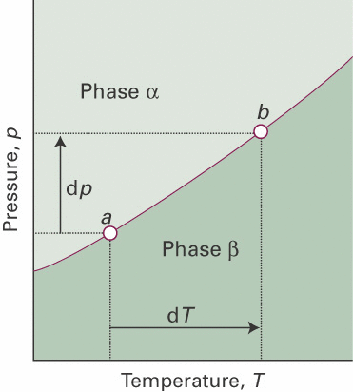
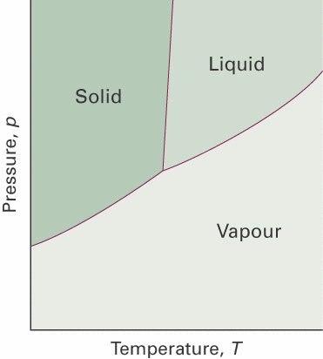
Phase boundary lines in phase diagrams of unary systems
Clapeyron
Clausius-Clapeyron

Slide 3
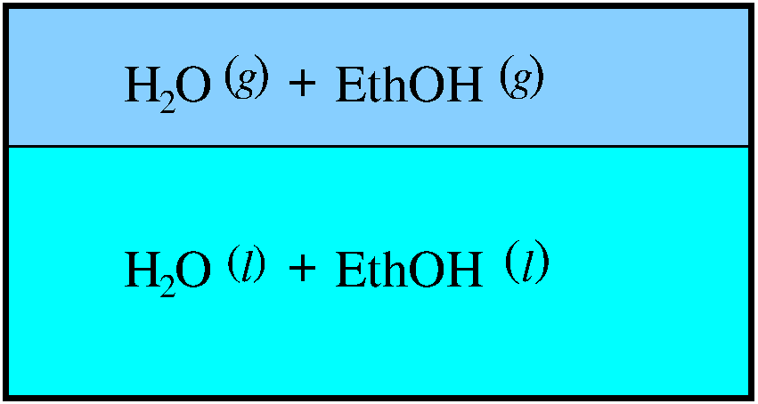
Phase diagrams: multicomponent phases
Importance of the chemical potential:
Equilibrium between phases of a single component
in equilibrium:
Equilibrium between phases of components i in mixtures
phase α
phase β
phases α, β
components i
in equilibrium:

Slide 4
Lecture 3: mixtures of compounds
Components (compounds):
Molarity (mol/L):
Molality (mol/kg):
Mole fraction ():

Slide 5
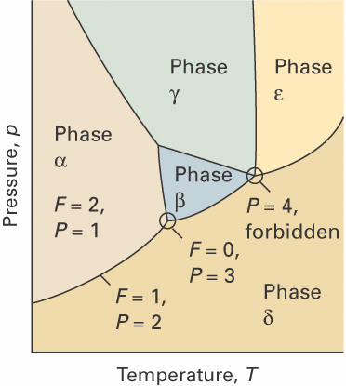
Phase diagrams of mixtures of compounds
Gibbs Phase Rule
# independent intensive variables:
# components (compounds):
# phases in mutual equilibrium:

Slide 6
Phase diagrams of mixtures of compounds
Gibbs Phase Rule
# independent intensive variables:
# components (compounds):
# components in each phase:
# phases in mutual equilibrium:

Slide 7
Phase diagrams of mixtures of compounds
Gibbs Phase Rule
# independent intensive variables:
# components (compounds):
# phases in mutual equilibrium:
all components in each phase:

Slide 8
Phase diagrams of mixtures of compounds
C −1 independent x_{i} per phase
T,P for all phases
Equilibrium condition:

Slide 9
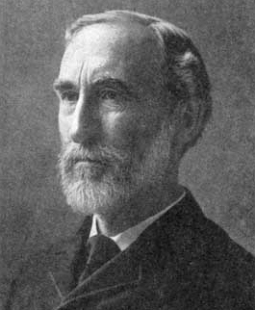
Phase diagrams of unary systems
C = 1
F = 2
P = 1
Gibbs phase rule
F: # degrees of freedom
C: # components
P: # phases
unary phase diagram

Slide 10
Phase diagrams of unary systems
C = 1
F = 1
P = 2
Gibbs phase rule
unary phase diagram

Slide 11
Phase diagrams of unary systems
C = 1
F = 0
P = 3
Gibbs phase rule
unary phase diagram

Slide 12
Phase diagrams of unary systems
C = 1
F = −1
P = 4
Gibbs phase rule
unary phase diagram

Slide 13
Phase diagrams of binary systems
C = 2
F = 3
P = 1
Gibbs phase rule

Slide 14
Phase diagrams of binary systems
C = 2
F = 3
P = 1
Gibbs phase rule
Composition x_{A}

Slide 15
Phase diagrams of binary systems
C = 2
F = 3
P = 1
Pressure
Gibbs phase rule
1
Temp.
Composition x_{A}

Slide 16
Phase diagrams of binary systems
C = 2
F = 3
P = 1
Gibbs phase rule
F=3
3
allowed
F=1
1
Temp.
2
F=2
Composition x_{A}

Slide 17
Partial molar quantities in mixtures

Slide 18
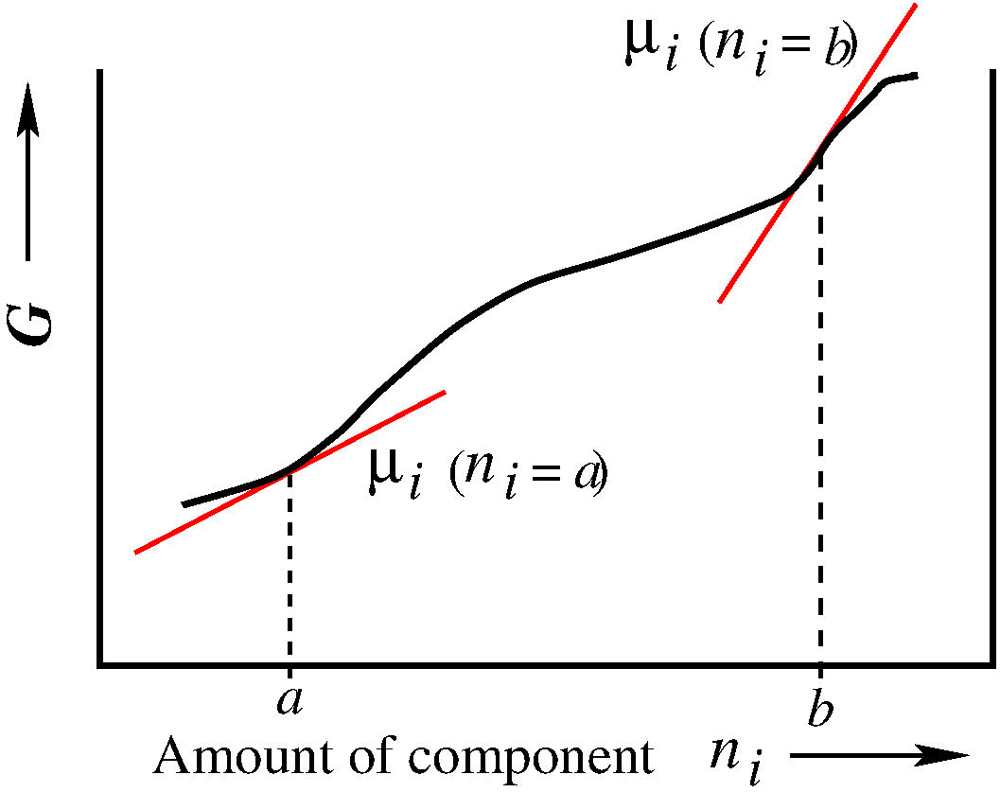
Partial molar quantities in mixtures
The chemical potential of a component i in mixtures
(Study guide p.11-13)
mixture
a_{i}: the activity of component i in the mixture
μ_{i}: the chemical potential is a partial molar quantity

Slide 19
Partial molar quantities: Chemical potential
The chemical potential of a component i in mixtures
Perfect gasses
For pure liquids
For pure solids

Slide 20
Partial molar quantities: Chemical potential
The chemical potential of a component i in mixtures
Standard state ϴ
for component i

Slide 21
Partial molar quantities: Chemical potential
Activity and activity coefficient
(Mole fraction example)
Mole fraction
(-)
Molarity (mol/L)
Molality (mol/kg)
example

Slide 22
Partial molar quantities: Chemical potential
The chemical potential of a component i in mixtures
Let’s work this out in detail
binary systems
for phase α
(Study guide p.13)

Slide 23
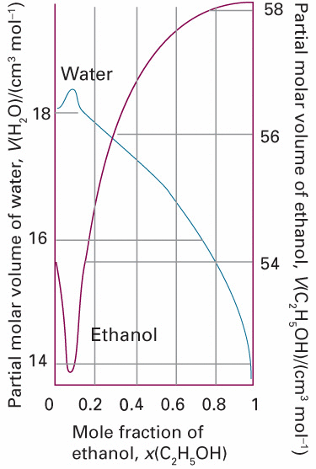
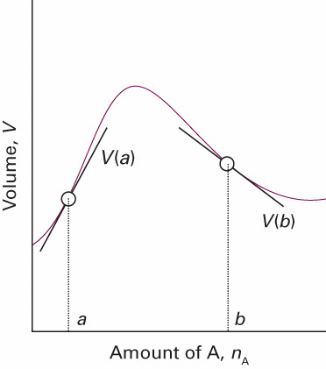
Partial molar quantities: Partial molar volume
The partial molar volume of a component i in mixtures
A
A
binary systems
for phase α

Slide 24
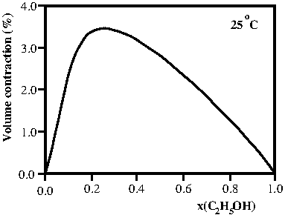
Partial molar quantities: Partial molar volume
The partial molar volume of a component i in mixtures
binary systems
for phase α

Slide 25
Partial molar quantities: Partial molar volume
The partial molar volume of a component i in mixtures
binary systems
for phase α
A
A
for each phase
(molar volume)
Exercise 10-11

Slide 26
Partial molar quantities: Gibbs-Duhem equation
Gibbs-Duhem
equation
(for any state function)

Slide 27
Mixing processes of perfect gases:binary mixture
(Study guide p.14-16)
The process of mixing two components @ P,T in gas phase
→
initial pure compounds
final mixture
Unary phase diagram: P = 1

Slide 28
Mixing processes of perfect gases:binary mixture
The process of mixing two components @ P,T in gas phase
→
(Dalton)
initial pure compounds
final mixture
Perfect gases

Slide 29
Mixing processes of perfect gases:binary mixture
The process of mixing two components @ P,T in gas phase
→
Final:
Initial:
_

Slide 30
Mixing processes of perfect gases:binary mixture
The process of mixing two components @ P,T in gas phase
→
Mole fraction

Slide 31
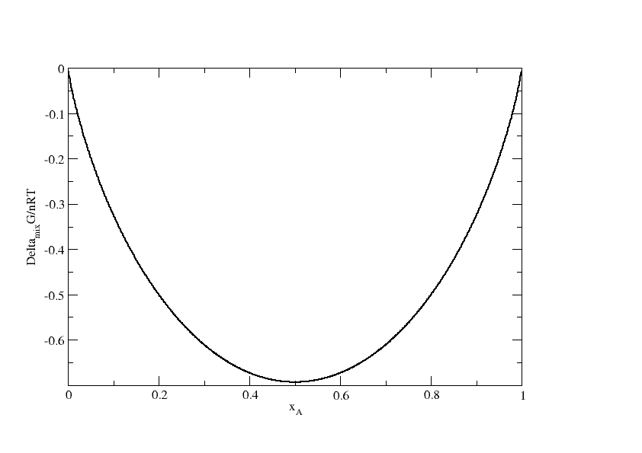
Mixing processes of perfect gases:binary mixture
Perfect gas mixing

Slide 32
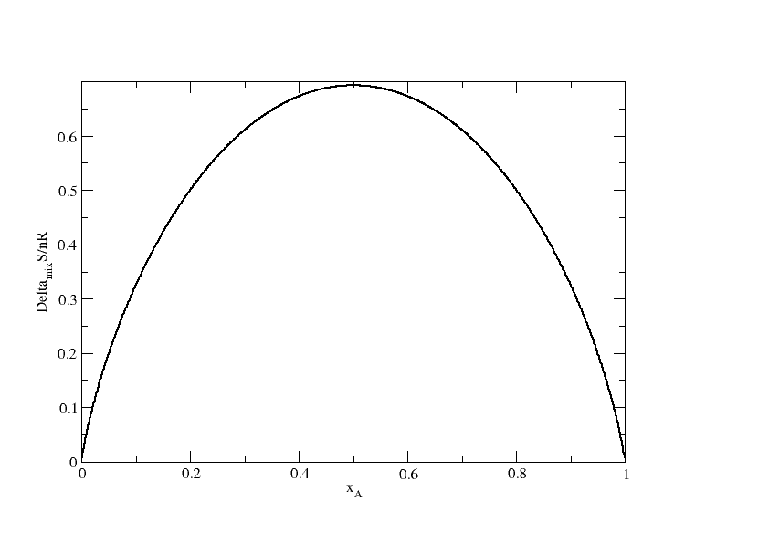
Mixing processes of perfect gases:binary mixture
Perfect gas mixing
2nd law: Mixing is spontaneous, towards increasing entropy

Slide 33
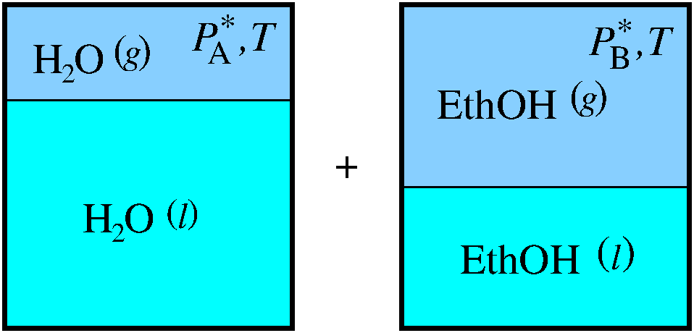
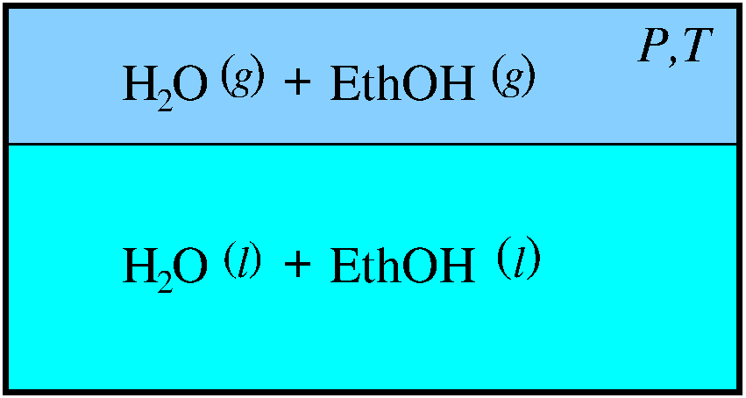
Solutions and mixing processes:binary mixture
The process of mixing two components @ T in l, g phases
phase α
→
phase β
initial pure compounds
final mixture
vapor pressures
vapor pressure
(* : pure compound)

Slide 34
Solutions and mixing processes:binary mixture
The process of mixing two components @ T in l, g phases
phase α
→
phase β
initial pure compounds
final mixture
vapor pressures
vapor pressure
P
P*
Clausius-Clapeyron
(* : pure compound)
Triple point
H₂O
T*
T
(* : reference T,P )

Slide 35
Solutions and mixing processes:binary mixture
The process of mixing two components @ T in l, g phases
phase α
→
phase β
initial pure compounds
final mixture
vapor pressures
vapor pressure
P
P*
Clausius-Clapeyron
(* : pure compound)
Triple point
H₂O
T*
T
(* : reference T,P )

Slide 36
Solutions and mixing processes:binary mixture
The process of mixing two components @ T in l, g phases
phase α
→
phase β
phase α
(sim. phase β)
(slide 18: def. of μ)
Initial:
(* : initial phases are pure; before mixing)
(Note: ϴ per definition for pure compound)

Slide 37
Solutions and mixing processes:binary mixture
The process of mixing two components @ T in l, g phases
phase α
→
phase β
phase α
Final:
Initial:
_

Slide 38
Solutions and mixing processes:binary mixture
The process of mixing two components @ T in l, g phases
phase α
→
phase β
phase α
(similar for phase β)

Slide 39
Solutions and mixing processes: gas phase α
The process of mixing two components @ T in l, g phases
phase α
→
phase β
initial: pure perfect gases
final: mixed perfect gases @ P

Slide 40
Solutions and mixing processes: gas phase α
The process of mixing two components @ T in l, g phases
phase α
→
phase β
Note:
and
like in slide 30!
What about phase β (liquid)?

Slide 41
Solutions and mixing processes: gas phase α
The process of mixing two components @ T in l, g phases
phase α
→
phase β
Raoult’s law: Ideal solutions:
vapor
vapor
liquid

Slide 42
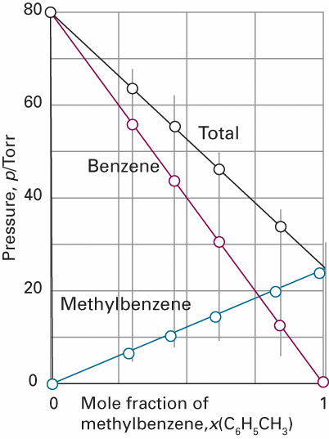
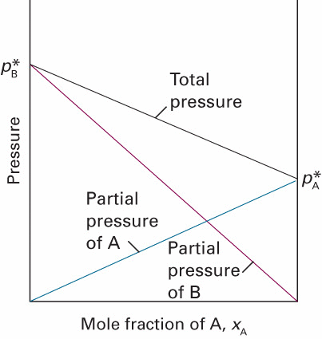
Solutions: Ideal solutions (Raoult)
Raoult’s law
Liquid mole fraction x_{A}
Raoult
Dalton

Slide 43
Solutions and mixing processes: gas phase α
The process of mixing two or more components @ T
phase α
→
phase β
Raoult’s law: Ideal solutions:
(Note the mixture of g and l parameters)
(different from the gas mixture in single gas phase situation)

Slide 44
Solutions and mixing processes: liquid phase β
The process of mixing two or more components @ T
phase α
phase β
Equilibrium

Slide 45
Solutions and mixing processes: liquid phase β
The process of mixing two or more components @ T
phase α
phase β
_
(similar for B)

Slide 46
Solutions and mixing processes: liquid phase β
The process of mixing two or more components @ T
phase α
phase β
Raoult’s law: Ideal solutions:
Ideal solutions:
(similar for B)

Slide 47
Solutions: Ideal solutions (Raoult) liquid phase β
The process of mixing two or more components @ T
phase α
→
phase β
final mixture
initial pure compounds
Ideal solution:
(similar for B)
Similar to the perfect gas case:
Ideal solution (of the liquid)

Slide 48
Solutions: Ideal solutions (Raoult) liquid phase β
Ideal liquid mixing

Slide 49
Solutions: Ideal solutions (Raoult) liquid phase β
Ideal liquid mixing
2nd law: Mixing is spontaneous, towards increasing entropy

Slide 50
Solutions: Ideal solutions (Raoult) liquid phase β
Ideal liquid mixing
2nd law: Mixing is spontaneous, towards increasing entropy
(Study guide p.14-16)

Slide 51
Solutions: Ideal solutions (Raoult) liquid phase β
Liquid mole fraction x_{A}
Ideal mixing (Raoult)
Exercise 12

Slide 52
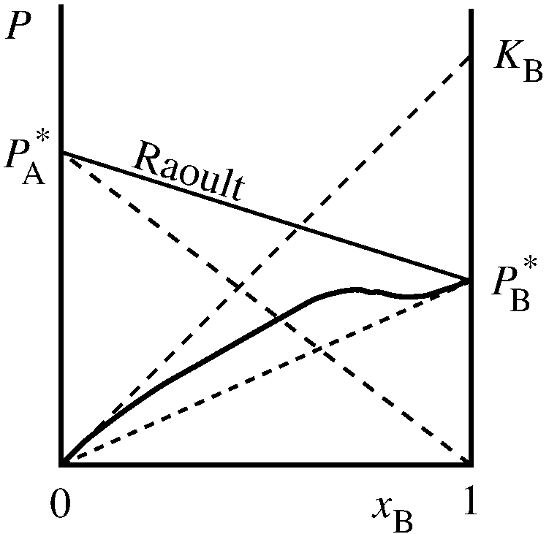
Solutions: Ideal-dilute solutions liquid phase β
Non-ideal mixing
Ideal-dilute solutions:
Henry constant K_{B}
almost pure solvent B
solute B expelled from solution
very low concentration of solute B

Slide 53
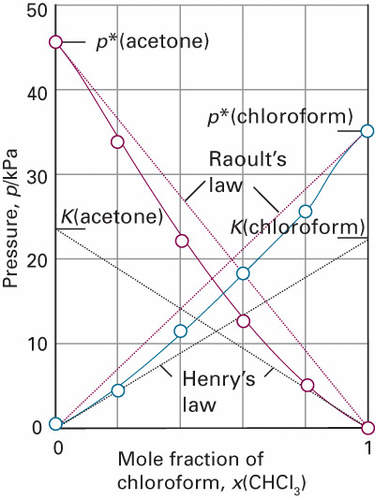
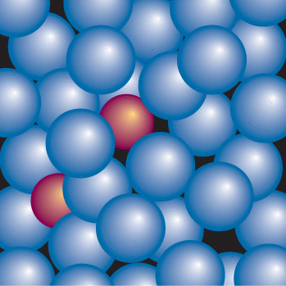
Solutions: Ideal-dilute solutions liquid phase β
Non-ideal mixing
x_{A}
Ideal-dilute solutions: Henry constant K_{B}
Exercise 13

Slide 54
Solutions: Ideal-dilute solutions liquid phase β
(Excess functions)
{
Non-ideal mixing

Slide 55
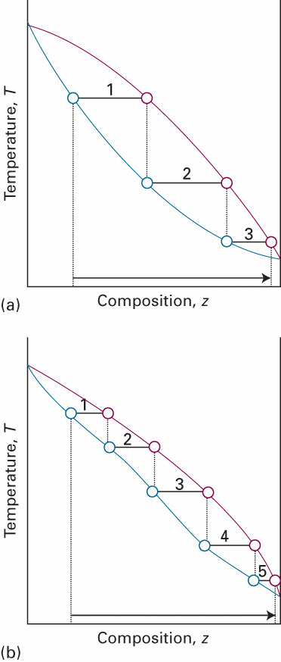
Temperature-composition diagrams
vapour
ideal solutions
G^{E} = 0
liquid

Slide 56
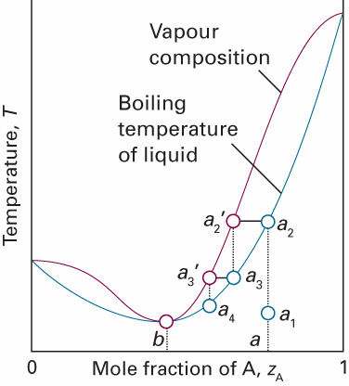
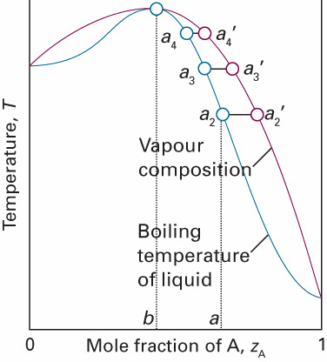
Temperature-composition diagrams
G^{E} >> 0
vapour
ideal solutions
G^{E} = 0
liquid
Non-ideal solutions
G^{E} < 0
G^{E} << 0

Slide 57
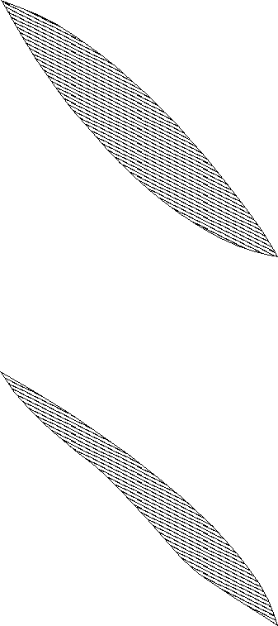
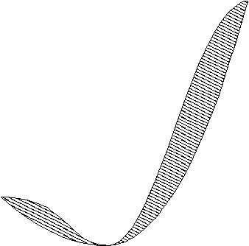
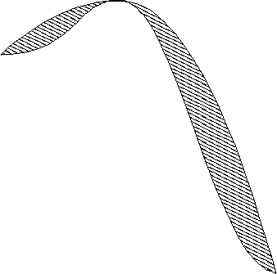
Temperature-composition diagrams
G^{E} >> 0
vapour
ideal solutions
G^{E} = 0
liquid
Non-ideal solutions
G^{E} < 0
G^{E} << 0

