Slide 1
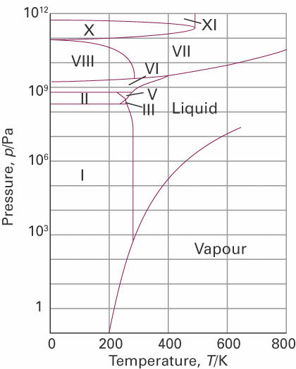
Phase diagrams and phase transitions
of unary systems
Phase transitions
Phase boundaries
Phase transition temperature
Melting point
Boiling point
Triple point
Critical point
Polymorphic forms
Thermodynamics vs kinetics
Metastable phases
Solids
Solid
(Equilibrium) Phase Diagram H₂O

Slide 2
Phase diagrams and phase transitions of unary systems
Solid
1 bar
(Equilibrium) Phase Diagram H₂O

Slide 3

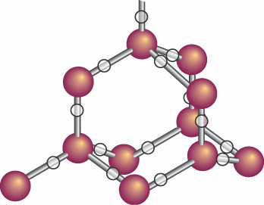
Phase diagrams and phase transitions of unary systems
Solid
1 bar
H-bonding
T_{fus} = T_{cryst} = 273.15 K
(Equilibrium) Phase Diagram H₂O

Slide 4
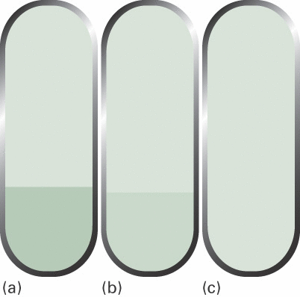
Phase diagrams and phase transitions of unary systems
g
Solid
1 bar
l
T_{vap} = 373.15 K
(Equilibrium) Phase Diagram H₂O

Slide 5

Phase diagrams and phase transitions of unary systems
Solid
1 bar
611 Pa
0.006 bar
Triple point
273.16 K
(Equilibrium) Phase Diagram H₂O

Slide 6
Phase diagrams and phase transitions of unary systems
Critical point
220.6 bar
Solid
1 bar
sc
Super critical
Triple point
647.1 K
(Equilibrium) Phase Diagram H₂O

Slide 7
Phase diagrams and phase transitions of unary systems
g
g
super
critical
l
l
T
Critical point

Slide 8
Phase diagrams and phase transitions of unary systems
Critical point
T < T_{c(ritical)}
T > T_{c}
220.6 bar
g
g
H₂O
647.1 K
super
critical
l
l
T
Critical point

Slide 9
Phase diagrams and phase transitions of unary systems
Critical point
Solid
1 bar
Triple point
H-bonding
(Equilibrium) Phase Diagram H₂O

Slide 10
Phase diagrams and phase transitions of unary systems
Polymorphic forms for the solids
Solid
1 bar
(Equilibrium) Phase Diagram H₂O

Slide 11
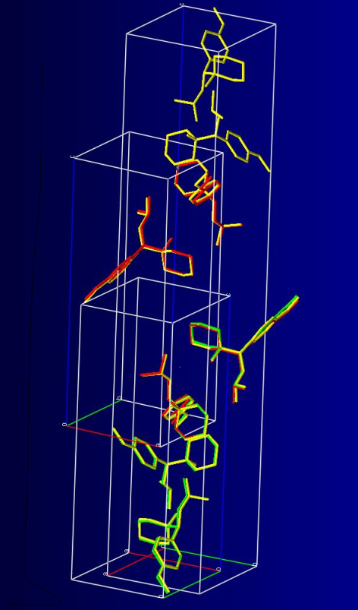
Phase diagrams and phase transitions of unary systems
T < 40 ºC T > 40 ºC T > 60 ºC (T_{fus} = 70 ºC)
Venlafaxine
Polymorphic (solid state) phase transitions

Slide 12
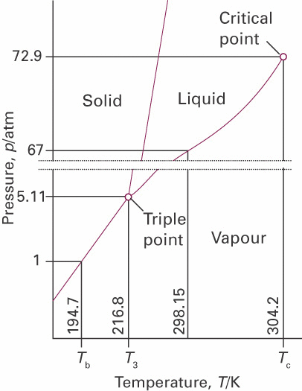
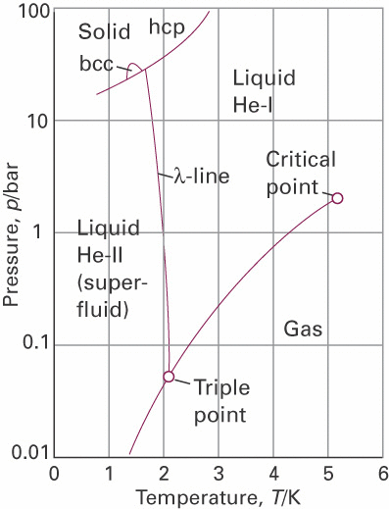
Phase diagrams and phase transitions of unary systems
1 bar
1 bar
sub
“dry ice”
CO₂
⁴He
ambient conditions
sublimation point
at 1 bar

Slide 13
Phase boundary lines in diagrams of unary systems

Slide 14
Phase boundary lines in diagrams of unary systems
Solid
g
l
Vapour and liquid are in mutual equilibrium only for (P,T) values on the line
(Equilibrium) Phase Diagram H₂O

Slide 15
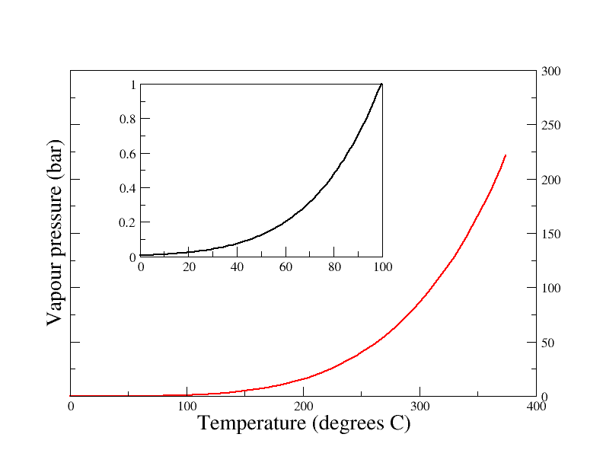
Phase boundary lines in diagrams of unary systems
Solid
Vapour and liquid are in mutual equilibrium only for (P,T) values on the line
(Equilibrium) Phase Diagram H₂O

Slide 16
Phase boundary lines in diagrams of unary systems
T = 373.15 K and P = 1 bar
Solid
g
1 bar
l
Vapour and liquid are in mutual equilibrium only for (P,T) values on the line
T_{vap} = 373.15 K
(Equilibrium) Phase Diagram H₂O

Slide 17
Phase diagrams and phase transitions of unary systems
Intermezzo:
in open system
g
Solid
Air
1 bar
l
@ T_{vap} = 373.15 K
Water starts to boil as
T_{vap} = 373.15 K
(Equilibrium) Phase Diagram H₂O

Slide 18
Phase diagrams and phase transitions of unary systems
Intermezzo:
Relative Humidity
Solid
1 bar
T_{vap} = 373.15 K
(Equilibrium) Phase Diagram H₂O

Slide 19
Phase boundary lines in diagrams of unary systems
Equilibrium between phases
g
l
The chemical potential of phase i (i = l,g)
(Study guide p.11-13)
Note: we are dealing with a unary system
(pure compound)

Slide 20
Phase boundary lines in diagrams of unary systems
Importance of the chemical potential:
Equilibrium between phases
g
Equilibrium
l

Slide 21
Phase boundary lines in diagrams of unary systems
Solids
Solid
(Equilibrium) Phase Diagram H₂O

Slide 22
Phase boundary lines in diagrams of unary systems
Solids
Solid
Triple point
(Equilibrium) Phase Diagram H₂O

Slide 23
Phase boundary lines in diagrams of unary systems
Solids
Solid
pure compound:
(Equilibrium) Phase Diagram H₂O

Slide 24
Phase boundary lines in diagrams of unary systems
Solids
Along phase boundary line:
Solid
Triple point
(Equilibrium) Phase Diagram H₂O

Slide 25
Phase boundary lines in diagrams of unary systems
Solids
Along phase boundary line:
Solid
Triple point
Clapeyron equation:
(Equilibrium) Phase Diagram H₂O

Slide 26
Phase boundary lines in diagrams of unary systems
Solids
Along phase boundary line:
Solid
Triple point
Let’s work this out in detail
Clapeyron equation:
(Equilibrium) Phase Diagram H₂O

Slide 27
Phase boundary lines in diagrams of unary systems
Along phase boundary line:
Solids
Clapeyron equation:
Solid
Perfect gas:
Triple point

Slide 28
Phase boundary lines in diagrams of unary systems
Along phase boundary line:
Solids
P
Solid
P*
Triple point
T*
T

Slide 29
Phase boundary lines in diagrams of unary systems
Along phase boundary line:
Solids
Clausius-Clapeyron equation:
P
Solid
P*
Triple point
T*
T
Clausius-Clapeyron equation

Slide 30
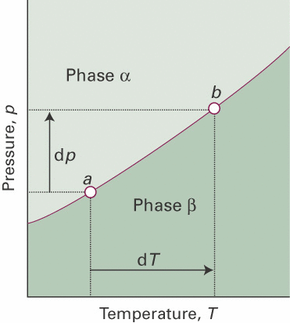
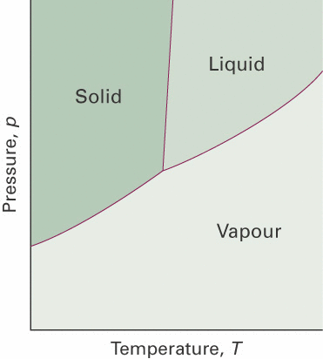
Phase boundary lines in phase diagrams of unary systems
Clapeyron
Clausius-Clapeyron
Exercise 5-8

Slide 31
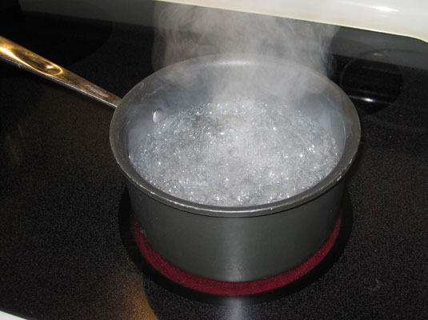

Phase transitions in phase diagrams of unary systems

Slide 32
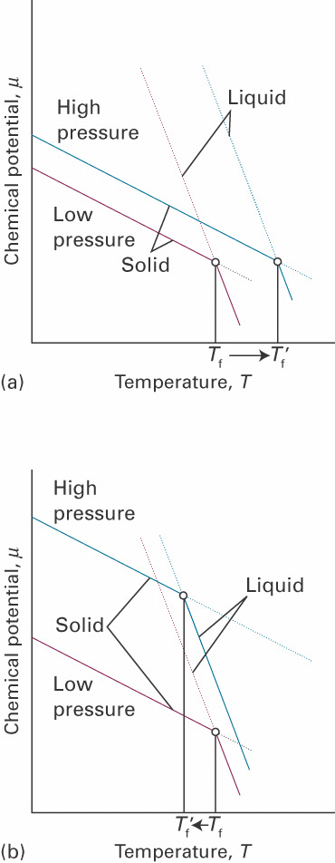
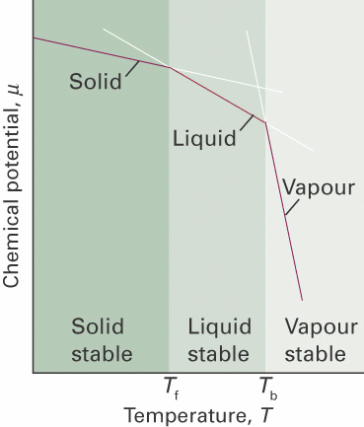
Phase transitions in phase diagrams of unary systems
(H₂O)

Slide 33
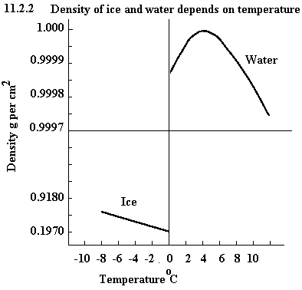
Phase transitions in phase diagrams of unary systems
3
(H₂O)
(H₂O)

Slide 34
Phase transitions in phase diagrams of unary systems
(H₂O)
1 bar
0.006 bar
(H₂O)
(H₂O)
273.15 K
273.16 K

Slide 36
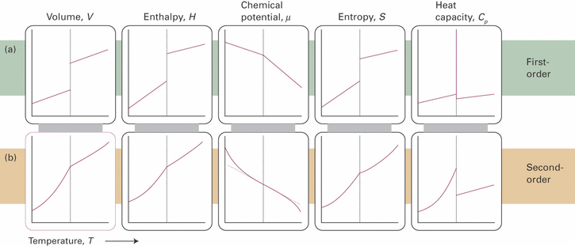
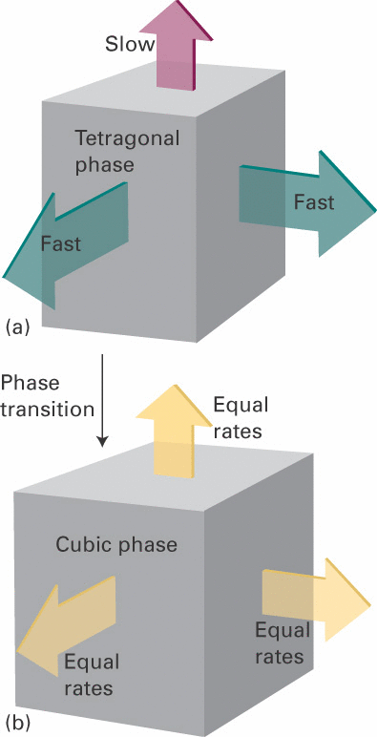
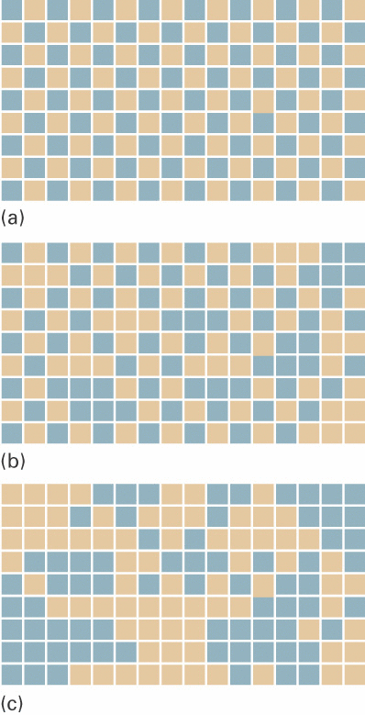
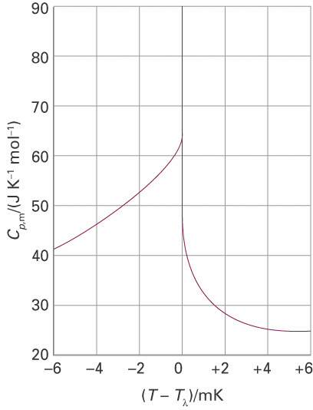
Ehrenfest classification of phase transitions transitions
Second order
First order
Exercise 9

Slide 37
Polymorphic (solid state) phase transitions
T < 40 ºC T > 40 ºC T > 60 ºC (T_{fus} = 70 ºC)
Venlafaxine

Slide 38
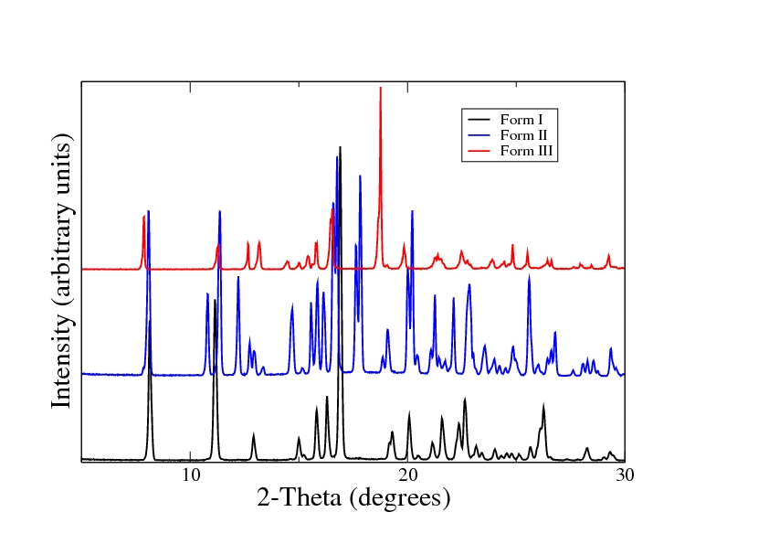
Polymorphic solid state phase transitions
Polymorphic forms characterized using
X-Ray Powder Diffraction

Slide 39
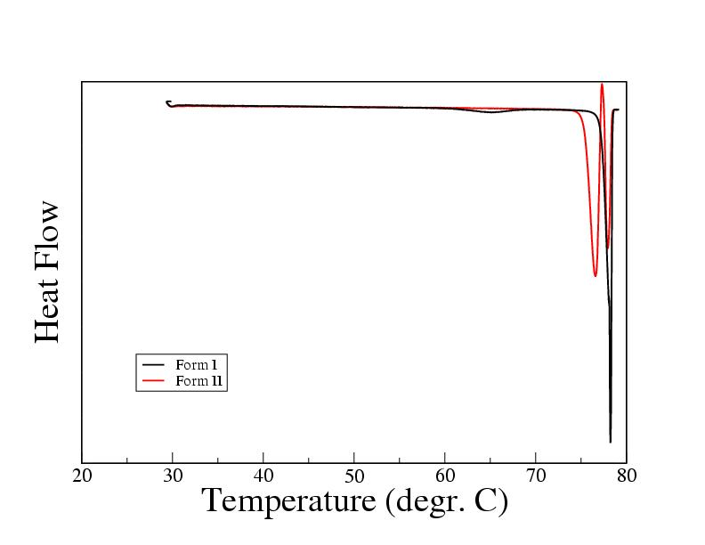
Polymorphic solid state phase transitions
Characterized using Differential Scanning Calorimetry

Slide 40
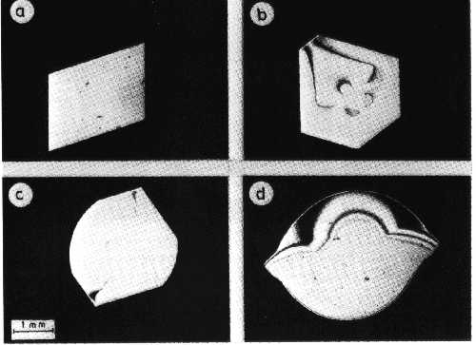
Kinetic roughening transition for naphthalene crystals in a toluene solution
a→d: increasing driving force for crystallization

Slide 41
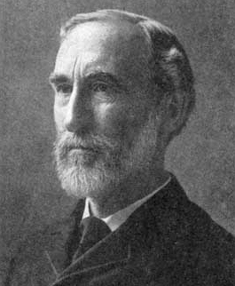
Gibbs phase rule: multicomponent phases

Slide 42
Phase boundary lines in diagrams of unary systems
Solids
Solid
Triple point
(Equilibrium) Phase Diagram H₂O
What about mixtures of compounds in the phases?

Slide 43
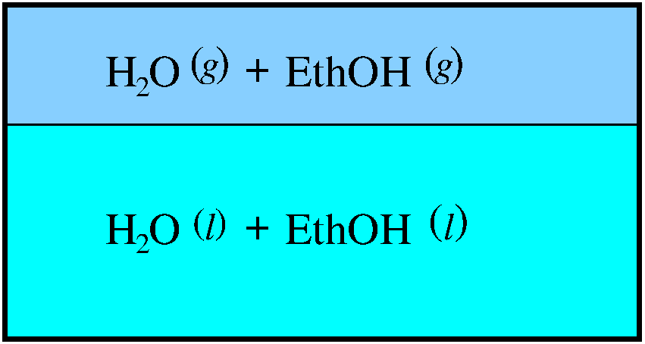
Gibbs phase rule: multicomponent phases
Importance of the chemical potential:
Equilibrium between phases
in equilibrium:
Equilibrium between phases of components i in mixtures
phase α
phase β
phases α, β
components i
in equilibrium:

Slide 44
Gibbs phase rule: multicomponent phases
phases α, β, γ, ....
components i =1
in equilibrium:
P phases in mutual equilibrium
unary phase diagram

Slide 45
Gibbs phase rule: multicomponent phases
phases α, β , γ, ....
components i =1, 2
in equilibrium:
C components in each phase
mole fraction of
component i
binary phase diagram

Slide 46
Gibbs phase rule: multicomponent phases
phases α, β, γ, ....
components i =1, 2, 3, ...
in equilibrium:
Equilibrium between P phases of components i in mixtures
C components in each phase
P phases in mutual equilibrium
# independent variables
whole
system
for each
phase

Slide 47
Gibbs phase rule: multicomponent phases
phases α, β, γ, ....
components i =1, 2, 3, ...
in equilibrium:
Equilibrium between P phases of components i in mixtures
C components in each phase
P phases in mutual equilibrium
for each phase
mole fraction
# independent variables

Slide 48
Gibbs phase rule: multicomponent phases
phases α, β, γ, ....
components i =1, 2, 3, ...
in equilibrium:
Equilibrium between phases of components i in mixtures
P phases in
mutual equilibrium
(P −1)C times
an “=” sign

Slide 49
Gibbs phase rule: multicomponent phases
phases α, β
components i
in equilibrium:
Equilibrium between P phases of C components in mixtures
C components in the mixtures
P phases in mutual equilibrium

Slide 50
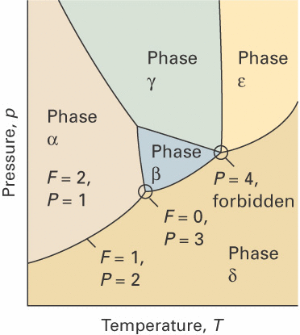
Gibbs phase rule: unary phase diagrams
C = 1
F = 2
P = 1
Gibbs phase rule
F: # degrees of freedom
C: # components
P: # phases
unary phase diagram

Slide 51
Gibbs phase rule: unary phase diagrams
C = 1
F = 1
P = 2
Gibbs phase rule
unary phase diagram

Slide 52
Gibbs phase rule: unary phase diagrams
C = 1
F = 0
P = 3
Gibbs phase rule
unary phase diagram

Slide 53
Gibbs phase rule: unary phase diagrams
C = 1
F = −1
P = 4
Gibbs phase rule
unary phase diagram

