Slide 1
Thermodynamics remedial 5
March 17th 2022
Chemical potential, colligative properties and statistical thermodynamics

Slide 2
Course outline
5 sessions:
  1 Basics, (state) functions, ideal gas, internal energy, work, heat, Enthalpy
  2 Energy, Entropy
  3 Energy, chemical reactions
  4 Electrochemistry
  5 Colligative properties & statistical thermo

Slide 3
Course today
  Chemical potential
    What is it and what is the function in thermodynamics
  Colligative properties
  Statistical thermodynamics

Slide 4
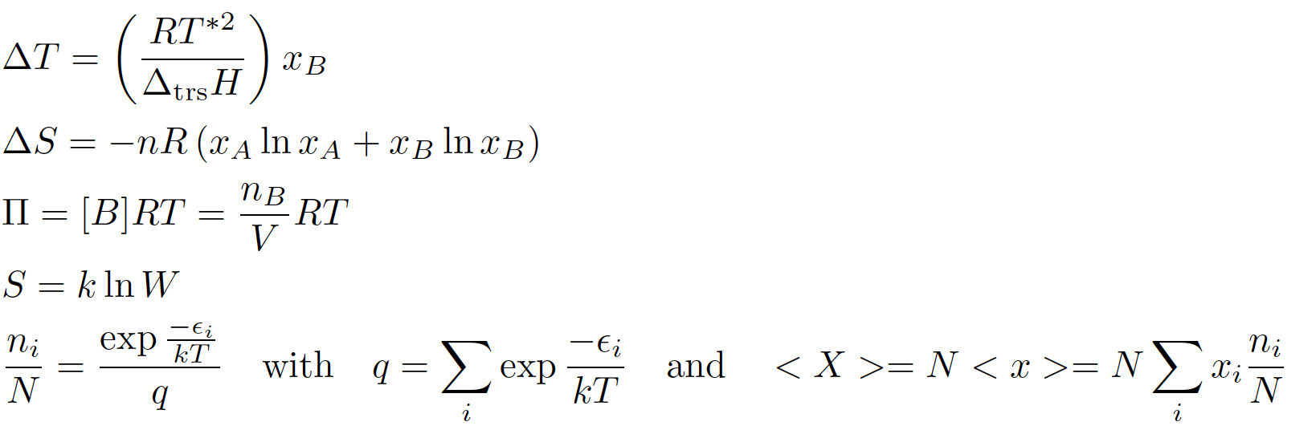
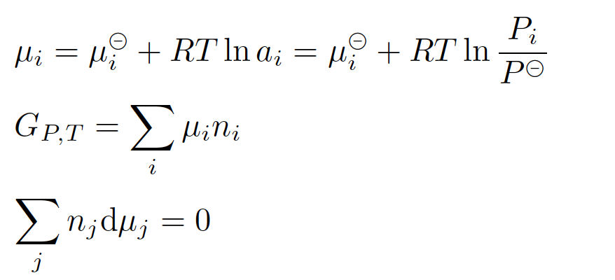
Study material
Study guide (page 14-17 & 22-25)
Atkins (see study guide)
Relevant formulas on formula sheet

Slide 5
Chemical potential:
Potential is the ability to perform work. Remember: being with low potential (impotent) you can’t perform action!
The more molecules of a certain type will be in a system, the more the ability to perform work (of that system) will depend on those molecules. That’s why the potential μ = G_{molar}.
In other words, the "chemical potential μ" is a measure of how much the Gibbs free energy of a system changes (by dG_{i}) if you add or remove a number dn_{i} particles of the particle species i while keeping the number of the other particles (and the temperature T and the pressure p) constant.
In equilibrium (nothing seems to happen, looking from a distance) the chemical potential of 2 systems connected to each other are equal! There is no driving force.
If there is a driving force (a spontaneous process), something happens and goes from high potential to low potential.

Slide 6
Use of chemical potential in this course
Basis for the derivation of colligative properties
  Equilibrium between liquid and vapour (boiling point elevation)
  Equilibrium between liquid and solid (freezing point depression)
  Osmotic pressure
It is hard to see from the derived formulas that chemical potential is the basis…. But it is!

Slide 7
Elevation of boiling point
At equilibrium:
µ_{gas} = µ_{liq}
p = p₀
C₆H₁₄(g)
At (69⁰C):
µ*_{gas} = µ*_{liq}
C₆H₁₄(l)
* means: pure substance!

Slide 8
Elevation of boiling point
At equilibrium:
µ_{gas} = µ_{liq}
p = p₀
C₆H₁₄(g)
µ*_{gas} = µ*_{liq} + correction for dissolving
C₆H₁₄(l)
+
C₂₀H₄₂(l)
p = p₀ , ideal dilute solution (low concentration)

Slide 9
Elevation of boiling point
p = p₀
C₆H₁₄(g)
∆T : elevation of boiling point
: boiling point of pure hexane
∆_{vap}H : enthalpy of vaporization of hexane
x_{B} : mole fraction of eicosane
C₆H₁₄(l)
+
C₂₀H₄₂(l)
p = p₀ , ideal dilute solution

Slide 10


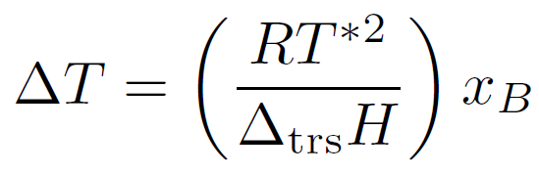
Boiling point elevation and freezing point depression
See also the
checklist of
key equations
trs = transition
p = p₀ , ideal dilute solution

Slide 11
Osmotic pressure
p = p₀
At equilibrium:
µ_{hexane,left} = µ_{hexane,right}
hexane
hexane
µ*_{hexane} = µ*_{hexane}

Slide 12
Osmotic pressure
additional pressure:
p = p₀
h
p = p₀+ Π
At equilibrium:
µ_{hexane,left} = µ_{hexane,right}
hexane
hexane
and
eicosane
µ*(p₀)_{hexane} = µ(p₀+Π)_{mixture}
µ*(p₀)_{hexane} = µ*(p₀)_{hexane} + correction for dissolving + additional pressure

Slide 13
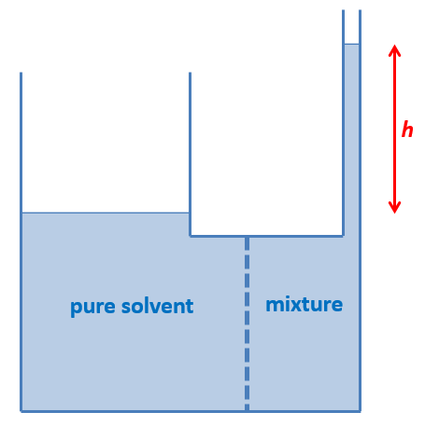
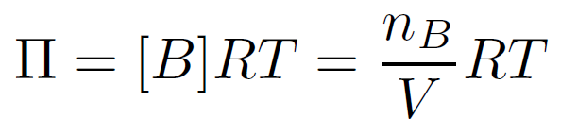
Osmotic pressure
µ*(p₀)_{hexane} = µ*(p₀)_{hexane} + correction for dissolving + additional pressure
p = p₀ , ideal dilute solution
Note: [B] in mol/m³
Π = ρ·g·h = [B]RT

Slide 14
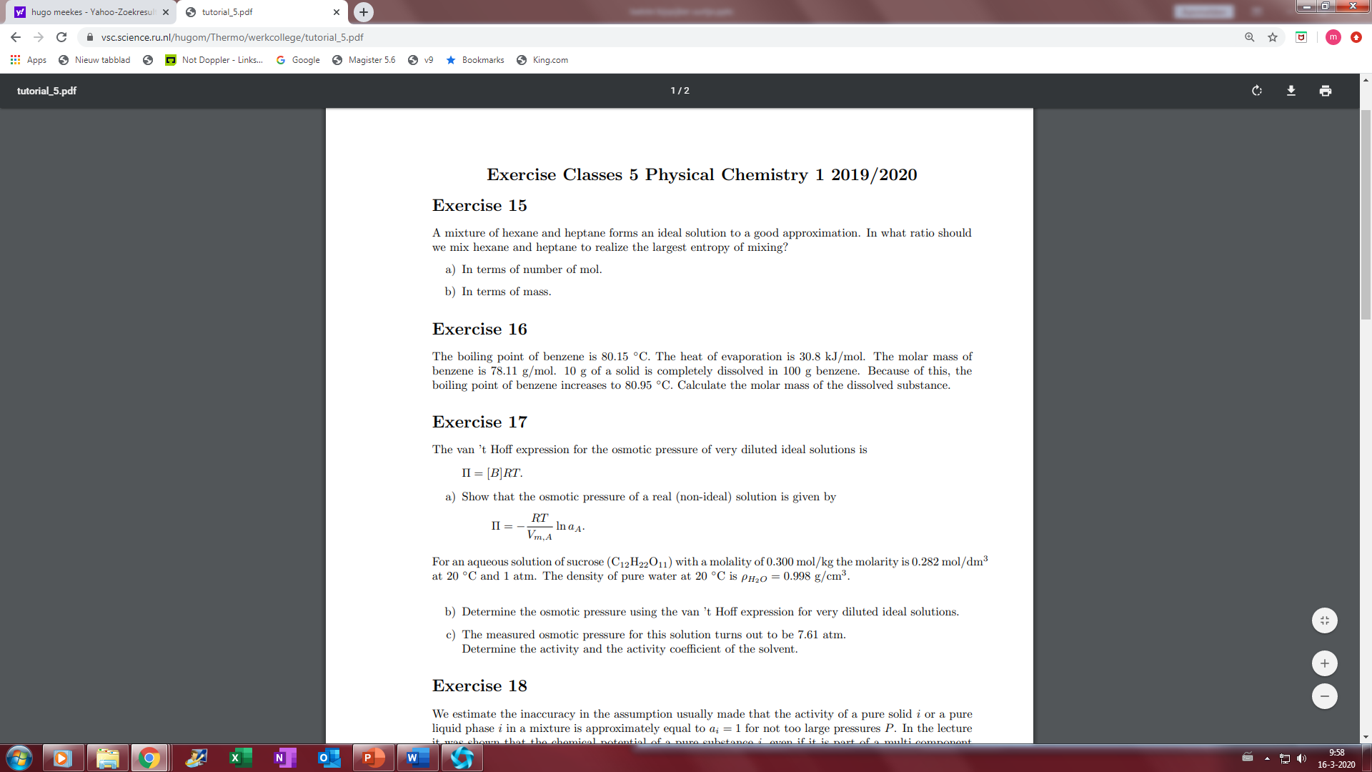

Slide 15
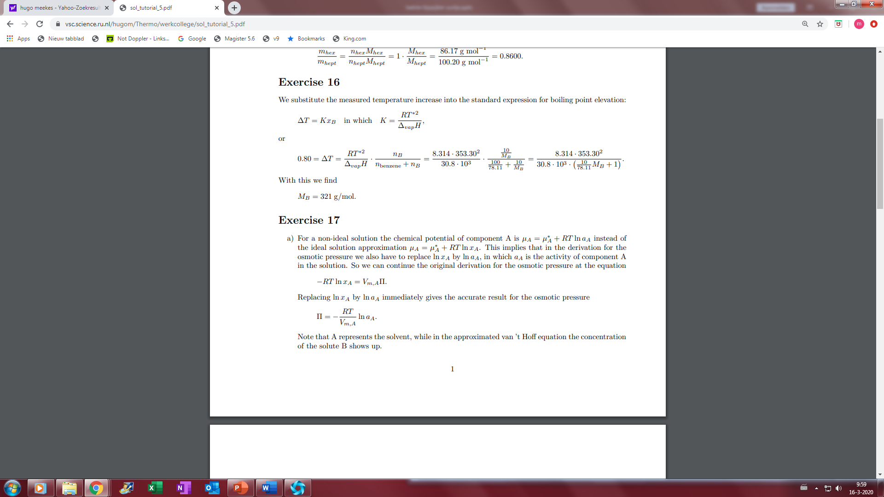

Slide 16
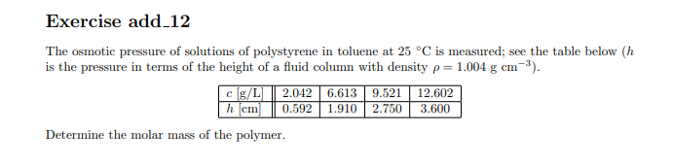

Slide 17
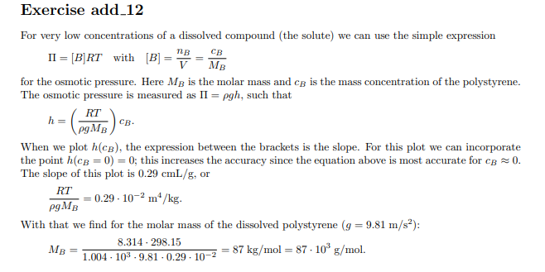

Slide 18
Statistical Thermodynamics
Based on statistics, chance
Used in this course
  to predict the chance that a particle is in a certain state
  To calculate entropy, microstates

Slide 19
System of particles: Boltzmann factor
Checklist of key equations: with
Equation for calculating the fraction of particles ( p_{i} ) present at energy level ε_{i}:

Slide 20
Nuclear spin H-atom: α and β
Energy
α
β

Slide 21
Nuclear spin α and β in a strong magnetic field
At T = 50 K and B = 4 Tesla
1.13 · 10⁻²⁵
β
1.13 · 10⁻²⁵ J
Energy (J)
0
α

Slide 22
Nuclear spin α and β in a strong magnetic field
At T = 50 K and B = 4 Tesla
1.13 · 10⁻²⁵
= 0.99984
β
Energy (J)
0
= 1.00000
α
0.99984
Chance(β) =
= 0.49996
1.00000 + 0.99984

Slide 23
simplified H atom (only 2 energy levels)
At T = 50000 K
1.63·10⁻¹⁸
= 0.094
2s
2p
2p
2p
121 nm
Energy (J)
0
= 1.000
1s
1.000
Chance(1s) =
= 0.727
1.000 + 4 x 0.094

Slide 24
Particle system: Boltzmann factor
In this presentation:
Partition function:
This summation is hard to calculate in real systems

Slide 25
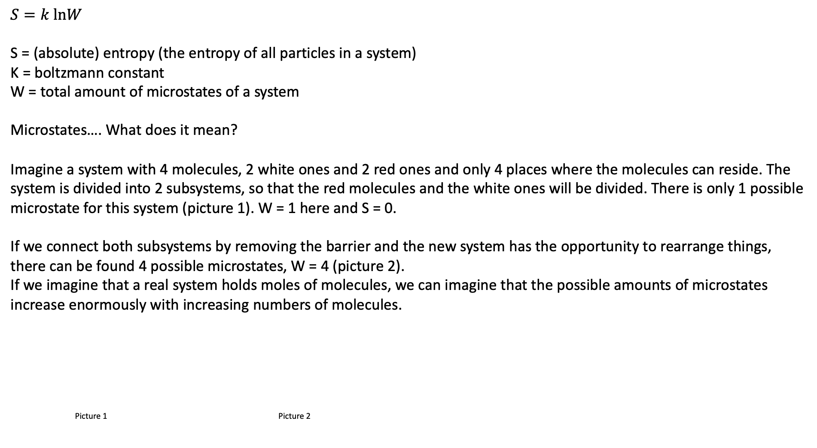
Entropy, statistical approach
$$S=k \text{ln}W$$
S = (absolute) entropy (the entropy of all particles in a system)
K = boltzmann constant
W = total amount of microstates of a system
Microstates…. What does it mean?
Imagine a system with 4 molecules, 2 white ones and 2 red ones and only 4 places where the molecules can reside. The system is divided into 2 subsystems, so that the red molecules and the white ones will be divided. There is only 1 possible microstate for this system (picture 1). W = 1 here and S = 0.
If we connect both subsystems by removing the barrier and the new system has the opportunity to rearrange things, there can be found 4 possible microstates, W = 4 (picture 2).
If we imagine that a real system holds moles of molecules, we can imagine that the possible amounts of microstates increase enormously with increasing numbers of molecules.
Picture 1 Picture 2

Slide 26
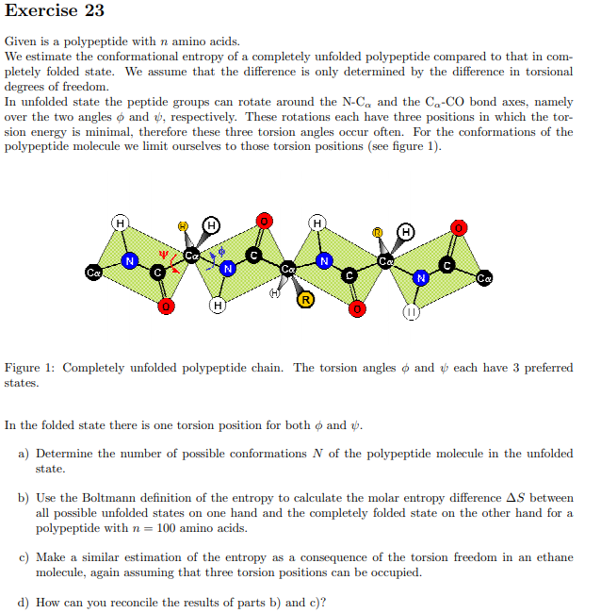

Slide 27
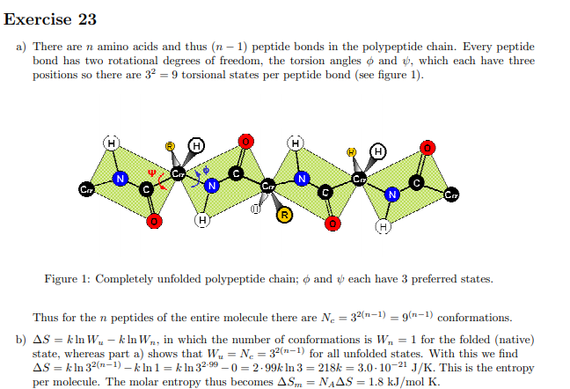

Slide 28
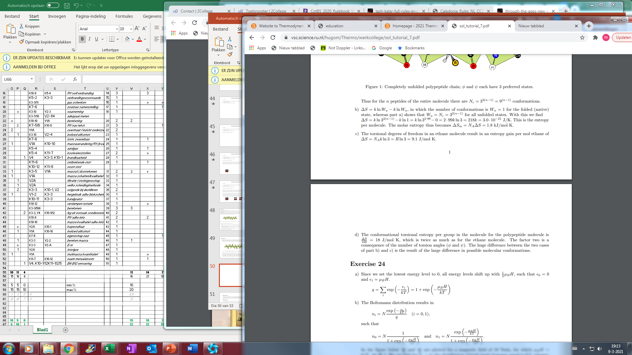

Slide 31
