Slide 1
Thermodynamics
Remedial Lecture 4
03 – 10 – 2022

Slide 2
Course outline
5 sessions:
1 Basics, (state) functions, ideal gas, internal energy, work, heat, Enthalpy
2 Energy, Entropy
3 Energy, chemical reactions
4 Electrochemistry
5 Colligative properties & statistical thermo

Slide 3
Course today
Definitions
Goals of today:
To understand what electrochemical/redox reactions are
To be able to give all redox reactions
To be able to calculate with Nernst law
Know the difference between E terminal and E cell
Calculations involving reactions in electrochemical cells

Slide 4
Study material
Study guide (page ….. & ..)
Atkins (see study guide)
Relevant formulas on formula sheet
Not on sheet but useful:
η = R_{L}/(R_{L} + R_{i})

Slide 5
Gibbs free energy and electrochemical cells
∆_{r}G = -νF∆E_{cell}
Electrochemical cell p,T constant:
ν: number of transferred electrons (according to the chemical equation)
F: Faraday constant = 96 485 C/mol
∆E_{cell} : electromotive force of the cell in Volt
If a process is spontaneous then: ∆_{r}G ≤ 0 (p,T constant)
So for a battery:
∆E_{cell} ≥ 0 (p,T constant)

Slide 6
Electrical Work
There is only one formula for electrical work
Be aware of units:
W’ in (M)J/mol
E in Volt, which is J/C
Thus q must be in Coulomb/mol (often 1 Faraday is used.
1 F = 96 485 C/mol

Slide 7
How to construct a chemical half reaction yourself
put the formula of the particle that reacts on the left hand side, and the formula of the particle that appears on the right hand side of the equation
put coëfficiënts in front of these formulas, to make sure all elements - except H and O - are equally present before and after the arrow
equal the missing O-atoms with H₂O
equal the missing H-atoms with H⁺
equal the charge with e⁻
check the environment: - if it is neutral, there can’t be any H⁺ ions present on the left hand side of the equation - if it is basic, there can’t be any H⁺ ions present on any side of the equation
In both cases, add as much OH⁻ ions as you need to neutralize the H⁺ ions to form H₂O. Don’t forget to add the same amount of OH⁻ ions on the other side of the equation!

Slide 8
Example questions
Give the half equation for the following half reactions:
Copper will become copper(II+) in acidic environment
Glucose will become carbondioxide in alkaline environment
Ethane-amine will become carbondioxide and nitrogen in neutral environment

Slide 9
Standard conditions
∆_{r}G^{Ɵ} = -νF∆E_{cell}^{Ɵ}
oxidizing agent |  | reducing agent | E^{Ɵ} (V)
Cu²⁺ + 2 e⁻ | → | Cu | + 0.34
2 H⁺ + 2 e⁻ | → | H₂ | 0.000000
Zn²⁺ + 2 e⁻ | → | Zn | - 0.76
Redox table
T = 298 K, p = p^{Ɵ} and
all activities a = 1
Standard Daniell cell: Zn(s) | Zn²⁺ || Cu²⁺ | Cu(s)
∆E_{cell}^{Ɵ} = 0.34 – (– 0.76) = 1.10 V
∆_{r}G^{Ɵ} = – 2 · 96485 · 1.10 = – 2.12·10⁵ J mol⁻¹ < 0

Slide 10
Cell notation of n electrochemical cell (a battery), no electrolysis:
Your electrodes will be on the utmost left hand side and utmost right hand side
The left hand side will always be the reducing agent (oxidizing reaction at the anode)
From your electrode to the electrolyte (a phase change) will be a: | sign
Electrolytes in the same phase will be seperated with a semicolon
A saltbridge or semi-permeable membrane will be depicted as: ||
Example:
Pt | Fe²⁺(1M),Fe³⁺(1M) ∥ Cl₂(g)∣Cl–(1M) ∣ Pt
Question
Given the reaction: 2Cr³⁺ + 7H₂O + 3Br₂(l)→Cr₂O₇²⁻ + 14H⁺ + 6Br⁻
Give the cell notation for this reaction in a electrochemical cell with platina electrodes

Slide 12
If p ≠ p^{Ɵ} and/or a ≠ 1, apply a correction:
Non-standard conditions
For each electrode: Ox + ν e⁻ → Red
E: potential of the electrode
Q refers to the half-reaction of the cell
For overall potential:
Q: reaction quotient
(similar to concentration quotient)

Slide 13
Example: the nickel chromium battery
Ni²⁺ + 2e⁻ → Ni
Cr → Cr³⁺ + 3e⁻
3 Ni²⁺ + 2 Cr → 3 Ni + 2 Cr³⁺
3x
2x
ν = 6 and
If the activities are known you can calculate the potential by:

Slide 14
Explanation for nickel chromium battery
fill in for the reduction reaction:
the terms together and because { y·ln(x) = y/2·ln(x²) }
Fill in: ΔE_{cel} = E_{+ pole} – E_{- pole}
y·ln (b) – y·ln (c) = y·ln (b/c)
By changing the quotients the – ln becomes + ln
Ni²⁺ + 2e⁻ ⇄ Ni
Cr³⁺ + 3e⁻ ⇄ Cr
Ni²⁺ + 2e⁻ → Ni
Cr → Cr³⁺ + 3e⁻
3 Ni²⁺ + 2 Cr → 3 Ni + 2 Cr³⁺
3x
2x

Slide 15
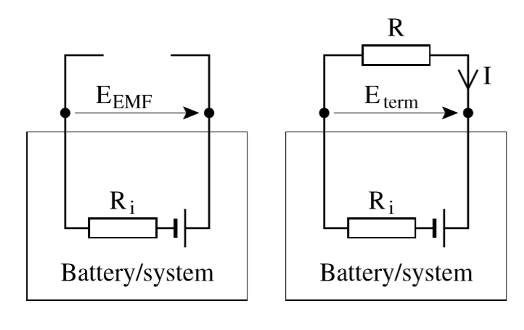
Batteries and internal resistance
L
Internal resistance is the resistance inside the battery. E_{term} is the voltage over the battery terminals
When I = 0, E_{term} = E_{cell}
E_{cell} is also called E_{EMF}
When I > 0, there is an internal resistance of the battery,
E_{term} = E_{cell} - E_{internal.}
with E_{internal} = I*R_{internal} and E_{L} = I*R_{L}
E_{term} = E_{cell}
E_{internal}
E_{cell}
E_{cell}

Slide 16
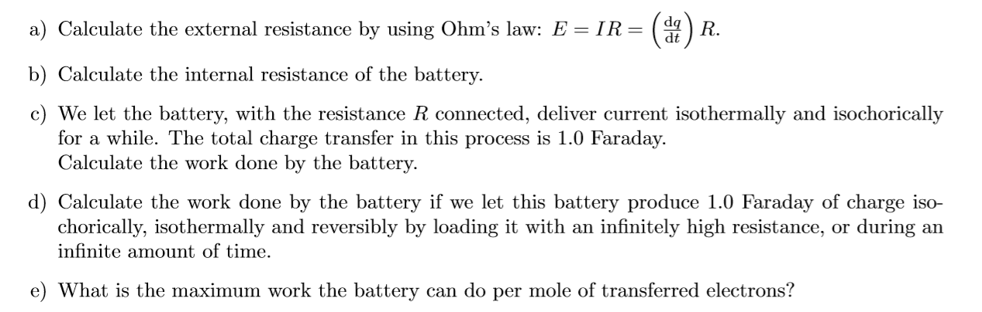

Slide 17
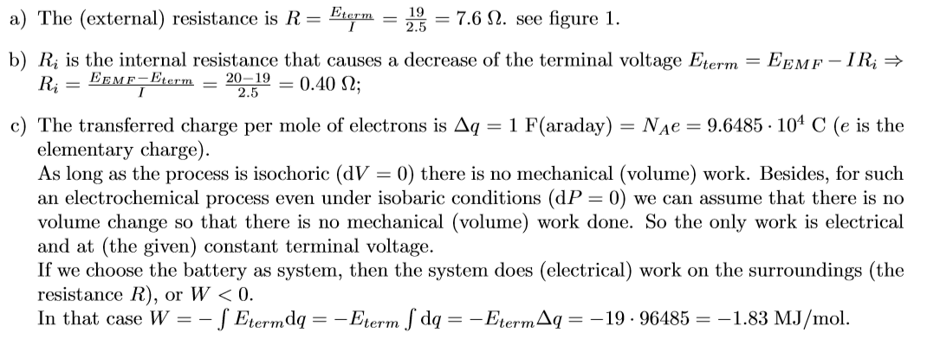

Slide 18
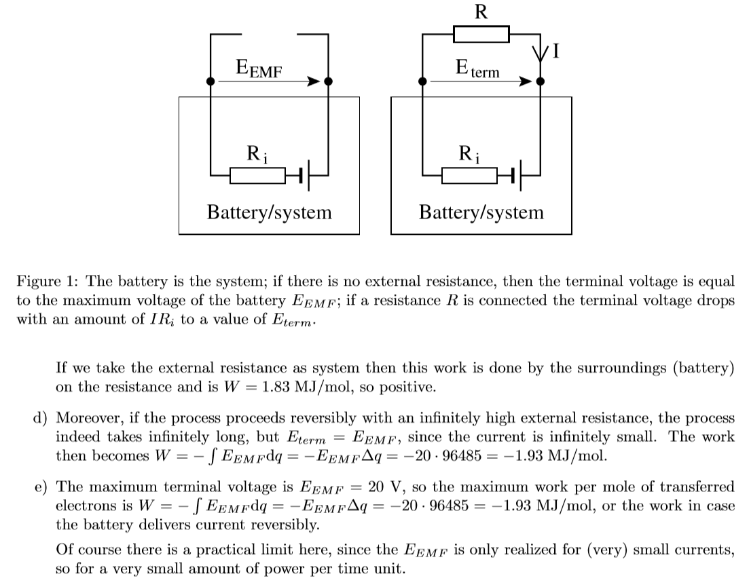

Slide 19
Nernst law
Calculations with Nernst law

Slide 21
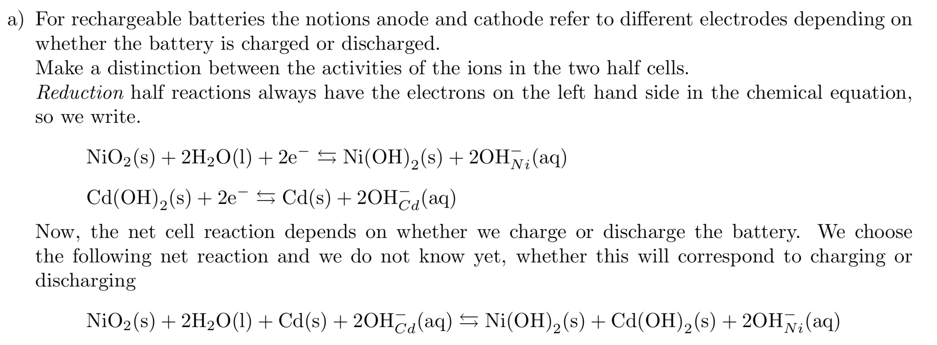

Slide 22
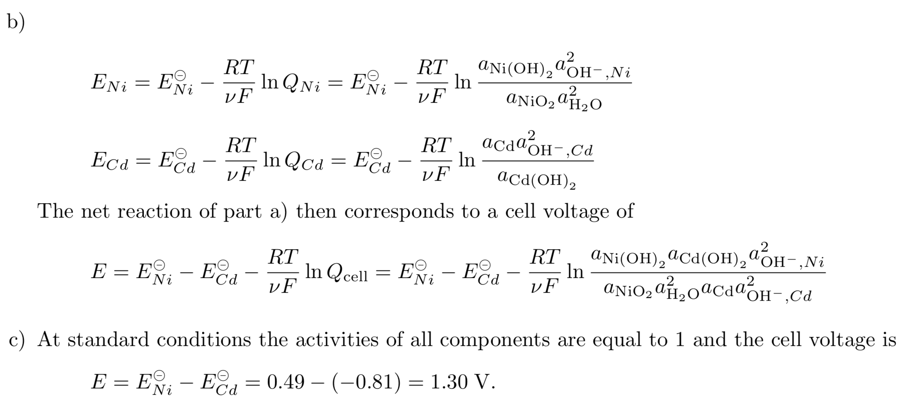

Slide 24
