Slide 1
Thermodynamics
Remedial Lecture 3
03 – 03 – 2022

Slide 2
Course outline
5 sessions:
1 Basics, (state) functions, ideal gas, internal energy, work, heat, Enthalpy
2 Energy, Entropy
3 Energy, chemical reactions
4 Electrochemistry
5 Colligative properties & statistical thermo

Slide 3
Course today
Energy effects during reaction
Activity and activity coefficient
Chemical equilibrium constant
Goals of today:
To be able to calculate enthalpy, entropy and gibbs free energy of reactions via the formation energies
Calculate equilibrium reactions
Know what acitivity is and activity coefficient

Slide 4
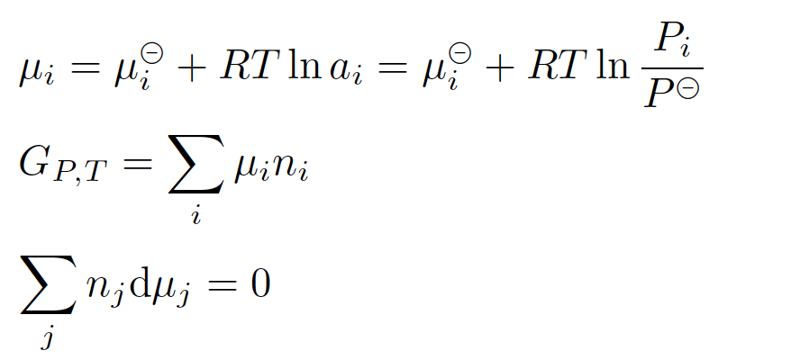
Study material
Study guide (page ….. & ..)
Atkins (see study guide)
Relevant formulas on formula sheet

Slide 5
Activity instead of concentration
activity (symbol a) is a measure of the “effective concentration” of a species in a mixture
the activity depends on any factor that alters the chemical potential. Such factors may include: concentration, temperature, pressure, interactions between chemical species, electric fields, etc. Depending on the circumstances, some of these factors may be more important than others.
The difference between activity and other measures of composition arises because molecules in non-ideal gases or solutions interact with each other, either to attract or to repel each other.
i.e ion – ion and ion – water interactions
Used to explain discrepancies between ideal solutions and real solutions (or mixtures of gases)

Slide 6
activity is dimensionless (so, there’s no unit)
Activity of a gas, use the ratio of the effective pressure to the standard state pressure:
a_{gas} = P / Pº a_{gas} is a ratio with no units.
Activity of a solute in solution:
a_{solute} = C / Cº a_{solute} is a ratio with no units.
The activity of pure substances in condensed phases (solid or liquids) is taken as unity (the number 1)
Relation between concentration and activity by a = γ [C] mol/L
γ = activity coefficient
Relation between molality and activity by a = γ b mol/kg solvent
γ = activity coefficient
Relation between mol fraction and activity by a = γ x mol/mol total
γ = activity coefficient
ALL THREE γ ‘s have different values………….
The lower the concentration of all solute particles in the solution, the closer the value of γ for each solute approaches 1

Slide 7
Progress of the reaction
= 1 when one of the reactants is depleted
So find out which reactant is depleted first
In equilibrium reactions, ksi will never be 1

Slide 8
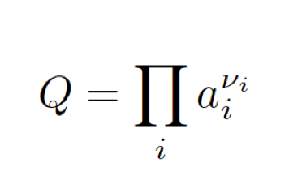
Q versus K
Q is always twata/twifota
In general
At equilibrium only; K = Q and

Slide 9
Calculation on reactions
See tutor hour next two slides
Followed by the formal way of presenting

Slide 10
How much heat is released during a chemical reaction?
If the reaction takes place under normal (laboratory) conditions, we may assume that the pressure is not influenced by the reaction.
Δ_{r}H^{Θ} is defined as the Δ_{f}H^{Θ} (products) – Δ_{f}H^{Θ} (reactants)
The Δ_{f}H^{Θ} of elements = 0.
In formula:
For example: the combustion of methane
CH₄(g) + 2 O₂ (g) → CO₂ (g) + 2 H₂O (l)
Δ_{r}H = –(– 74.81) – 2∙0 + (– 393.51) + 2∙(– 285.83) = – 890.36 kJ/mol CH₄

Slide 11
The combustion of methane in an enthalpy diagram:
H (kJ/mol)
0
T = 298 K
C + 2 H₂ + 2 O₂
- Δ_{f} H_{(CH4)} = + 74.81
Δ_{f} H_{(CO2)} = -393.51
CH₄ + 2 O₂
CO₂ + 2 H₂ + O₂
Δ_{r}H = -890.36
Δ_{f} H_{(H2O)} = -2∙285.83
CO₂ + 2 H₂O

Slide 12
The Formal way

Slide 17
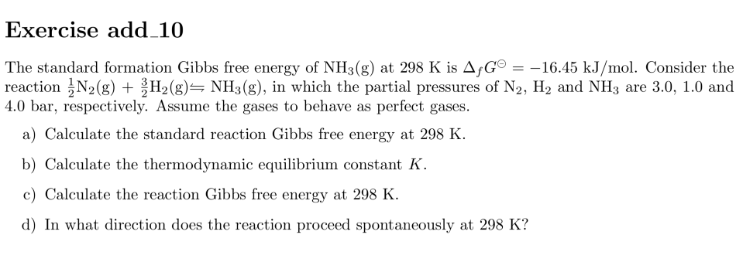

Slide 18
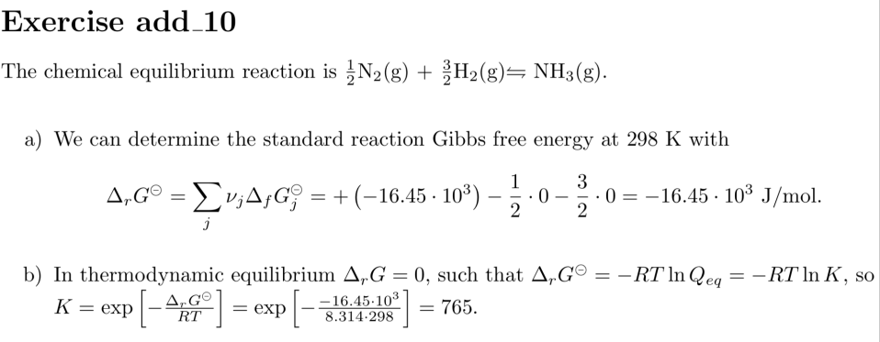

Slide 19
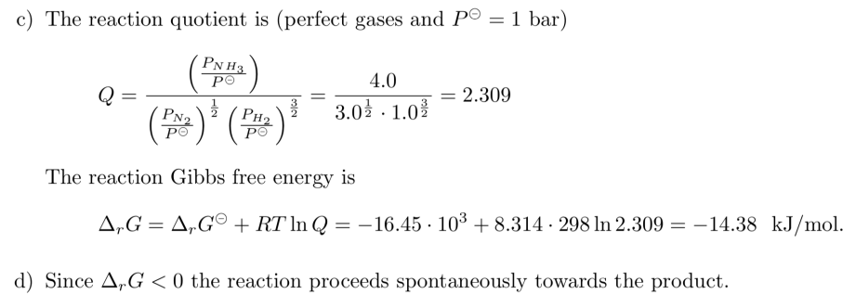

Slide 20
The folded state of the protein lysozyme in a solution transforms to the unfolded state at 75◦C with an enthalpy change equal to ∆_{unfold}H = 509 kJ/mol. At this temperature the folded and unfolded states are in equilibrium. The pressure change corresponding to that transition, in solution, is negligible. The diﬀerence between the isobaric heat capacity in unfolded and folded state is ∆c_{P} = c_{P}(unfolded) − c_{P}(folded) = 6.28 kJ/molK. Furthermore, we can consider both the c_{P} values to be independent of temperature.
Calculate the entropy change of the unfolding process at 75◦C.
Next we consider the unfolding process of the protein starting in the metastable folded state at a higher temperature of 105◦C.
b) Describe a reversible path as alternative for the irreversible unfolding process at 105 ◦C. Hint: only use isobaric paths.
c) Calculate the enthalpy change of the unfolding process at 105 ◦C. Hint: Determine ∆H via the alternative reversible path and use the state function property of H.
d) Calculate the entropy change of the unfolding process at 105 ◦C.
e) Use the second law of thermodynamics to verify whether the unfolding process proceeds spontaneously at 105 ◦C.

Slide 21
