Slide 1
Thermodynamics
Remedial Lecture 1
17 – 1 – 2022

Slide 2
Expectations
Short repetition of theory, not replacing the course, not integrally repeating the course
Exercises, level between tutor hour and tutorial
Active participation
Be prepared:
  Study course material in the STUDY GUIDE & book (see website Thermo) https://www.vsc.science.ru.nl/hugom/Thermo/Thermo.html
  Bring formula sheet!!!

Slide 3
Course outline
5 sessions:
  1 Basics, (state) functions, ideal gas, internal energy, work, heat
  2 Energy, Entropy
  3 Energy, chemical reactions
  4 Electrochemistry
  5 Colligative properties & statistical thermo

Slide 4
Course today
Basics
  Previous exams all contained 4 problems with each 4 subproblems with equal weight
  (explanation of) formulas / quantities (always! 30 out of 160 points)
Perfect monoatomic gas
  Equations of state
  Internal Energy, Work, Heat, Entropy, Enthalpy
  relations

Slide 5
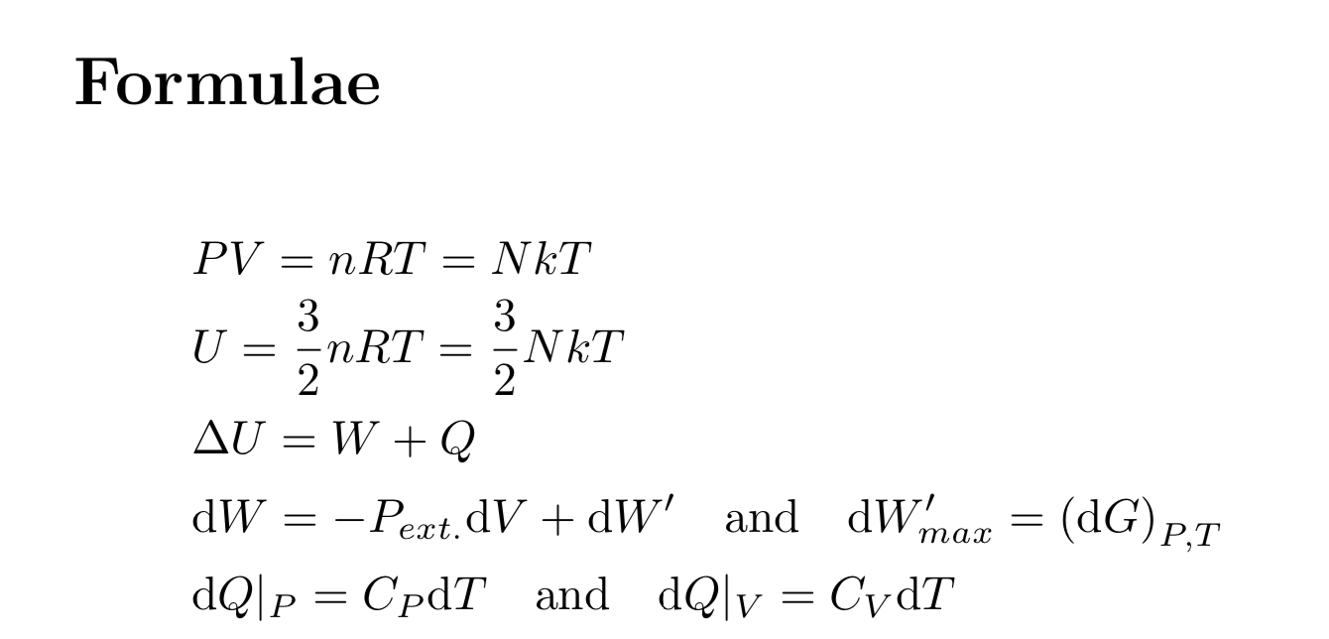
Basics include to study…….
Study guide (page 4 – 7 & B1)
Atkins (see study guide)
Relevant formulas on formula sheet
For reversible process

Slide 6
Basics include some definitions 1
State variables
Macroscopic quantities (P, V, T, n, · · ·) that describe the thermodynamic state of a system.
Equation of state
Relation between state variables that determines the possible states of the system in thermodynamic equilibrium, eg pV=nRT (Only for perfect gas)
Thermodynamic equilibrium
A system is in thermodynamic equilibrium if the state variables of the system do not change spontaneously.
State function
A (thermodynamic) single valued function of the (independent) state variables; The value of a state function is independent of the way the system has reached a certain state, eg H, G……, but also P,T,....

Slide 7
Basics include some definitions 2
Reversible process
A process during which the system is in thermodynamic equilibrium at every moment
Irreversible process
A process that is not necessarily reversible.
Isothermal process dT = 0
Isobaric process dP = 0
Isochoric process dV = 0
Adiabatic process dQ = 0
Isolated system dW = dQ = dn = 0
Intensive quantity Does not change if we enlarge the system; e.g. T and P.
Extensive quantity Doubles if we make the system twice as large; e.g. V and n.

Slide 8
Exercise 1 often involves:
the difference between “State function” (U, H, S etc) and
“Equation of State” (pV = nRT)
whether something is a “State function” or not
State Function: not a State Function:
H, U, G, A Q, W
S_{sys} S_{tot ,} S_{sur}
T, p etc.
mathematical operations
of the functions above:
H + U
pT
S_{sys}T
Q + W ?
S_{tot} – S_{sur} ?
∆U
S_{sys}

Slide 9
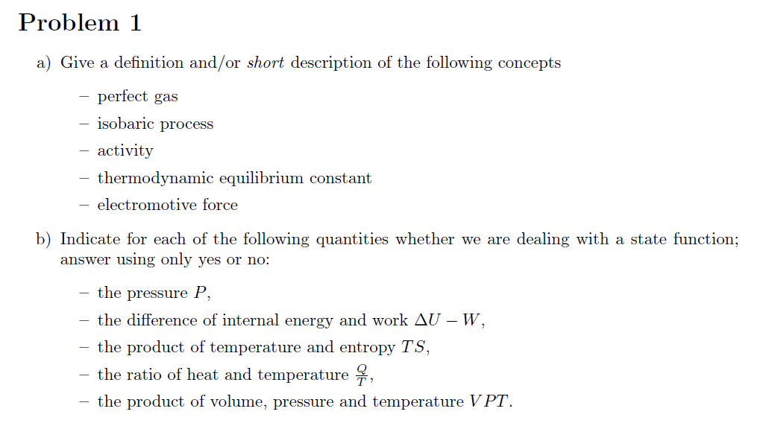
Gas that complies with pV=nRT
Process in which dP = 0
Later
the value of the reaction quotient Q_{t} at equilibrium
energy per unit electric charge
Yes
No (= Q)
Yes
No
Yes

Slide 10
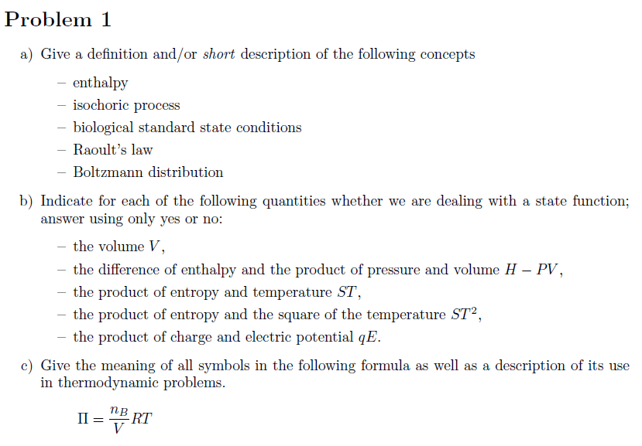
(2017)
See Appendix B: Glossary and theory
Yes
= U Yes
Yes, S & T both are state functions
Yes
Yes
To calculate the large molecular mass of substance B in a solution from a measured osmotic pressure due to a difference in concentration over a membrane.

Slide 11
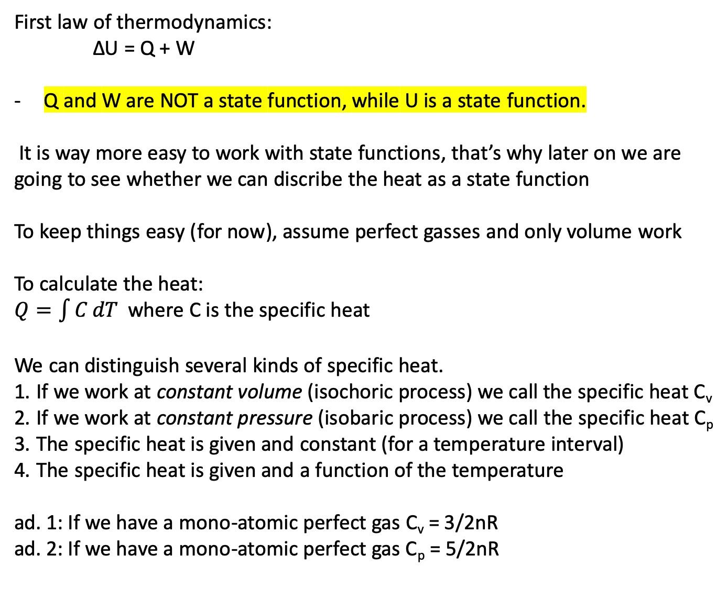
First law of thermodynamics:​
ΔU = Q + W​
​
Q and W are NOT a state function, while U is a state function.
It is way more easy to work with state functions, that’s why later on we are going to see whether we can discribe the heat as a state function
To keep things easy (for now), assume perfect gasses and only volume work
To calculate the heat:
$Q=\int{C}dT$ where C is the specific heat
We can distinguish several kinds of specific heat.
If we work at constant volume (isochoric process) we call the specific heat C_{v}
If we work at constant pressure (isobaric process) we call the specific heat C_{p}
The specific heat is given and constant (for a temperature interval)
The specific heat is given and a function of the temperature
​ad. 1: If we have a mono-atomic perfect gas C_{v} = 3/2nR
ad. 2: If we have a mono-atomic perfect gas C_{p} = 5/2nR
​

Slide 12
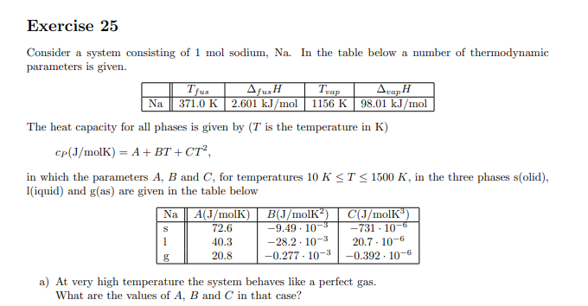

Slide 13
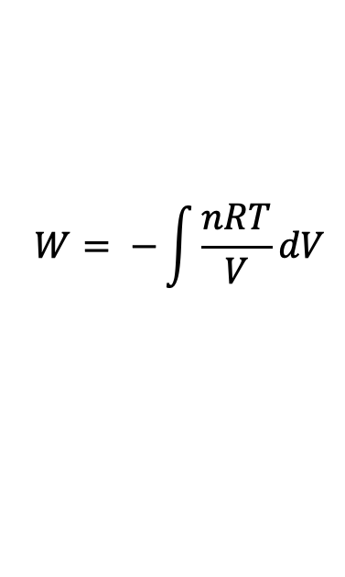
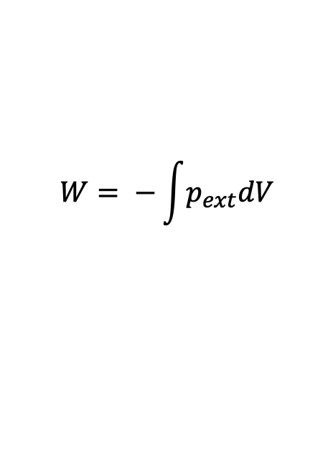
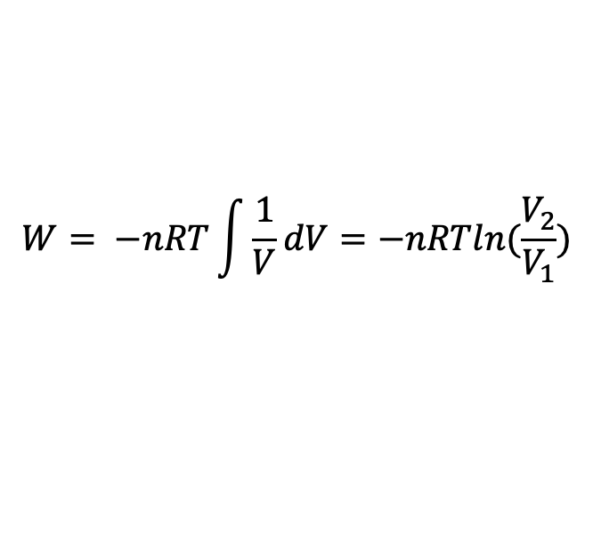
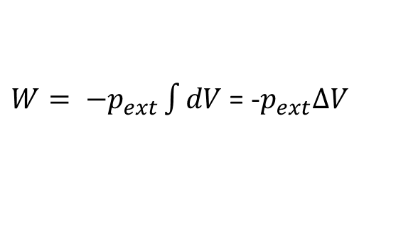
ΔU = Q + W​
To calculate the work we can use:
If we work isochoric: dV = 0 and there is no (volume-)work
If we work isobaric: p stays constant, get it out of the integral sign
If we work reversible: p_{ext} = p_{int} and since we consider a perfect gas p=nRT/V
If we work reversible AND isothermic AND in a closed system:
$$W= −\int{p_{ext}dV}$$
$W= −p_{ext}\int{dV}$ = -$p_{ext}∆V$
$$W= −\int{\frac{nRT}{V}dV}$$
$$W= −nRT\int{\frac{1}{V}dV=−nRTln(\frac{V_{2}}{V_{1}})}$$

Slide 14
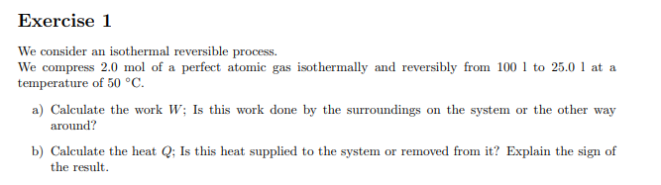

Slide 15
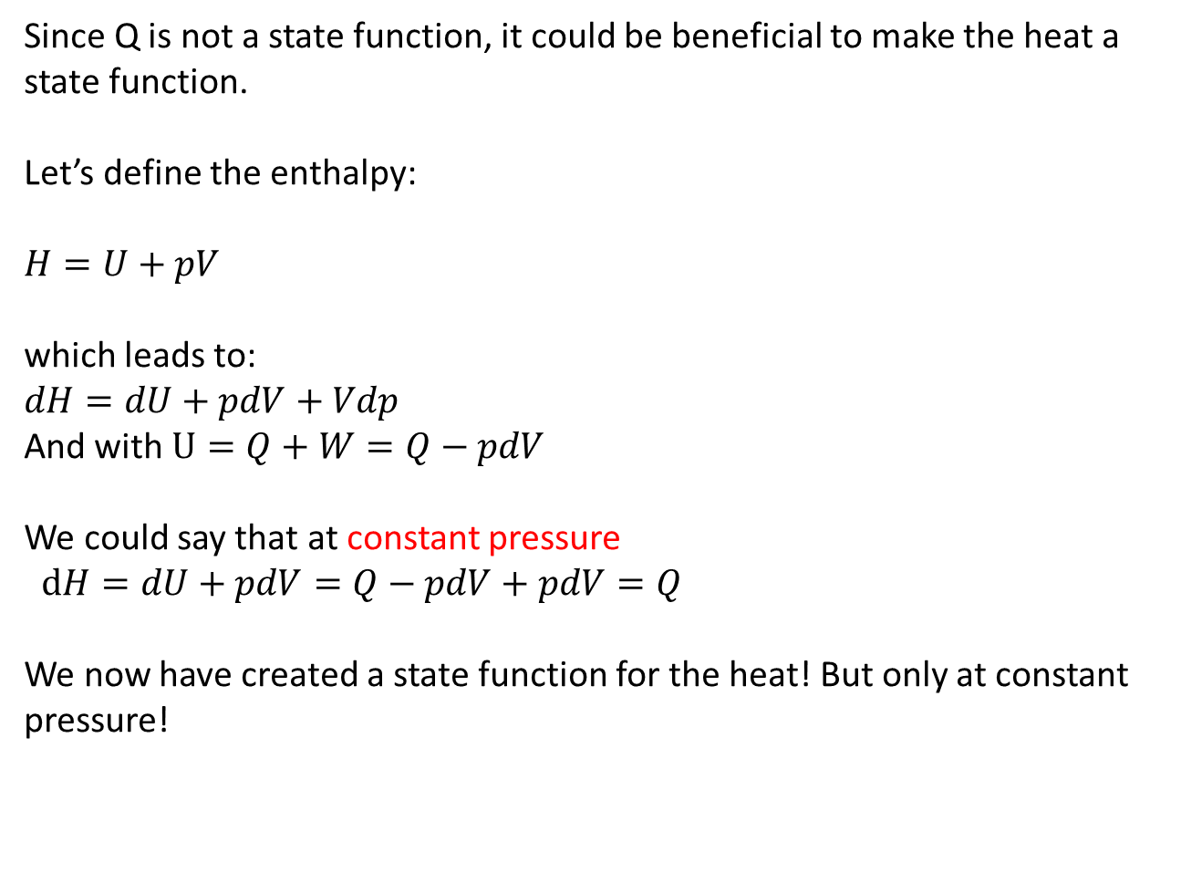
Since Q is not a state function, it could be beneficial to make the heat a state function.
Let’s define the enthalpy:
$H=U+pV$
which leads to:
$dH=dU+pdV+Vdp$
And with $U=Q+W=Q−pdV$
We could say that at constant pressure
$dH=dU+pdV=Q−pdV+pdV=Q$
We now have created a state function for the heat! But only at constant pressure!

Slide 16
The moral of this story
  Basics are important to pass the exam
  Wonder yourself with each step:
    What am I doing (subject, question asked etc)
    What is the meaning of symbols and constants used
  Start practising with all material available:
    Tutor hour
    Tutorials https://www.vsc.science.ru.nl/hugom/Thermo/Thermo.html

Slide 17
Perfect monoatomic gasses
Learn to play with the formulas

Slide 18
Four processes
with a monoatomic
perfect gas:
20 dm³
298 K
1.25 bar
process 2 reversible
isothermic
10 dm³
596 K
5.0 bar
10 dm³
298 K
2.5 bar
20 dm³
596 K
2.5 bar
process 1
reversible
isochoric
process 3
reversible
isobaric
Formulas for each of the processes 1, 3 and 4 to calculate the work W and heat Q and Entropy ∆S for the processes 1, 2, 3 using:
dS = dQ_{rev}/T
process 4 adiabatic
irreversible and p_{ext} = 0.5 bar
20 dm³
T = ?
p = ?

Slide 19
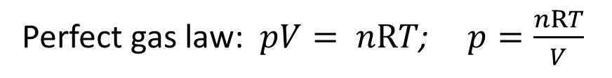
a) Derive a formula to calculate the exerted work W for each of
the four processes, using the formula:
Perfect gas law: $pV= nRT$; $p=\frac{nRT}{V}$
No | kind of process | W | Q | ∆U
1 | isochoric
2 | isothermic
3 | isobaric
4 | adiabatic
0
̶ nRT∙ln(V_{f}/V_{i})
̶ p_{ext}∆V
̶ p’_{ext}∆V

Slide 20
b) heat Q:
c) ΔU:
For a monoatomic perfect gas is defined: U = 3/2·nRT so ∆U = 3/2·nR∆T
and: C_{V} = 3/2·nR
and: C_{p} = 5/2·nR
Nr | kind of process | W | Q | ΔU
1 | isochoric
2 | isothermic
3 | isobaric
4 | adiabatic
+ =
0
3/2 nR ∆T
∫ C_{V} dT
C_{V} ∆T
3/2 nR ∆T
C_{V} ∆T
̶ nRT∙ln(V_{f}/V_{i})
?
+ nRT∙ln(V_{f}/V_{i})
0
̶ nR∆T
̶ p_{sys}∆V
̶ p_{ext}∆V
5/2 nR ∆T ̶ p∆V
C_{p} ∆T ̶ p∆V
5/2 nR ∆T
3/2 nR ∆T
∫ C_{p} dT
C_{p} ∆T
̶ p_{ext}∆V
0
̶ p_{ext}∆V

Slide 21
Nr | kind of process | Q | ∫ dQ_{rev}/T | = ∆S
1 | isochoric
2 | isothermic
3 | isobaric
4 | adiabatic
∫ C_{v}dT
∫ (C_{v} /T)dT
C_{v}∙ln(T_{f}/T_{i})
nRT∙ln(V_{f}/V_{i})
nR∙ln(V_{f}/V_{i})
∫ C_{p}dT
∫ (C_{p} /T)dT
C_{p}∙ln(T_{f}/T_{i})
e) irreversible process: you have to construct an alternative reversible path

Slide 22
Four processes
with a monoatomic
perfect gas:
20 dm³
298 K
1.25 bar
10 dm³
596 K
5.0 bar
10 dm³
298 K
2.5 bar
process 3
reversible
isobaric heating
20 dm³
596 K
2.5 bar
process 4
adiabatic irreversible
p_{ext} = 0.5 bar expansion
process 5
reversible
isochoric
cooling
20 dm³
? K
? bar

Slide 23
Question 4 (from tutor hour)
A sample consisting of 1.00 mol of perfect gas atoms, initially at p₁= 1.00·10⁵ Pa and T₁= 300 K, is heated reversibly to 400 K at constant volume. Calculate the final pressure, ΔU, Q and W

Slide 24
Question 4
p₁/T₁ = p₂/T₂; p₂ = p₁·T₂/T₁ = 1.33·10⁵ Pa
ΔU = 3/2·nRΔT = 1247 J
W = – ∫pdV in which dV = 0 so W = 0 J
Q = ΔU – W = 1247 – 0 = 1247 J

Slide 25
2. 1.0 mole of helium of 25° C and p = p0 is reversibly and isothermically expanded until the pressure is 1.0 10^4 Pa. Given: Cv = 12.55 J K⁻¹ mol⁻¹
a) Calculate the work done by the gas
b) Calculate the heat
2. a) 5706 J b) -5706 J

Slide 26
3. 1.0 mole of helium of 25° C and p = p0 is adiabatically expanded until the pressure is 1.0 10^4 Pa.
a) Calculate the temperature after expansion
b) Calculate the volume after expansion
c) Calculate the work
d) Calculate the heat
3. a) 119 K b) 97.5 L c) 2238 J d) 0 J

Slide 27
1. 1.0 L hydrogen of 20° C and p = p0 is adiabatically compressed to a temperature of 80° C.
a) Calculate the volume after compression
b) Calculate the pressure after compression
c) Calculate the work, done on the gas
Answers:
1. a) 0.631 L b) 1.91·105 Pa c) 51.29 J

Slide 28
End for today!

