Slide 1
Thermodynamics
tutorhour 7
Statistical Thermodynamics

Slide 2
At equal energy levels
Head or tails?
dice
Energy
Energy
head
tails
one
two
three
four
five
six
Chance(tails) = ½ = 0.500
Chance(six) = 1/6 = 0.167

Slide 3
At different energy levels
Lucky coin
Loaded dice
head
one
Energy
Energy
two
three
four
five
tails
six
Chance(tails) = ????
Chance(six) = ????

Slide 4
Performing an experiment → frequencies
Lucky coin
Loaded dice
836012
753214
head
one
Energy
Each ± 876000
Energy
two
three
four
five
1000000
1000000
tails
six
Chance(tails) = ????
Chance(six) = ????

Slide 5
Probability with uneven energy levels
Lucky coin
Loaded dice
0.836
0.753
Head
one
Energy
Energy
Each 0.876
two
three
four
five
1.000
1.000
Tails
six
1.000
1.000
Chance(tails) =
Chance(six) =
1.000 + 0.836
1.000 + 4 x 0.876 + 0.753
Chance(tails) = 0.54 > 0.500
Chance(six) = 0.235 > 0.167

Slide 6
System of particles: Boltzmann factor
Checklist of key equations: with
Equation for calculating the fraction of particles ( p_{i} ) present at energy level ε_{i}:

Slide 7
Nuclear spin H-atom: α and β
Energy
α
β

Slide 8
Nuclear spin α and β in a strong magnetic field
At T = 50 K and B = 4 Tesla
1.13 · 10⁻²⁵
β
1.13 · 10⁻²⁵ J
Energy (J)
0
α

Slide 9
Nuclear spin α and β in a strong magnetic field
At T = 50 K and B = 4 Tesla
1.13 · 10⁻²⁵
= 0.99984
β
Energy (J)
0
= 1.00000
α
0.99984
Chance(β) =
= 0.49996
1.00000 + 0.99984

Slide 10
simplified H atom (only 2 energy levels)
At T = 50000 K
1.63·10⁻¹⁸
= 0.094
2s
2p
2p
2p
121 nm
Energy (J)
0
= 1.000
1s
1.000
Chance(1s) =
= 0.727
1.000 + 4 x 0.094

Slide 11
Particle system: Boltzmann factor
In this presentation:
Partition function:
This summation is hard to calculate in real systems

Slide 12
Follow-up session: tips and tricks (January 8th):
8.30 – 9.15 tutorhour
tutors | rooms
Ade Hoekstra | HG00.308
Els Heijmen | HG00.068
André Steenbergen | HG01.028
Martin Waals | HG00.086

Slide 13
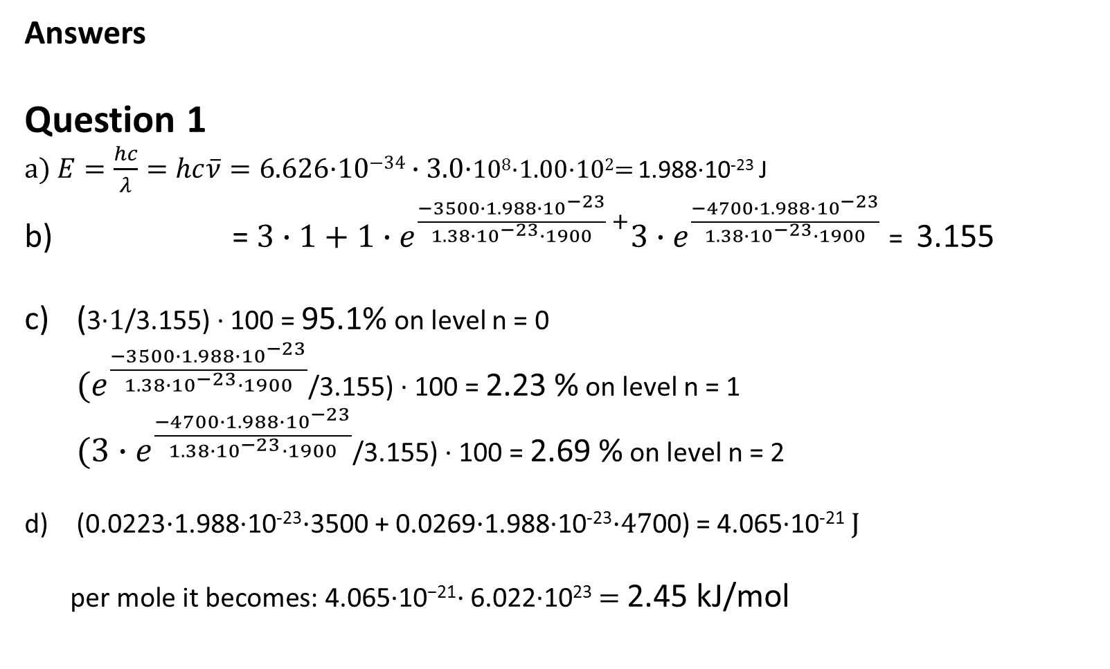
Answers
Question 1
$\text{a}\text{) }E=\frac{hc}{λ}=hc\overline{ν}=\text{6.626·10}\text{−34}∙3.0\text{·}$10⁸·1.00·10²= 1.988·10⁻²³ J
b) =$3∙1+1∙e^{\frac{−3500∙1.988∙{10}^{−23}}{1.38∙{10}^{−23}∙1900} +}{3∙e}^{\frac{−4700∙1.988∙{10}^{−23}}{1.38∙{10}^{−23}∙1900}}$ = 3.155
c) (3·$1$/3.155) · 100 = 95.1% on level n = 0
${(e}^{\frac{−3500∙1.988∙{10}^{−23}}{1.38∙{10}^{−23}∙1900}}$/3.155) · 100 = 2.23 % on level n = 1
${(3∙e}^{\frac{−4700∙1.988∙{10}^{−23}}{1.38∙{10}^{−23}∙1900}}$/3.155) · 100 = 2.69 % on level n = 2
(0.0223$\text{·}$1.988·10⁻²³$\text{·}$3500 + 0.0269$\text{·}$1.988·10⁻²³$\text{·47}$00) = 4.065·10⁻²¹$J$
$\text{per} \text{mole} \text{it} \text{becomes}\text{: 4.065}\text{·10}\text{−}\text{21}\text{·}$6.022·10²³$=$ 2.45 kJ/mol

Slide 14

Question 2
$\frac{p_{1}}{p_{0}}=\frac{1}{2}$
$p_{1}=\frac{n_{1}}{N}=\frac{e^{\frac{{−ε}_{1}}{kT}}}{q}$
$p_{0}=\frac{n_{0}}{N}=\frac{e^{\frac{{−ε}_{0}}{kT}}}{q}=\frac{1}{q}$
$\frac{p_{1}}{p_{0}}=\frac{e^{\frac{{−ε}_{1}}{kT}}}{q}∙\frac{q}{1}=e^{\frac{{−ε}_{1}}{kT}}$
$\frac{1}{2}=e^{\frac{{−ε}_{1}}{kT}}$
$\text{k}Tln\frac{1}{2}={−ε}_{1}$
$T=\frac{{−ε}_{1}}{\text{k}ln\frac{1}{2}}$ = 623 K

Slide 15

Question 3
$\frac{p_{1}}{p_{0}}=\frac{15}{85}=0.1765$
$\frac{p_{1}}{p_{0}}=\frac{{2∙e}^{\frac{{−ε}_{1}}{kT}}}{q}∙\frac{q}{1}={2∙e}^{\frac{{−ε}_{1}}{kT}}$
$\frac{{−ε}_{1}}{\text{k}T}=ln⁡(\frac{0.1765}{2})$
$ε_{1}=−\text{k}T\ln\left(\frac{0.1765}{2}\right)=7.136∙{10}^{−21}J$
$\frac{7.136∙{10}^{−21}}{1.60∙{10}^{−19}}=$ 0.045 eV

