Slide 1
Thermodynamics tutorhour 3
Gibbs energy

Slide 2
Gibbs energy is defined as:
at constant T this becomes:
at constant T,p this becomes:
Second Law:
leading to the Clausius inequality:
So when p and T are constant, for a spontaneous process holds:

Slide 3
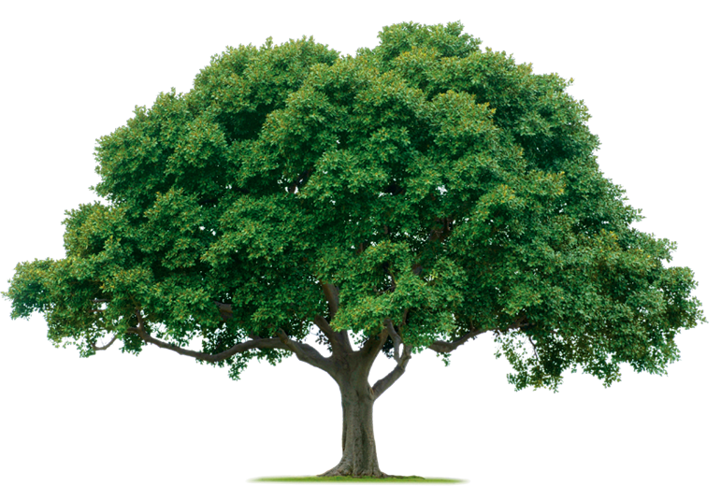
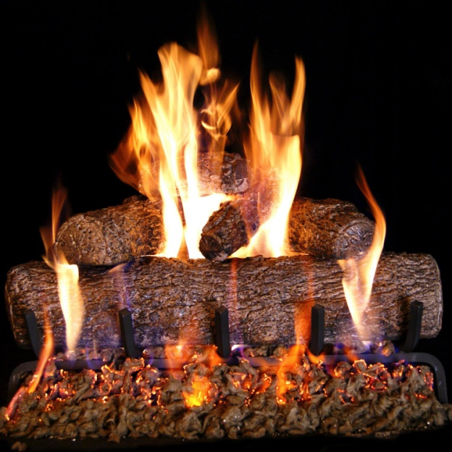
Spontaneous process?
6 CO₂ + 6 H₂O → C₆H₁₂O₆ + 6 O₂
C₆H₁₂O₆ + 6 O₂ → 6 CO₂ + 6 H₂O
Δ_{r}G = + 28.3·10⁵ J mol⁻¹ > 0
Δ_{r}G = – 28.3·10⁵ J mol⁻¹ < 0

Slide 4
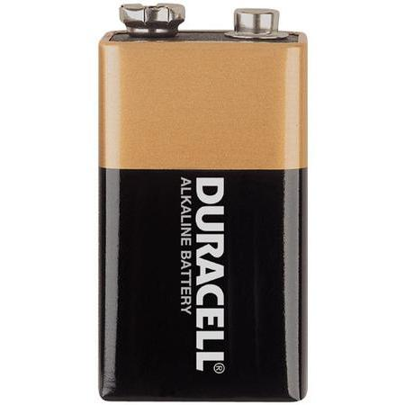
Spontaneous process?
Δ_{r}G_{battery} = – 17.4·10⁵ J mol⁻¹ < 0
_
+
Δ_{r}G_{system} = + 2.1·10⁵ J mol⁻¹ > 0
Zn (s) + Cu²⁺ → Cu (s) + Zn²⁺
Zn²⁺ + Cu (s) → Cu²⁺ + Zn (s)
Δ_{r}G = – 2.1·10⁵ J mol⁻¹ < 0
Δ_{r}G_{total} = – 15.3·10⁵ J mol⁻¹ < 0
Δ_{r}G = + 2.1·10⁵ J mol⁻¹ > 0

Slide 5
mixing lowering of freezing point elevation of boiling point osmotic pressure
colligative properties
electro-chemistry
Does this reaction occur?
Yes, if…
ΔG
at equilibrium ΔG = 0 and Q = K so:

Slide 6
Activity instead of concentration
Activity (symbol a) is a measure of the “effective concentration” of a species in a mixture
The difference between activity and other measures of composition arises because molecules in non-ideal gases or solutions interact with each other, either to attract or to repel each other.
i.e ion – ion and ion – water interactions
Used to explain discrepancies between ideal solutions and real solutions
(same for mixtures of gases)

Slide 7
Activity of a gas: use the ratio of the effective pressure to the standard state pressure
a_{gas} = $\frac{\text{P}}{\text{P}Ρ}$ a_{gas} is a ratio with no units.
Activity of a solute in solution: use ratio of effective concentration to the standard state of solute concentration (C$Ρ$ = 1 mole solute / kg solvent = 1 molal):
a_{solute} = $\frac{\text{C}}{\text{C}Ρ}$ a_{solute} is a ratio with no units.
The activity of pure substances in condensed phases (solid or liquids): a = 1
Relation between activity and concentration: a = γ [compound] γ: activity coefficient
The lower the concentration of all solute particles in the solution, the closer the value of γ for each solute approaches 1, resulting in the approximation: a = [compound]

Slide 8
Question 1
Equilibrium: Δ_{r}G = Δ_{r}G⊖_{298K} + RT ln K = 0 => Δ_{r}G⊖_{298K} = – RT ln K
ln K = Δ_{r}G⊖_{298K} / (– RT ) = (– 68.3∙10³) / (– 8.3145 ∙ 298) = 27.565 K = 9.4∙10¹¹ (at 298 K)
b) We assume that Δ_{r}H⊖ and Δ_{r}S ⊖ are temperature-independent: Δ_{r}H⊖_{400K} = Δ_{r}H⊖_{298K} => Δ_{r}G⊖_{400K} = Δ_{r}H⊖_{298K} – TΔ_{r}S ⊖_{298K} = –63.99∙10³ – (400 ∙ 14.4) = – 69.75∙10³ J/mol
Equilibrium: Δ_{r}G = Δ_{r}G⊖_{400K} + RT ln K = 0 => Δ_{r}G⊖ _{400K} = – RT ln K
ln K = Δ_{r}G⊖_{400K} / (– RT) = (– 69.75∙10³) / (– 8.3145 ∙ 400) = 20.97 K = 1.3∙10⁹ (at 400 K)
Question 2
Equilibrium, so Δ_{r}G = 0
b) $K=\frac{ \frac{p_{H_{2}}}{p^{θ}} · \frac{p_{I_{2}}}{p^{θ}}}{{\left(\frac{p_{HI}}{p^{θ}}\right)}^{2}}$ $=\frac{x_{H_{2}}· x_{I_{2}}}{(x_{HI})^{2}}$ $=\frac{0.114 · 0.114}{(0.772)^{2}}$ = 0.0218
c) Equilibrium: Δ_{r}G = Δ_{r}G⊖ + RT ln K = 0 => Δ_{r}G⊖ = – RT ln K Δ_{r}G⊖ = – 8.3145 ∙ 1000 ∙ ln 0.0218 = 31.8 kJ/mol
molefraction x | HI | H₂ | I₂
start | 1.00 | 0 | 0
change | -0.228 | +0.114 | +0.114
equilibrium | 0.772 | +0.114 | +0.114

Slide 9
Question 3
a) $Q=\frac{\frac{p_{N_{2}O_{4}}}{p^{θ}}}{{\left(\frac{p_{{NO}_{2}}}{p^{θ}}\right)}^{2}}=\frac{\frac{2.0}{1.0}}{{\left(\frac{6.0}{1.0}\right)}^{2}}=0.0566$
Δ_{r}G = Δ_{r}G⊖_{298K} + RT ln Q
Δ_{r}G = -4.73·10³ + 8.3145 ∙ 298 ∙ ln 0.0566 = -11.89·10³ J/mol
b) Δ_{r}G is negative, no equilibrium, reaction proceeds spontaneously to the right.

Slide 10
Question 4
Assumptions:
Δ_{r}H⊖ is independent of temperature
Δ_{r}S ⊖ is independent of temperature
Decomposition starts when K = Q = 1
Decomposition starts when Δ_{r}G = 0
Δ_{r}G = Δ_{r}G⊖ + RT ln Q
0 = Δ_{r}G⊖ + 0 => Δ_{r}G⊖ = 0
Δ_{r}G⊖ = Δ_{r}H⊖_{298K} - TΔ_{r}S ⊖_{298K} => Δ_{r}H⊖_{298K} = TΔ_{r}S ⊖_{298K}
$T= \frac{∆_{r}H_{298K}^{\text{⊖}}}{∆_{r}S_{298K}^{\text{⊖}}}=\frac{299∙{10}^{3}}{753}=397 K$

