Slide 1
Thermodynamics tutorhour 2

Slide 2
Four processes with a monoatomic
perfect gas:
20 dm³
298 K
1.25 bar
process 2 reversible
isothermic
10 dm³
596 K
5.0 bar
10 dm³
298 K
2.5 bar
20 dm³
596 K
2.5 bar
process 1
reversible
isochoric
process 3
reversible
isobaric
process 4 adiabatic
irreversible and p_{ext} = 0.5 bar
20 dm³
T = ?
p = ?

Slide 3
a) Derive a formula to calculate the exerted work W for each of the four processes, using the formula:
Perfect gas law: $pV= nRT$; $p=\frac{nRT}{V}$
No | kind of process | W | Q | ∆U
1 | isochoric
2 | isothermic
3 | isobaric
4 | adiabatic
0
̶ nRT∙ln(V_{f}/V_{i})
̶ p_{ext}∆V
̶ p’_{ext}∆V

Slide 4
Four processes with a monoatomic
perfect gas:
20 dm³
298 K
1.25 bar
b) Derive a formula for each of the processes 1, 3 and 4 to calculate the heat Q.
process 2 reversible
isothermic
10 dm³
596 K
5.0 bar
10 dm³
298 K
2.5 bar
20 dm³
596 K
2.5 bar
process 1
reversible
isochoric
process 3
reversible
isobaric
process 4 adiabatic
irreversible and p_{ext} = 0.5 bar
20 dm³
T = ?
p = ?

Slide 5
c) ΔU:
b) heat Q:
For a monoatomic perfect gas is defined: U = 3/2·nRT so ∆U = 3/2·nR∆T
and: C_{V} = 3/2·nR
and: C_{p} = 5/2·nR
Nr | kind of process | W | Q | ΔU
1 | isochoric
2 | isothermic
3 | isobaric
4 | adiabatic
+ =
0
3/2 nR ∆T
∫ C_{V} dT
C_{V} ∆T
3/2 nR ∆T
C_{V} ∆T
̶ nRT∙ln(V_{f}/V_{i})
?
+ nRT∙ln(V_{f}/V_{i})
0
̶ nR∆T
̶ p_{sys}∆V
̶ p_{ext}∆V
5/2 nR ∆T ̶ p∆V
C_{p} ∆T ̶ p∆V
5/2 nR ∆T
3/2 nR ∆T
∫ C_{p} dT
C_{p} ∆T
̶ p’_{ext}∆V
0
̶ p’_{ext}∆V

Slide 6
Four processes with a monoatomic
perfect gas:
20 dm³
298 K
1.25 bar
d) Derive the change of entropy ∆S for the processes 1, 2, 3 using: dS = dQ_{rev}/T
process 2 reversible
isothermic
10 dm³
596 K
5.0 bar
10 dm³
298 K
2.5 bar
20 dm³
596 K
2.5 bar
process 1
reversible
isochoric
process 3
reversible
isobaric
process 4
adiabatic irreversible p_{ext} = 0.5 bar
20 dm³
T = ? p = ?

Slide 7
Nr | kind of process | Q | ∫ dQ_{rev}/T | = ∆S
1 | isochoric
2 | isothermic
3 | isobaric
4 | adiabatic | 0
∫ C_{v}dT
∫ (C_{v} /T)dT
C_{v}∙ln(T_{f}/T_{i})
nRT∙ln(V_{f}/V_{i})
nR∙ln(V_{f}/V_{i})
∫ C_{p}dT
∫ (C_{p} /T)dT
C_{p}∙ln(T_{f}/T_{i})
e) irreversible process: you have to construct an alternative reversible path

Slide 8
Four processes with a monoatomic
perfect gas:
20 dm³
298 K
1.25 bar
e) How could you calculate the change of entropy ΔS for process 4?
10 dm³
596 K
5.0 bar
10 dm³
298 K
2.5 bar
process 3
reversible
isobaric heating
20 dm³
596 K
2.5 bar
process 4
adiabatic irreversible
p_{ext} = 0.5 bar expansion
process 5
reversible
isochoric
process
20 dm³
? K
? bar

Slide 9
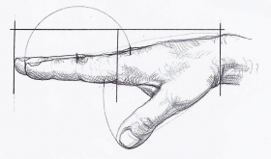
Question 2
We could perform process 4 in the following manner: We take an isolated cylinder with a frictionless piston. On the right hand of the piston there is a monoatomic perfect gas, p = 2.5 bar, and on the left of the piston there is a p_{ext} = 0.5 bar. The initial temperature of the gas is 298 K. Both compartments measure 10 dm³.
After withdrawing the hand, the piston moves to its maximum volume: 20 dm³.
a) Calculate the number of moles of the gas present in the cylinder.
b) Calculate the temperature and the pressure when the maximum volume is reached. Use ∆U = -p_{ext}∆V = 3/2nR∆T.
c) Calculate the change of entropy, ∆S, of the system.

Slide 10
Question 2
pV = nRT
n = pV/RT = (2.5∙10⁵ ∙ 10∙10⁻³ )/(8.3145 ∙ 298) = 1.0 mol
∆U = -p_{ext} ∆V = -0.5∙10⁵ ∙ 10∙10⁻³ = - 500 J
∆U = (3/2)nR∆T = - 500 J; ∆T = (- 500 ∙ 2)/(3 ∙ 1.0 ∙ 8.3145) = - 40 K
T_{final} = 298 – 40 = 258 K
p_{system} = nRT/V = 1.0 ∙ 8.3145 ∙ 258/0.020 = 1.07∙10⁵ Pa = 1.07 bar
c) We have to construct an alternative reversible path!

Slide 11
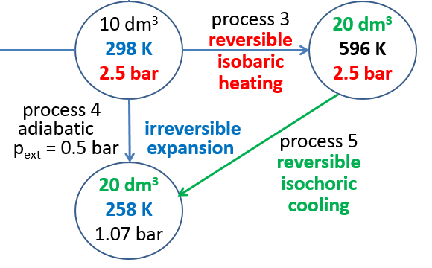
Question 2
c) The alternative reversible path for process 4 is successively process 3 and process 5:
ΔS_{process 3} = ∫ dQ_{rev}/T = C_{p}∙ ln(T_{f}/T_{i}) = C_{p}∙ ln(596/298) = C_{p}∙ ln(2)
ΔS_{process 5} = ∫ dQ_{rev}/T = C_{V}∙ ln(T_{f}/T_{i}) = C_{V}∙ ln(258/596) = C_{V}∙ ln(0.4329)
ΔS_{process 4} = ΔS_{process 3} + ΔS_{process 5}
= C_{p}∙ ln(2) + C_{V} ∙ ln(0.4329) =
= 5/2∙nR ∙ ln(2) + 3/2∙nR ∙ ln(0.4329) = 14.41 – 10.44 = 3.97 J K⁻¹

